Slide 1
Woodland School District
2026-2027 Budget Summary
Presented by:
Stacy Brown
Executive Director of Business Services
August 13, 2026

Slide 2
26-27 Budget
Enrollment History (including Running Start) – Budget to Actual
Actual enrollment for 25-26 (not including Running Start) was 89.94 students less than budget. The estimated enrollment for 26-27 (not including Running Start) is 109 students less than the 25-26 budget (20 students less than the 25-26 average). Last year, we expected an increase in students due to the growth and new housing developments. However, that did not materialize so for 26-27 we are being much more conservative than we were last year.

Slide 3
26-27 Budget
General Fund Apportionment Change Year over Year
This graph shows the history of apportionment changes. Total budgeted enrollment in 26-27 (including RS, ALE and Dropout) is 119 students less than the 25-26 budget. This is a decrease between budget years of 4.9%. Increases to the funding formula including state funding increases for salaries (2.6% IPD), medical benefit increase of 5.3% and MSOC increases of 2.6% are reasons why the total decrease was not closer to the decrease in projected enrollment.

Slide 4
26-27 Budget
Historical Fund Balance/Fund balance as a % of Expenditures

Slide 5
2026-27 Budget Highlights
Item/Description
Total Revenue Percent Increase from 25-26 | +2.4%
Total Expenditure Percent Increase from 25-26 | +3.0%
Projected Decrease in Fund Balance | -$602,000
Enrollment Decrease (FTE/% 25-26 Budget to 26-27 Budget) | -119/-4.9%
Enrollment Decrease (FTE/% 25-26 Actual to 26-27 Budget) | -10/-.5%
Special Education Enrollment Percent Decrease from 25-26 Budget | -2.3%
Certificated Staff Decrease (FTE) | -6.39
Classified Staff Decrease (FTE) | -1.19
Wage Increase %’s | +2.6%-+4.0%
Medical Benefit (SEBB) Percent Increase | +5.1%

Slide 6
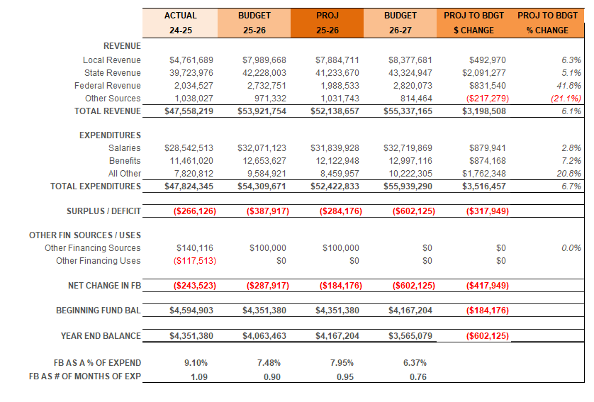
26-27 Budget – General Fund History of Revenue/Expenditure/Fund Balance Summary

Slide 7
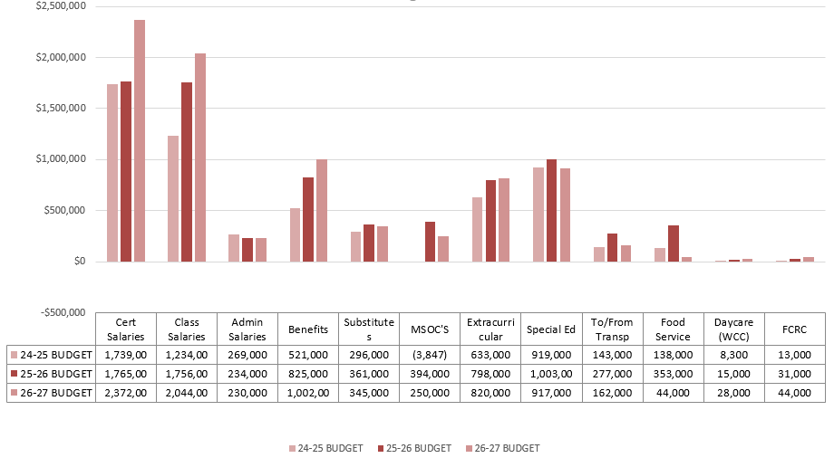
24-25 THROUGH 26-27 Budget
Uses of Levy/Enrichment Funds

Slide 8
26-27 Budget
Uses of Levy/Enrichment Funds
Expenditure Type | Enrichment Funds 2025-2026 | Enrichment Funds 2026-2027
Certificated Salaries | $ 1,765,000 | $ 2,372,000
Classified Salaries | $ 1,756,000 | $ 2,044,000
Administrator Salaries | $ 234,000 | $ 230,000
Benefits | $ 825,000 | $ 1,002,000
Substitutes | $ 361,000 | $ 345,000
MSOC (Mat’l/Supplies/Op Costs) | $ 394,000 | $ 250,000
Extracurricular | $ 798,000 | $ 819,000
Special Education | $ 1,003,000 | $ 916,000
WCC | $ 15,000 | $ 44,000
Food Service | $ 353,000 | $ 299,000
To/From Transportation | $ 277,000 | $ 162,000
FCRC | $ 31,000 | $ 44,000

Slide 9
26-27 Budget
General Fund – Revenues by Source3 Budget
General Fund – Revenues By Source
For the 26-27 Local Sources increased due to a 4.7% increase in the levy, up from $7.4M to $7.75M). State general apportionment decreased, but we have increases in Special Education ($300,000) and a sizeable increase ($1.2M) in Transportation.
Federal funds are very close to the same amount as in 25-26 and funds from Other Sources are less due to lower KWRL unfunded (as a result of the large allocation increase).

Slide 10
26-27 Budget
General Fund Expenditures - % of Total by Object
Salaries and benefits account for 81.7% of total expenditures. This is down from 82.5% last year. Staff numbers have decreased in both certificated and classified from the 25-26 budget and services are up due to increased Special Education outside placements and insurance costs.

Slide 11
26-27 Budget
Transportation & Food Service
Transportation Revenues/Expend
Food Service Revenues/Expend
Revenues only include the state-funded revenues. We also receive payments from the other districts. Woodland’s portion of KWRL for 26-27 is $161,000 ($30,000 less than the 25-26 budget).
26-27 Food Service cost is approximately $299,000 in comparison with the previous year budgeted cost of $353,000. Participation has increased in the last year and salary and benefit increases were less than last year. We did not make any increases or decreases to staffing levels.

Slide 12
26-27 Budget
Before and After School Care
For many years, the WCC programs have provided opportunities for parents and students in a small community without many daycare options for families.
The programs served about 120 families throughout the year at Columbia and North Fork. They also provide summer care at Columbia.
The WCC program is licensed by the state and able to provide options for low-income families.
Daycare programs are budgeted to run at a loss of $32,000 for 26-27 (in comparison with $15,000 in 25-26). The DSHS fees have leveled off (they increased considerably the past couple of years) and DSHS pays more in fees than our parents who pay the hourly rate. Increases to salaries and benefits have also contributed to the greater budgeted cost of WCC.

Slide 13
26-27 Budget
History of Staff Changes
It made more sense to compare 25-26 Actual to the 26-27 Budget instead of the 25-26 Budget, since there were some positions that we did not fill due to the enrollment loss. Even with that, you can see that we have almost 6 less teachers for 26-27, based on the resolution passed by the board in May. The increase in classified staff is mostly due to an increase in bus drivers.

Slide 14
OTHER FUNDS
Capital Projects
Debt Service
ASB
Transportation vehicle

Slide 15
CAPITAL PROJECTS FUND
Beginning Fund Balance $ 800,000
Revenues/Other Financing Source $1,112,000
Expenditures/Financial Uses $ 850,000
Ending Fund Balance $1,062,000

Slide 16
DEBT SERVICE FUND
Beginning Fund Balance $ 2,000,000
Revenues/Other Financial Source $ 4,087,906
Expenditures/Other Financial Uses $ 3,705,000
Ending Fund Balance $ 2,302,906
Debt Outstanding 9/1/26 = $36,450,000

Slide 17
ASB FUND
ASB funds are for the extracurricular benefit of the students. Their involvement in the decision-making process is an integral part of associated student body government.
Beginning Fund Balance $ 480,000
Revenues $ 589,500
Expenditures $ 591,000
Ending Fund Balance $ 478,500

Slide 18
TRANSPORTATION VEHICLE FUND
This fund is used to replace buses for the KWRL Cooperative districts. Revenue comes from the State (in the form of depreciation payments), and interest earned on the investments. We received a grant from the EPA ($2.8M) and the WA State Dept of Ecology ($2.9M) for electric buses. The beginning balance reflects these grants. Due to the grants received, the decision was made to not collect the funds from the 4 districts for 26-27.
Beginning Fund Balance $ 6,200,000
Revenues $ 3,280,000
Expenditures $ 4,000,000
Ending Fund Balance $ 5,480,000

