Slide 1
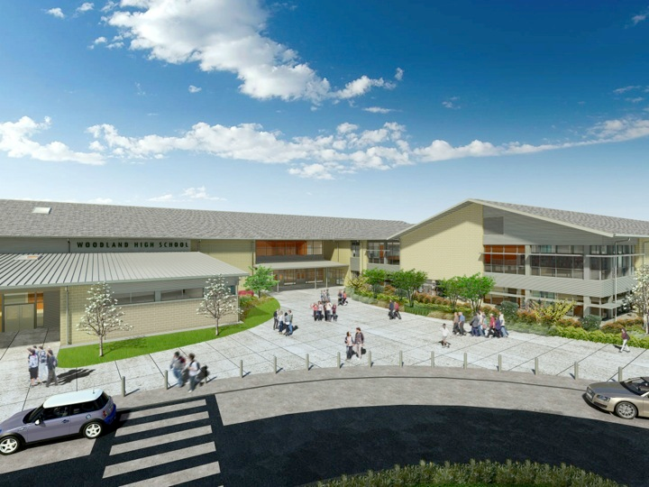
Woodland Public Schools
Facilities Report February
2026

Slide 2
Facilities/Safety Report
We are planning a site visit for WMS fire alarm contractors during Spring Break.
The Grounds crew is working on sports field management and weed control as we move toward spring.
Grounds is also taking care of some tree removal and trimming in order to facilitate our High School security cameras.
Maintenance has been working on exterior lighting and leaks as well as replacing ice machines and HVAC filters. We are preparing for our surplus sale and inventorying items.
A crew of volunteers is having materials delivered and will be constructing some new dugouts at our JV baseball and softball fields at WHS.
We are hoping to utilize some grant funding to replace the roof at the covered play area of CES.
Facilities is prepared for inclement weather days. We will be on early shifts on days with snow or ice to prepare for staff and student arrivals.
We are working with the other Districts in the area to create a cooperative reunification plan for shared use of our facilities in the event of the need to reunify evacuated students to their families at an off site location.

