Slide 1
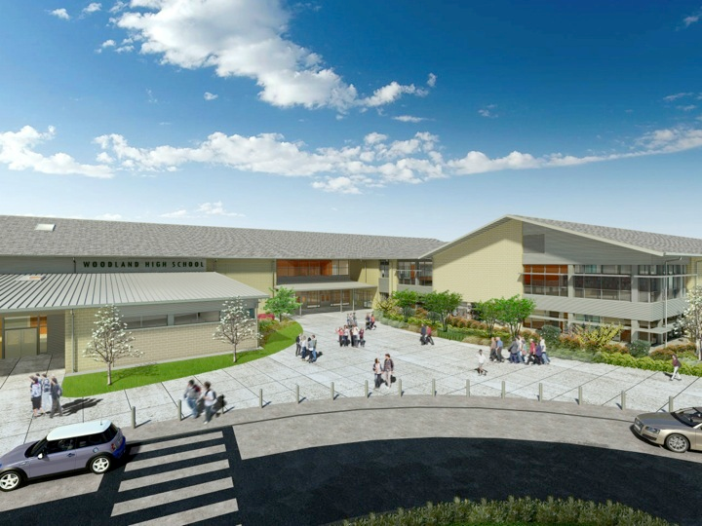
Woodland Public Schools
Facilities Report September
2025

Slide 2
Facilities/Safety Report
New staff at Yale Elementary School are doing great in their new roles as cook/custodian/grounds.
New custodial staff (Mason Knight, Jaqulynn Rainey) are settling into their roles and taking care of our elementary campuses.
The High School varsity baseball field is looking great with efforts from our community and grounds crew. The infield has been resurfaced, leveled, and re-seeded. The outfield has been rolled and fertilized.
Landscapes are looking good going into fall. We’re looking forward to the grass going dormant so we can turn our attention to some other efforts, like the High School parking lot beds, pruning, and sports field prep.
With a lot of great input from user groups and the community we’re finalizing the facilities use calendar for the upcoming winter season.

Slide 3
Looking ahead
The new IQCU branch at WHS is expected to be operational in October.
We’ll be doing some repairs to new vandalism and damage in our middle school restrooms.
You’ll notice some obsolete fencing disappear at North Fork Elementary School.
The cooler months are the appropriate time for tree pruning. Don’t be alarmed if you see some that look pretty thin. They’ll come back in the spring.
In safety we are going to do a full audit of our PA systems in the District to determine where we need to add or enhance to improve communications.
We’re working to hire custodial substitutes to cover staff absences and school events. Also in preparing to have help to do deep disinfecting in case cold and flu season creates a significant attendance drop.
We’re beginning to build our list for Christmas Break projects. Stay tuned.

