Slide 1
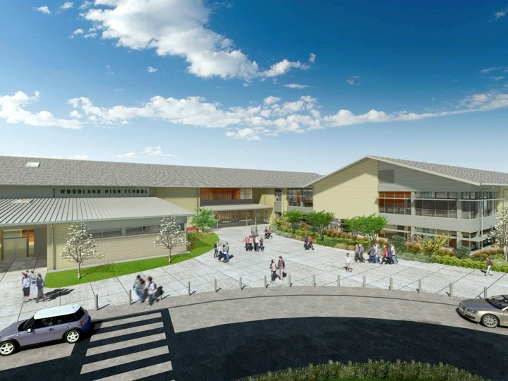
Woodland Public Schools
Facilities and Safety Report
May 2025

Slide 2
Facilities/Safety Report
D1 grant Study and Survey work is near completion.
Seismic assessment is under way of all facilities.
Summer work planning is nearly complete. We have hired three short term laborers for the summer.
Summer contract work is planned and we’re receiving bids for roofing, parking lot painting, and tree pruning.
Maintenance and Grounds are working on end of year aesthetics for graduation and other ceremonies.
The new portable at North fork is installed. Last steps are fire alarm installation and final occupancy permit. These should be complete by the end of the month.
We’ve had some changes in custodial staff and made a new hire. Troy Maynard is our new swing shift Custodian at WMS. If you see him around, please welcome him.
The Admin team is working through a safety tabletop exercise around a train derailment scenario.
Safety team is exploring the implementation of an emergency alert system platform that uses district devices and cell phones.

