Slide 1
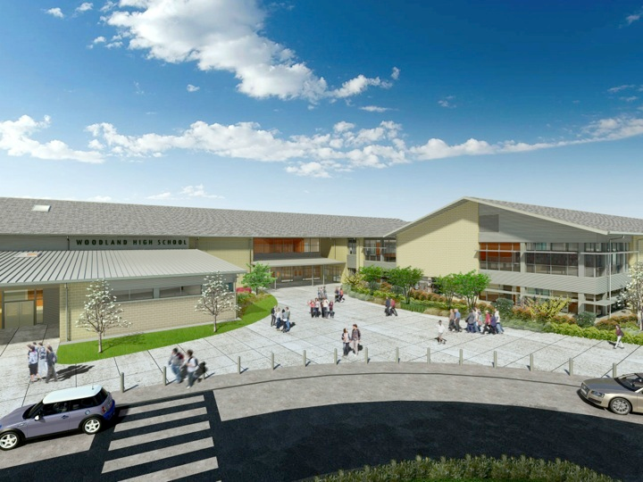
Woodland Public Schools
Facilities Report November
2024

Slide 2
Facilities Report
Middle School fuel savings incentive/rebate – Woodland School District will be receiving a $25,500 rebate from Cascade natural gas, for the installation of the new high efficiency gas furnaces that were installed at the middle school. I have been working with TRC Energy advisors, on behalf of Cascade Natural Gas, for the last year and a half to secure this generous rebate.
North Fork Portable – The City has been slow to release the building permits for the new portable. I’m happy to report the City is ready to issue the permit, once Clark/Cowlitz Fire and Rescue signs off. I have sent in a request for the CCFR to fast track their process, so we can move forward with setting the portable. I have all subcontractors lined up and ready to go once we receive the permit.
Middle School Fire Alarm System – We have had numerous failures with our 32 year old fire alarm system. We have been scrambling to make repairs and keep the system functioning. The system is currently functioning and adequately protecting the school, staff and students. We have additional repairs scheduled for the system during Thanksgiving break shutdown. We are currently soliciting bids for a complete system replacement.

