Slide 1
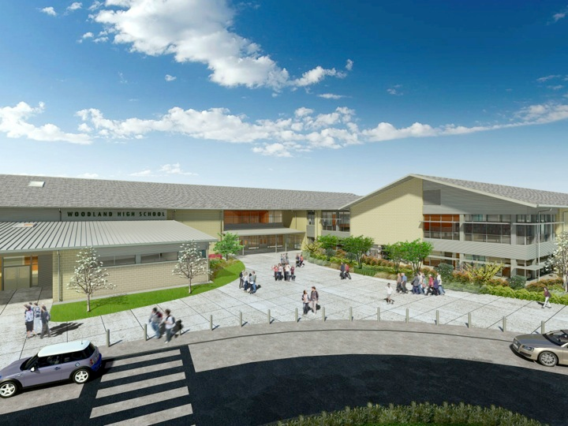
Woodland Public Schools
Facilities Report September
2024

Slide 2
Facilities Report
Middle School partial roof and gutter replacement – We replaced the remaining portion of the yellow gym classroom wing composite roofing. We also replaced all gutters on this section of roof and some roof sheathing that was damaged from water intrusion due to the failing existing roof. We replaced 33 sheets of 5/8 plywood with a total additional cost of $3,957.00 for materials and labor.
Summer moves – Our facilities department assisted in quite a few relocations at the Middle School campus over the summer. We relocated our business office and the district/board meeting room to the LRA campus and moved LRA to the business office portable classroom, located right next to TEAM High. We also had a handful of other small moves on the Middle School campus, including classroom and administration room/office changes.
Third street drainage improvements – With help from the City of Woodland Public Works we were able to open up and repair the drywell drainage system at the end of 3rd Street where it meets our parking lot at the Middle School. A large portion of the SW side of our campus, including the grandstands and 3rd Street drain into this dry well on our property. Majority of the financial burden was absorbed by the City of Woodland. The total cost to the district for this repair was $3,971.00
Middle School HVAC upgrades – The HVAC system upgrades at the Middle School are finally complete, with all new gas furnaces for all green and yellow hall classrooms and new heat pump systems for offices.

Slide 3
Facilities Report Cont.
We completed a number of small projects district wide including a in-house resurfacing of the High School aux gym floor, re-stripe of North Fork Elementary parking lot, floor waxing, painting, general deep cleaning, exterior pressure washing and some re-carpeting. This summer was a challenge being short staffed due to levy cuts. We did not have the staffing to complete everything we usually accomplish during the summer. Our department is looking forward to next summer with hopes of being fully staffed.
North Fork Elementary portable classroom – We have ordered and built a new portable classroom for North Fork. The classroom is ready for delivery. We are waiting on permits from the City of Woodland to be issued. Once the permits are issued, the new classroom will be delivered and setup onsite. We hope to have the classroom ready for staff and students by December 1st.
Small district modernization grant – We have been working with Ameresco to apply for a $10,645,794.00 grant to improve our aging building infrastructure. This year the state opened up the small district modernization grant to school districts with less than a 3,000 student enrollment. If we are awarded this grant we will be able to update Columbia’s HVAC equipment, fire protection systems, kitchen freezer, dishwasher, lighting and roofing. Middle School’s fire protection systems, lighting, kitchen freezer, refrigeration, dishwasher, covered outdoor walkway and roofing. North Fork fire protection systems, HVAC equipment, lighting, refrigeration systems and dishwasher. Yale’s roofing and lighting.

