Slide 1
Woodland School District
2024-2025 Budget Summary
Presented by:
Stacy Brown
Executive Director of Business Services
August 8, 2024

Slide 2
24-25 Budget
Enrollment History (including Running Start) – Budget to Actual
Actual enrollment for 23-24 (not including Running Start) was 30.71 students less than budget. The estimated enrollment for 24-25 (not including Running Start) is 12 students more than the 23-24 budget. With an expectation that some of the growth will result in additional students districtwide, this is a conservative estimate in comparison with prior years.

Slide 3
24-25 Budget
Historical Fund Balance/FB as a % of Expenditures

Slide 4
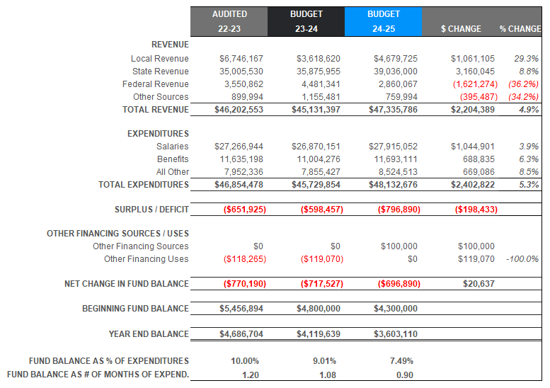
24-25 Budget – General Fund History of Revenue/Expenditure/Fund Balance Summary

Slide 5
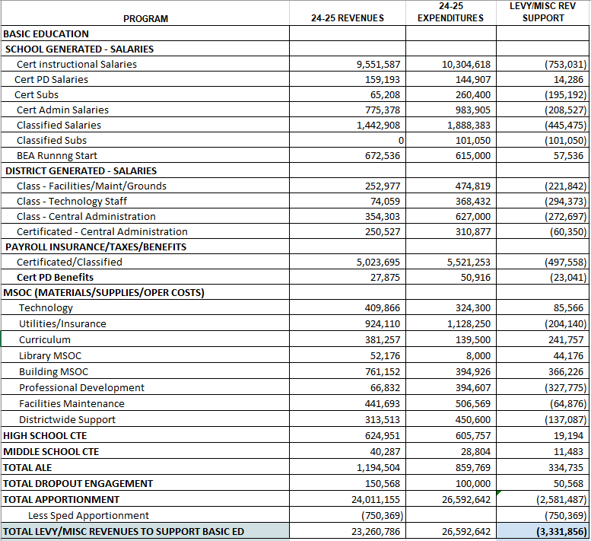
24-25 Budget
Sources and Uses Sheet (BEA)

Slide 6
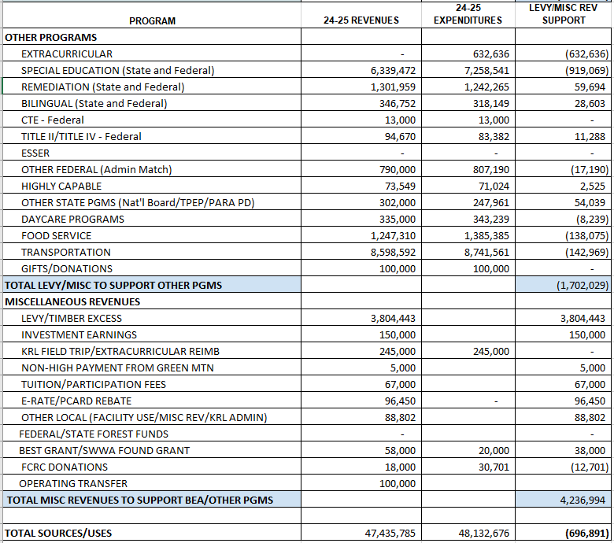
24-25 Budget
Sources and Uses Sheet (Other Programs)

Slide 7
24-25 Budget
General Fund – Revenues by Source3 Budget
General Fund – Revenues By Source
For the 24-25 revenue sources, the Local Sources have increased with the addition and increase to the 2025 levy (full levy increased from $6.1M to $7.05M and we receive approx. half for each fiscal year). State funds are increased due to IPD and inflationary increases in all programs, Special Education enrollment increase, large increase in LAP and Transportation allocations.
Federal funds are consistent with the end of the ESSER Funds (req’d to be fully spent by Sept 2024).

Slide 8
24-25 Budget
General Fund Apportionment Change Year over Year
This graph shows the history of apportionment. Changes. Total enrollment (including RS, ALE and Dropout) is 21 students greater than in 23-24 (less than 1%). Increases to the prototypical school funding model includes increases to counseling, nurses, social workers, psychologists, paras, secretaries, community engagement and student safety (increase of 2.8 certs, .11 Admin and 1.15 FTE classified). There are also funded increases of 3.7% in salaries,7.1% in health benefits and a slight increase in retirement rates. The MSOC’s also increased by 3%.

Slide 9
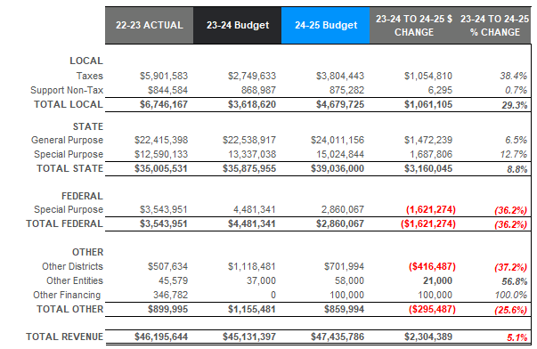
24-25 Budget
22-23 Actual, 23-24 and 24-25 Budget Comparison – Revenues
Slide shows year to year budget comparison of revenues. Large increase in local taxes due to increase of levy from 2023 $6,100,000 to 2025 $7,050,000. State General Purpose include apportionment increases identified in previous slide. Special Purpose increases in Special Education, Transportation and LAP (details on detail slide). Federal Special Purpose much lower than in previous years due to requirements for ESSER (Covid) funds. Must be spent by 9/30/2024 (must be spent before we receive the revenue). Decrease from Other Districts for KWRL unfunded (state allocation has caught up to the growth so the unfunded amount that we bill the other districts for is much less) and Partners in Transition program has more Woodland students than in the past. Increased revenues from Other Entities includes funds from the ESD for the BEST new teacher mentoring program and the Juul Settlement funding. Other Financing includes transfer of state forest funds from DSF to CPF and then transferred to GF to cover technology purchases.

Slide 10
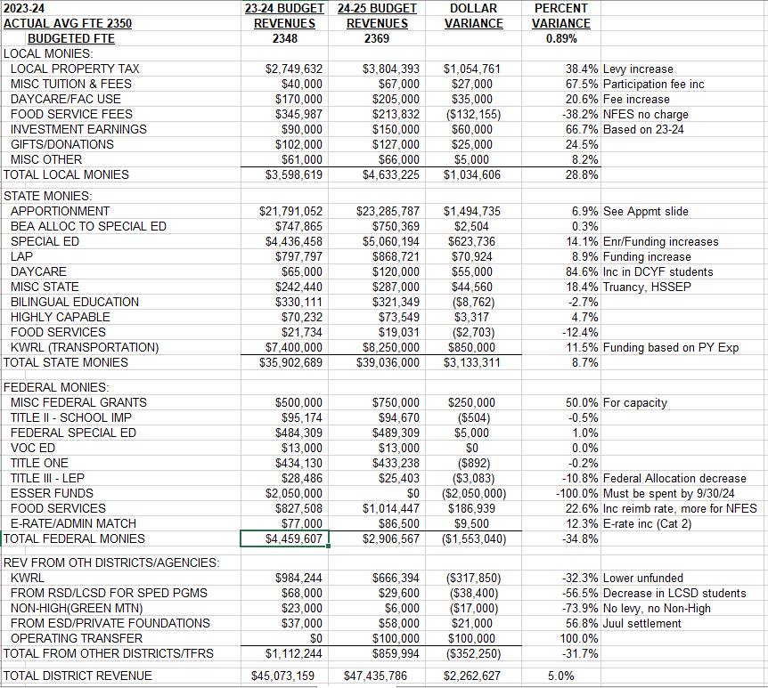
24-25 Budget – Detailed Revenue Comparison

Slide 11
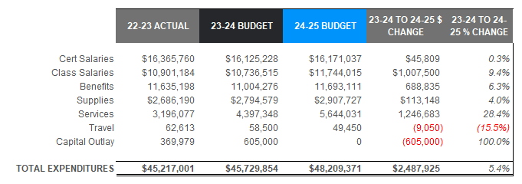
24-25 Budget
Expenditure Comparison – By Object22-23 Budget Comparison – By Object
Slide shows changes from budget year to budget year. Certificated staff will receive an increase of 4.7% overall, however, there were cuts made to the number of positions, resulting in a very small increase. Classified salaries increased by 9.4%. In 23-24 KWRL employees received an increase of 13% (only 10 of this was budgeted). As that increase compounds to 24-25 and the other groups are also received IPD (3.7%) plus additional percentages. The Benefit increase is larger due to the increased classified staff, increases in salaries and an increase to the health benefit of 7% as well as an increase for capacity. Supply increases due to increased technology purchases and inflation. Purchased Services increased as I added $250,000 for capacity (with offsetting revenues), OT services are being contracted, Running Start increased by almost $400,000, Open Doors increased by $60,000, Skyward cost budget increase ($110,000 that was missed in the 23-24 budget, increased costs for students going out of district, increases in insurance and utilities. Capital Outlay was budgeted for the HVAC systems using ESSER funds. The projects will be completed in the 23-24 fiscal year.

Slide 12
24-25 Budget
General Fund Expenditures - % of Total by Object
Salaries and benefits account for 82.2% of total expenditures. This is down from 83% last year, due to decreased certificated staffing.

Slide 13
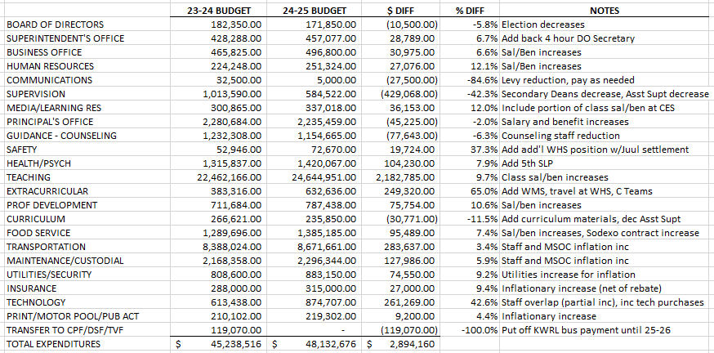
24-25 Budget – Expenditures by Activity

Slide 14
24-25 Budget
Uses of Levy/Enrichment Funds
Expenditure Type | Enrichment Funds 2023-2024 | Enrichment Funds 2024-2025
Certificated Salaries | $ 302,000 | $ 738,745
Classified Salaries | $ 1,160,000 | $ 1,234,387
Administrator Salaries | $ 336,000 | $ 268,877
Benefits | $ 613,000 | $ 520,599
Substitutes | $ 266,000 | $ 296,242
MSOC (Mat’l/Supplies/Op Costs) | $(415,000)** | $ (3,847)**
Extracurricular | $ 383,000 | $ 632,636
Special Education | $ 672,000 | $ 919,069
WCC | $ 55,000 | $ 8,342
Food Service | $ 95,000 | $ 138,075
To/From Transportation | $ 325,600 | $ 142,969
KWRL Bus Purchase | $ 119,000 | $ 0
Total | $ 3,645,600 | $ 4,896,094
** - If district is overfunded for MSOC’s, must state how this will improve student achievement. The district has made the decision to provide classroom staff instead of MSOC’s. We feel this will have a more profound impact on student achievement.

Slide 15
24-25 Budget
Transportation & Food Service
Transportation Revenues/Expend
Food Service Revenues/Expend
Revenues only include the state-funded revenues. We also receive payments from the other districts. Woodland’s portion of KWRL for 24-25 is $149,632 (operations $250,000 less and bus purchase $119,000 less than the 23-24 budget).
24-25 Food Service cost is approximately $138,000 in comparison with the previous year budgeted cost of $95,000. In the past 2 years we have received over $100,000 in Covid Supply Chain Assistance funds which has definitely helped the bottom line. We will no longer be receiving SCA.

Slide 16
24-25 Budget
Before and After School Care
For many years, the WCC programs have provided opportunities for parents and students in a small community without many daycare options for families.
The programs served about 120 families throughout the year at Columbia and North Fork. They also provide summer care at Columbia.
The WCC program is licensed by the state and able to provide options for low-income families.
Daycare programs are budgeted to run at a loss of $8,342 for 23-24 (in comparison with $55,000 in 23-24). Part of the levy reduction plan was that WCC would be self-supporting. Missy and I have worked together to minimize staff while still staying in compliance with the states regulations, increasing fees and Missy has received some private donations to help cover the cost of snacks and other supplies.

Slide 17
24-25 Budget
History of Staff Changes

Slide 18
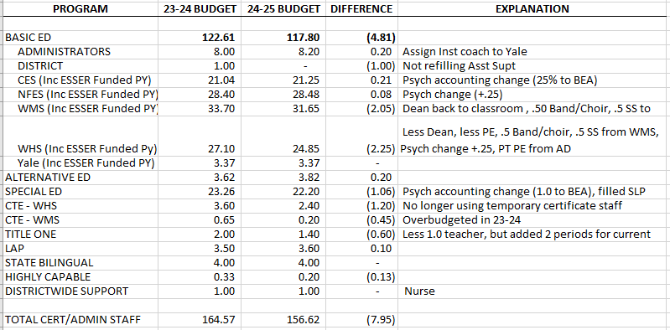
24-25 Budget
Certificated Staff Detail

Slide 19
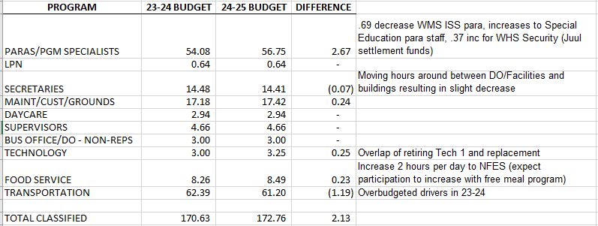
24-25 Budget
Classified Staff Detail

Slide 20
OTHER FUNDS
Capital Projects
Debt Service
ASB
Transportation vehicle

Slide 21
CAPITAL PROJECTS FUND
Beginning Fund Balance $ 412,000
Revenues/Other Financing Source $ 505,000
Expenditures/Financial Uses $ 640,000
Ending Fund Balance $ 277,000

Slide 22
DEBT SERVICE FUND
Beginning Fund Balance $ 1,740,000
Revenues/Other Financial Source $ 3,647,867
Expenditures/Other Financial Uses $ 3,698,000
Ending Fund Balance $ 1,689,867
Debt Outstanding 9/1/24 = $39,935,000

Slide 23
ASB FUND
ASB funds are for the extracurricular benefit of the students. Their involvement in the decision-making process is an integral part of associated student body government.
Beginning Fund Balance $ 330,000
Revenues $ 400,500
Expenditures $ 411,000
Ending Fund Balance $ 319,500

Slide 24
TRANSPORTATION VEHICLE FUND
This fund is used to replace buses for the KWRL Cooperative districts. Revenue comes from the State (in the form of depreciation payments), interest earned on the investments and the annual payments made by the four member districts (Kalama, Woodland, Ridgefield and La Center) to cover options and buses necessary for growth. We have received a grant from the EPA ($2.8M) for electric buses and are looking into securing other funding for buses and the required infrastructure. The budget revenues and expenditures reflect the additional electrification revenues and expenditures.
Beginning Fund Balance $ 5,170,000
Revenues $ 7,522,488
Expenditures $ 7,500,000
Ending Fund Balance $ 5,192,488

