Slide 1
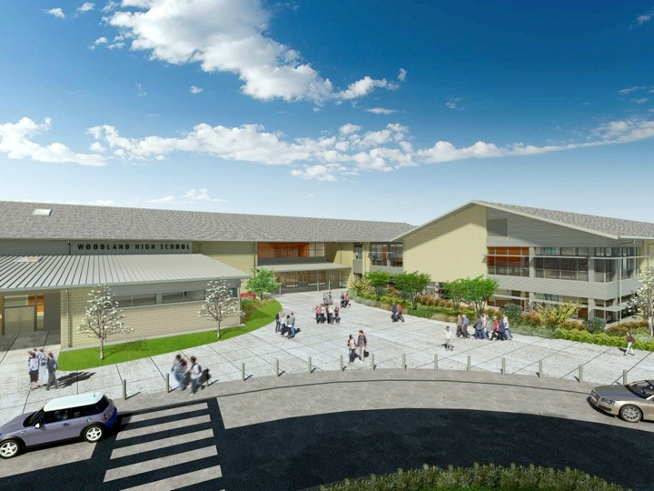
Woodland Public Schools
Facilities Report April
2024

Slide 2
Facilities Report
Spring Break Facilities Department Projects – Our facility department teams were busy during spring break. At North Fork Elementary, we had a tree removed that was leaning into the phone and cable lines on Lewis River Hwy. We had the arborist limb up the tree in the gravel overflow parking lot. It had some dangerous limbs that needed to be removed for safety. We also did extensive exterior pressure washing at the High School, North Fork and Columbia to clean areas of the buildings and sidewalks.
North Fork Elementary Portable – We have a new portable classroom ordered for North Fork Elementary. The new portable will be a carbon copy of our existing portables, and will add two additional classrooms. This portable was needed to address our current and future student capacity. The new portable will be installed this summer and ready for the 2024-2025 school year.
Columbia Elementary Track – Over spring break, a new ¼ mile gravel walking track was added to the main activity field at Columbia Elementary. This was completed at no cost to the District. All materials and labor were donated. A special thanks to Ryan’s Excavating and Trucking, Simplicity by Hayden Homes, C & E Rentals, and Matt Rychel for making this happen for our kids and community.

