Slide 1
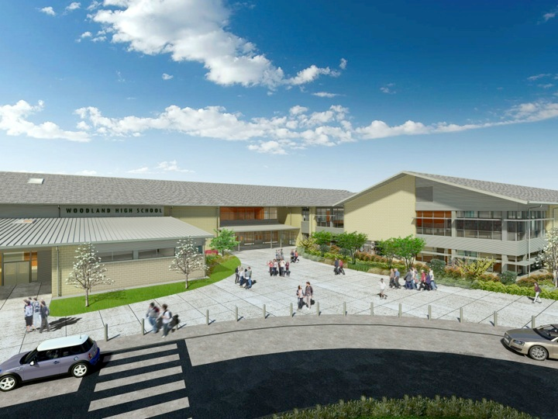
Woodland Public Schools
Facilities Report February
2024

Slide 2
Facilities Report
January Winter Storm – Many school districts in our region experienced extensive damage to their buildings due to the recent winter storm. I’m happy to report that Woodland School District escaped old man winter’s wrath with only minor damage. We lost power at Yale Elementary for almost two days. We have an outside pump house that had a pipe freeze and break. Our maintenance team quickly repaired the broken pipe and restored the water supply to the school. We prepared well in advance of the storm and continually monitored the buildings for issues, including repairing and maintaining the heating systems through the event. We also called in our grounds crew early on to clear the parking lots and sidewalks so we could open the schools promptly once the weather warmed up.
LED Lighting Upgrades – We are working with Cowlitz PUD on our LED lighting conversion. We are going to receive up to $8.00 per bulb in rebates from Cowlitz PUD. We are currently testing a few LED bulbs for best light temperature, bulb quality, and cost per bulb.
5th Street Drainage and Grading – With the heavy rain this fall and winter, 5th Street became a small lake with water levels exceeding 12” in the lowest points, and covering 80% of the roadway at the bend. This was creating a safety and traffic concern. We were able to dig up the existing dry well and rebuild the drainage system. The repair worked extremely well and has handled the extensive rainfall this winter.

