Slide 1
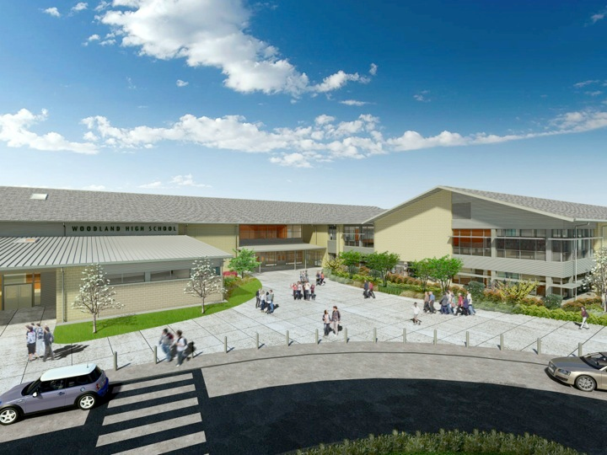
Woodland Public Schools
Facilities Report September
2023

Slide 2
Facilities Report
New Roof Coating on the Middle School Old Wood/Metal Shop Building – Our maintenance staff coated the flat roof at the Middle School with GE Enduris 3500 silicone roofing system that was purchased in 2016 to extend the life of the existing asphalt roofing. We had just enough material in stock to complete the coating, and this should give us 10 to 15 years of additional life to the roof.
Middle School Roof Replacement Update — We were able to complete a partial roof replacement at the Middle School this summer. We focused on replacing the sections that required immediate replacement due to ongoing leak issues. Thankfully, there was minimal dry rot found. We had to replace 352 square feet of plywood roof decking and a few facia boards. We only went $2,030.00 over the proposed project cost of $154,940 for the structural repairs.
Middle School and High School Gym Floor Resurface – This is a WSD first! Our maintenance department did our own in-house gym floor resurfacing with amazing results. Last year, we purchased equipment for our maintenance team to do our own gym floor resurfacing to save money and service the floors yearly. In the past, the Middle School gym floors were only being resurfaced every few years, creating a slick floor that was a safety concern.
Columbia Elementary Playground – We excavated and removed years of compacted woodchips that was causing rain water drainage issues, with large ponds of water forming. We also installed a dry well drainage system under the new layer of wood chips.

Slide 3
Facilities Report Cont.
Yale Elementary – We installed new parameter boarding for the parking lot and the playground. We also installed new wood chips in the playground area after the installation of the new parameter boarding.
Exterior Doors Rekey – This summer, we rekeyed all exterior doors at North Fork and Yale for added security. All schools in the District have their own separate keys that are not shared with any other buildings. Additionally, we limit the number of staff with physical keys and provide electronic card keys to keep better key control for security reasons.
Middle School HVAC Upgrade – Trane of Oregon has been replacing the classroom and office HVAC systems over the summer at WMS. The project was supposed to be completed by early September, but the completion date looks to be early October. All ventilation systems are up and running for classrooms and offices.

