Slide 1
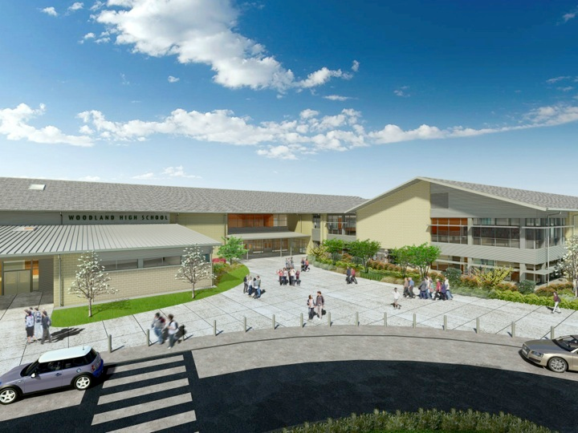
Woodland Public Schools
Facilities Report
March 2023

Slide 2
Facilities Report
Office Security Installation Update — We are nearing the home stretch for this project. Prewire is complete and AIPHONE video/intercom system hardware installation is scheduled for the last two weeks of March. The lockdown door system had a small setback, some of the door hardware that came in was the wrong type and had to be reordered. The estimated completion of the lockdown door system is now April 30th.
In-ground heating oil tank decommissioning at Yale will take place over spring break, and should be complete by the end of the week. Preliminary soil samples don’t indicate any leakage from the in-ground tank.
Our grounds crew has been hard at work completing landscaping pruning, trimming and removal of trees/bushes that were identified by Compass Consulting to increase visual sightlines, camera coverage, potential hiding spots and reduce a pathway to access the roof.
Additional parking lot lighting has been ordered and will be installed at Columbia Elementary to address the issue of inadequate lighting. This work will be completed in April.
In January and February we closed 132 work orders, with 47 in progress.
Reviewed utility expenses for January/February billing cycle. All utility costs fall within statistical norm.

Slide 3
Facilities Report Cont.
Middle School Roof Replacement Update — We have most of our project bids in for the replacement roof. We will be holding off on awarding the project until we know if the levy passes.
5th Street Update — We currently have this project on hold at the engineering level until we know if the levy passes.
High School Exterior Door Security Upgrades — Added two keycard access points for staff, to eliminate the need to program doors to be unlocked at the beginning and end of school for increased safety and security. Added a door alarm and emergency exit sign to the exterior doors exiting the east side of building towards Walmart.

