Slide 1
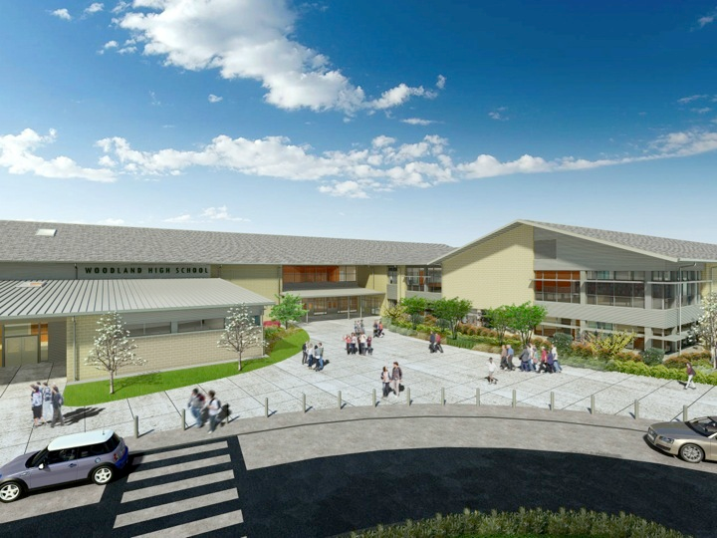
Woodland Public Schools
Facilities Report January
2023

Slide 2
Facilities Report
Office Security Installation Update - Installation of an improved office security system is currently underway at WHS, WMS, NFES and CES. This upgrade includes multiple enable points for lock down, panic and momentary release controls for evacuations. In November, we added an additional scope to this project. We are installing a video intercom system with a buzz in/out feature for an additional level of security at all four main office locations, and also the District Office. The estimated completion date for this project with the additional Aiphone video intercom system is now March 31^{st .}
In-ground heating oil tank decommissioning is underway at Yale Elementary. The oil tank has been pumped dry of existing oil and will be fully decommissioned during spring break.
Completed multiple small projects around the District during winter break shutdown including: 2 classroom carpet projects, hall and classroom painting in the Middle School, North Fork and Columbia, door lock repairs and upgrades, Yale septic system inspection with tank pumping and annual fire system service, and inspections at all schools.
In November and December, we closed 73 work orders, with 34 in progress.
Reviewed utility expenses for November/December billing cycle. All utility costs for the District were higher for all locations compared to the previous billing cycles one year ago. This was due to our unusually cold weather for November and December. There was also a natural gas rate increase this year as well.

Slide 3
Facilities Report Cont.
Middle School Roof Replacement Update - We are currently soliciting estimates for the roof replacement at the Middle School. We have estimates coming in up to -$72,000.00 less than our original budget figure.
5th Street Update - We had the storm water infiltration study performed. Preliminary and long-term infiltration rates came in much lower than expected. The original design with paved asphalt was to use 100% infiltration for storm water. This approach will not be possible because of the low infiltration rates. As discussed during the October board meeting, we decided to scale back this project without doing any paving and staying with gravel due to budgetary constraints. We have asked the City of Woodland if they are still going to require a storm water drainage system with the change from asphalt to gravel. We are still waiting for a response from the City.

