Slide 1
WOODLAND SCHOOL DISTRICT 2021-2022 YEAR END FINANCIAL SUMMARY
Presented by:
Stacy Brown
Exec Director of Business Services

Slide 2
Historical Fund Balance Summary
History of total fund balance at year-end and the percentage of budgeted expenditures
Year Ended | % of Expenditures | Budget | Total Fund Balance
2015 | 11.4% | $ 25,016,430.00 | $ 2,842,390.00
2016 | 9.5% | $ 28,233,915.00 | $ 2,676,560.00
2017 | 9.1% | $ 30,270,375.00 | $ 2,764,560.00
2018 | 7.9% | $ 33,573,646.00 | $ 2,636,629.00
2019 | 7.2% | $ 37,468,437.00 | $ 2,695,935.00
2020 | 9.9% | $ 40,114,208.00 | $ 3,953,697.00
2021 | 10.6% | $ 42,894,083.00 | $ 4,542,036.00
2022 | 12.4% | $ 44,157,085.00 | $ 5,456,894.00

Slide 3
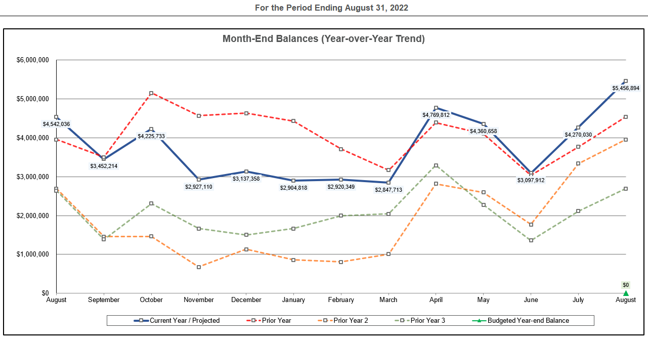
Monthly FB Summary

Slide 4
Fund Balance/Enrollment
 | August 31, 2022 | August 31, 2021
Total Ending Fund Bal – (SF0/SF1) | $5,456,894 $2,897,528/$2,559,366 | $4,542,036 $2,859,880/$1,682,156
Restricted for Pgm Carryover | $ 849 | $ 0
Nonspendable for Prepaid Exp | $ 151,600 | $ 190,879
Assigned for Building/Dept CO – 2022 inc ELA Curriculum | $ 709,220 | $ 304,918
Unassigned Fund Bal | $4,595,225 | $4,046,239
Unreserved FB Increase 20-21 to 21-22 | $ 548,986 | $ 556,349
Budgeted Inc/(Dec) in FB | ($ 493,807) | ($ 259,219)
Actual Inc/(Dec) in FB | $ 914,858 | $ 588,339
Budgeted Enrollment | 2,306.00 | 2,366.00
Actual Enrollment | 2,285.52 | 2,291.39

Slide 5
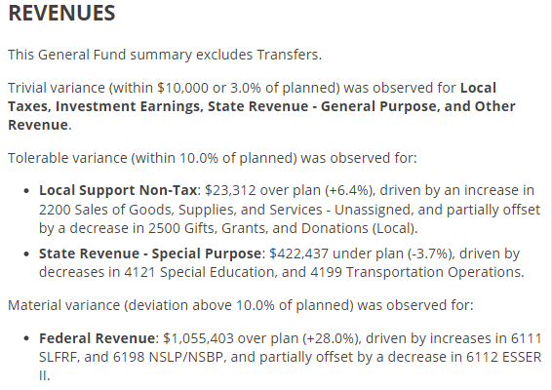
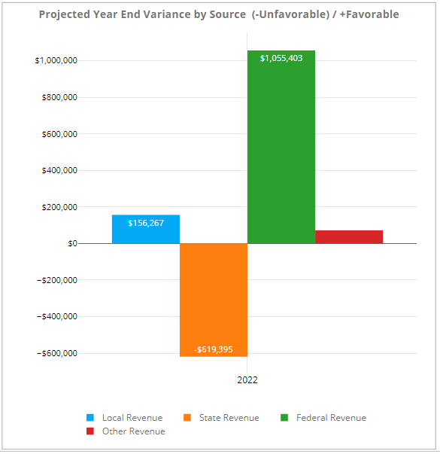
GF Revenues – Variance to Budget

Slide 6
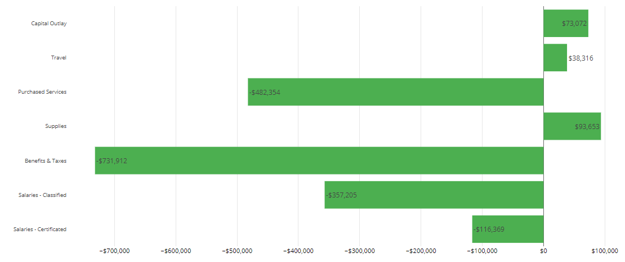
GF Object Expenditures – Variance to Budget

Slide 7
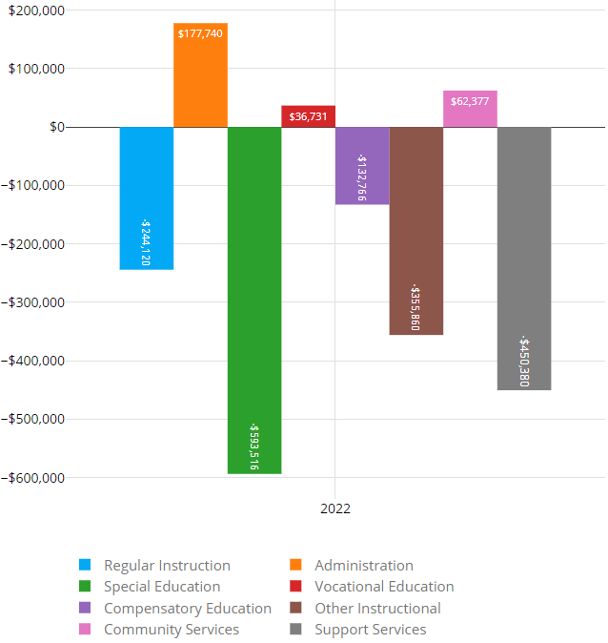
GF Program Expenditures – Variance to Budget

Slide 8
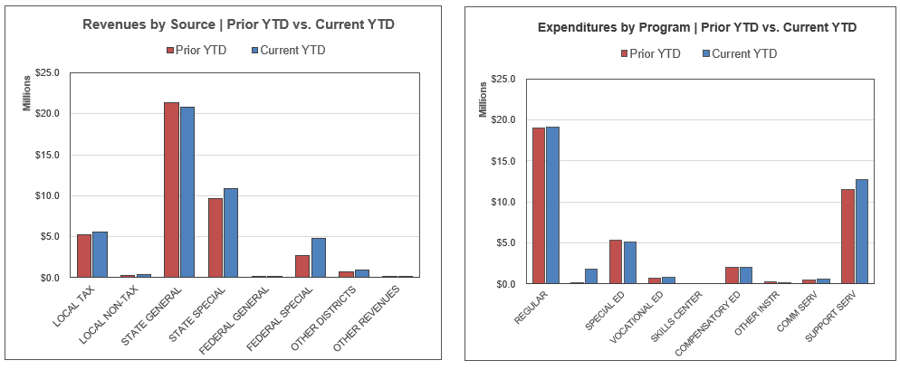
Revenues/Expenditures By Object, Compared to Prior Year (does not include transfers)

Slide 9
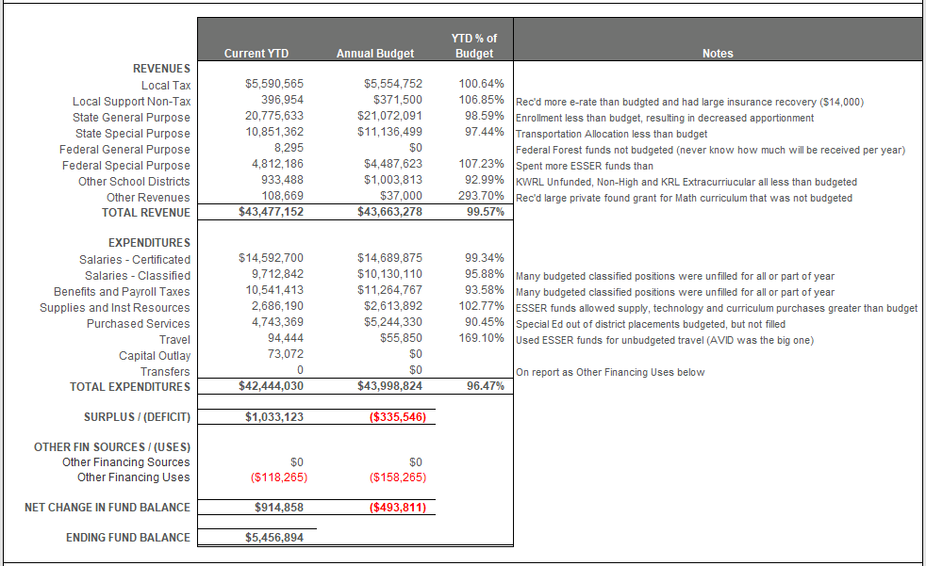
GF Financial Summary-YTD % of Budget

Slide 10
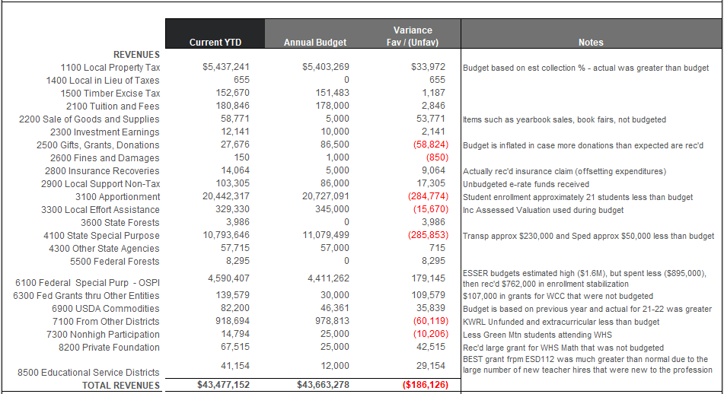
Detail Revenues Compared to Budget

Slide 11
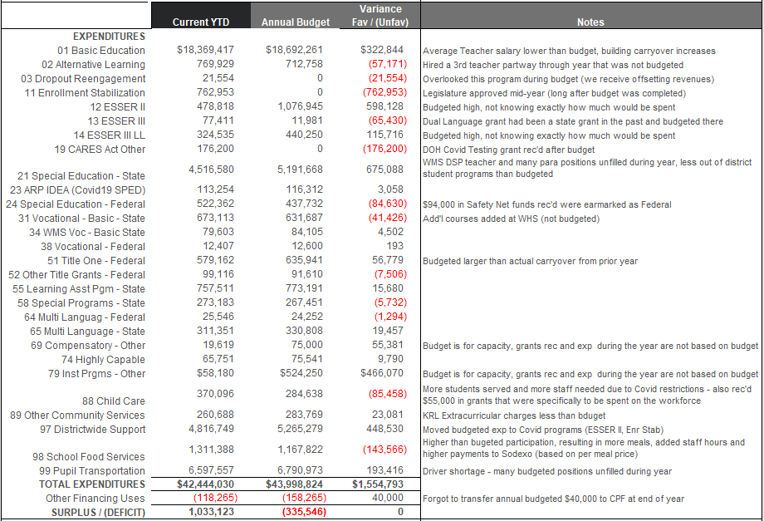
Detail Expenditures Compared to Budget

Slide 12
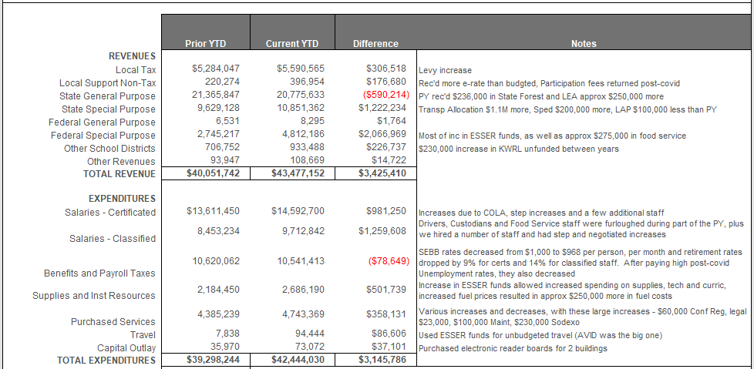
GF Financial Summary Comparison to Prior Year

Slide 13
Levy/Local Dollars
Expenditure Type | Levy Dollars 2021-2022 | Levy Dollars 2020-2021
Certificated Salaries | $ 729,700 | $ 675,000
Classified Salaries | $1,757,000 | $1,458,000
Administrator Salaries | $ 452,500 | $ 452,000
Benefits | $1,201,500 | $1,042,000
Supplies/Services/Travel/Utilities/Insurance | $ 79,000 | $ 780,000
Extracurricular | $ 612,500 | $ 486,000
Special Education | $ 56,000 | $ 419,000
Food Service Program | $ 0 | $ 99,000
To/From Transportation/Bus Purchase | $ 474,500 | $ 355,000
Daycare | $ 73,000 | $ 86,000
Family Resource Center | $ 0 | $ 2,000

Slide 14
Transportation & Food Service
Transportation
Food Service
Total Students transported = Approx 5,850 Basic average per day and 269 Special Ed/Homeless per day average
Total Expenditures (inc Utilities) = $6,650,000
Total Revenues = $5,699,000
Total Unfunded = $950,500 Budgeted unfunded plus utilities was $908,500.
District received funds from other districts based on budgeted unfunded through August. This resulted in a deficit of ($44,860) received versus owed. This will be carried forward into 22-23 (increasing what the districts owe for next year).
Woodland’s portion of unfunded plus CPF Transfer is $324,000, which represents 34.09% ownership of the Co-Op compared to 36.11% from 19-20 (the last normal year before Covid)
Due to the pandemic, the Summer Food Service Program was run for the entire year. This means that meals were served free of charge to all students all year.
There was no delivery this year and all meals were served in the school cafeterias.
We returned to the traditional summer program at WMS in July and August.
Because all meals were free district participation increased. We served an average of 430 breakfasts and 1,330 lunches per day (compared to 750 per day last year).
Sodexo Guarantee was ($170,760) and this year the food service program broke even. This means that the guarantee was met.

Slide 15
Before and After School Care
The WCC and YCC programs add opportunities for parents and students in a small community without many daycare options for families
Programs served about 130 families throughout the year and also provided summer care. Although the schools were closed at the beginning of the school year, WCC was open all year. They also extended their hours to provide service to families during the school day so that students had a place to go during hybrid learning on their days off.
WCC program is licensed by the state and able to provide options for low income families
Daycare programs ran at a loss of $73,000. Last year they had a loss of $86,000. With the extended hours and additional staffing, we were thankful for $96,000 in grants from the Cowlitz Tribe and DSHS to help cover the additional costs.
The program continues to provide an important service in a community with very little daycare available and providing convenience for parents (now at both schools). It was good to get back to normal after all of the hybrid learning, masks, additional staff, etc….

Slide 16
Other Funds
Capital Projects
Debt Service
ASB
Transportation vehicle

Slide 17
Capital Projects Fund
Beginning Fund Balance $ 670,237
Revenues/Other Fin Srce $ 407,769
Expend/Other Fin Uses $ 382,320
Ending Fund Balance $ 695,686
Expenditures were approx. $374,000 for ESSER funded HVAC projects and a about $8,000 for the KWRL projects. Total Fund Balance is made up of $255,354 in Impact Fees, $95,284 Designated for Future Capital Projects and $345,048 for KWRL projects.

Slide 18
Debt Service Fund
This fund is used to collect tax revenue and pay the principal and interest on bonds. Payments are made twice a year, December and June.
 | Debt Balance 9/1/21 | Debt Issued/ Increased | Debt Redeemed/ Decreased | Debt Balance 8/31/22
Voted Debt | $47,690,000 | $ 19,220,000 | $23,530,000 | $43,380,000
Pension Liability** | $ 1,829,909 | $ 3,131,512 | $ 0 | $ 4,961,421
Compensated Absences** | $ 630,623 | $ 0 | $ 74,585 | $ 556,038
Leases Payable** | $ 146,972 | $ 0 | $ 104,722 | $ 42,250
Total | $50,297,504 | $ 22,351,512 | $23,709,307 | $48,939,709
** Required to be reported, per accounting rules. Not debt owed.
Amount available for principal/interest at August 31, 2022 = $1,653,000

Slide 19
ASB FUND
ASB funds are for the extracurricular benefit for the students. Their involvement in the decision-making process is an integral part of associated student body government.
Beginning Fund Balance $256,211
Revenues $245,179
Expenditures $237,099
Ending Fund Balance $264,390

Slide 20
TRANSPORTATION VEHICLE FUND
This fund is used to replace buses. Revenue comes from the State (in the form of depreciation payments), interest earned on the investments and the annual levy payments made by the for Co-Op districts.
Beginning Fund Balance $2,464,372
Revenues $1,293,850
Expenditures $1,091,152
Ending Fund Balance $2,667,069

