Slide 1
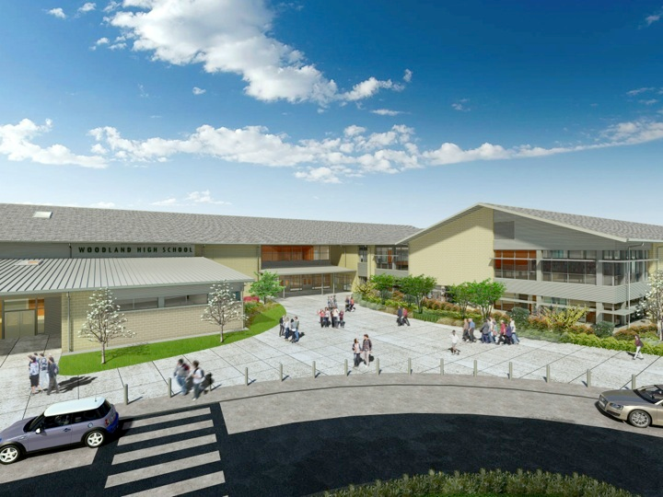
Woodland Public Schools
Facilities and Safety Report
May 2022

Slide 2
Facilities Report
Entry Cameras - Installed entry cameras for the District and NFES offices. Over the next few weeks WHS and Yale schools will also be installed. This is a dedicated camera and monitor that provides office workers a preemptive view of persons approaching the school offices.
Improved Office Security - Met with Stanley Security for hardening office security access and egress. The goal of this project is to improve office security, and provide egress for office workers in the event that they would need to flee the area while still maintaining the second level time barrier. The upgrades also include redundant security controls.
Reader Boards - Finished the installation of Columbia’s new LED full color reader board.
Met with the City regarding proposed changes to 5th Street. We still plan to stop traffic at the 90 bend in the road, but the City was reluctant to allow the District to block any part of the road. This means the parking area for the portables will be slightly to the east of the City turnaround, which should be OK. This small modification to the plan has the same end result, and accomplishes the safety goals desired.
Summer Work – In addition to the regular deep cleaning and painting projects District-wide, there are a total of 82 line items scheduled this summer. These are preventive/corrective maintenance and projects, including the revisions to 5th Street, HVAC ESSER projects, and a surplus sale.

Slide 3
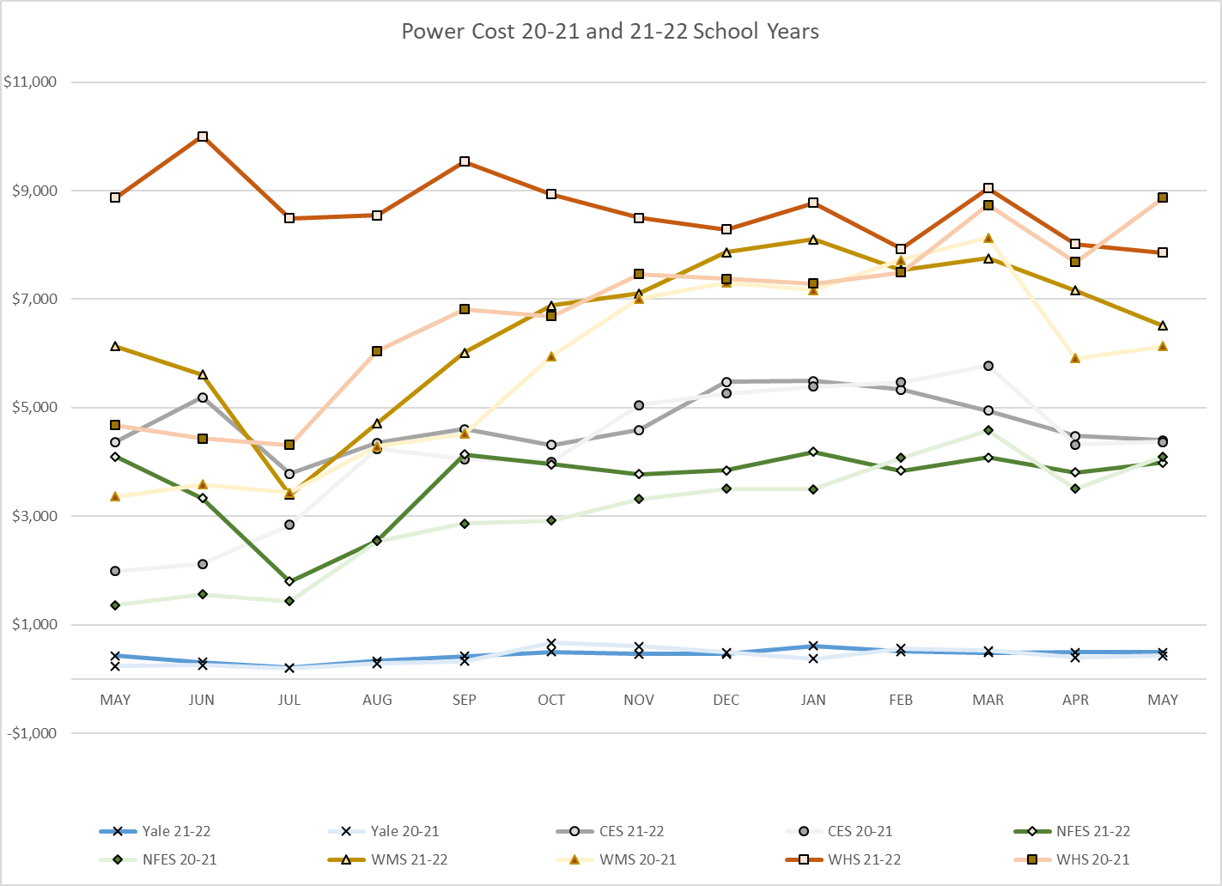
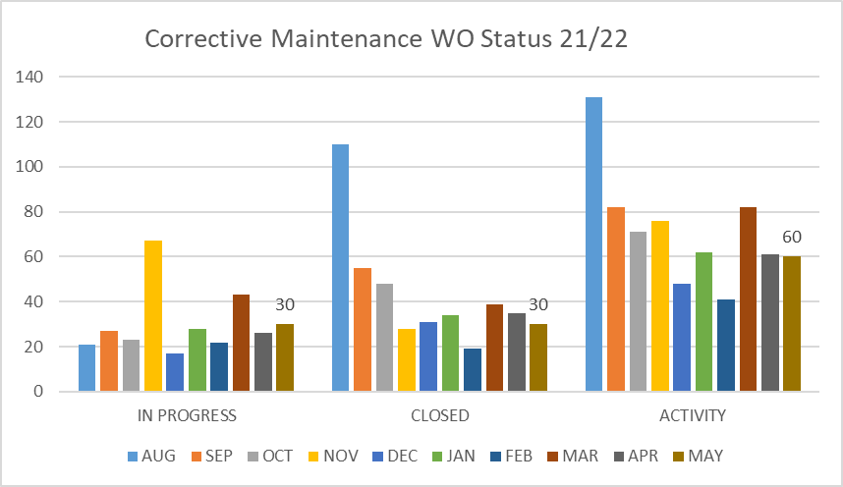
FACILITY CHARTS – POWER COST AND WORK ORDER STATUS

Slide 4
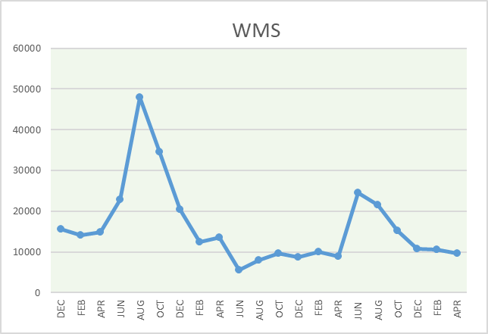
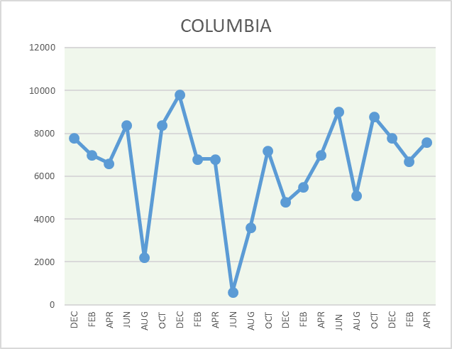
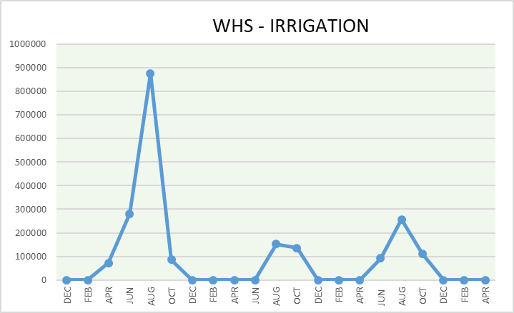
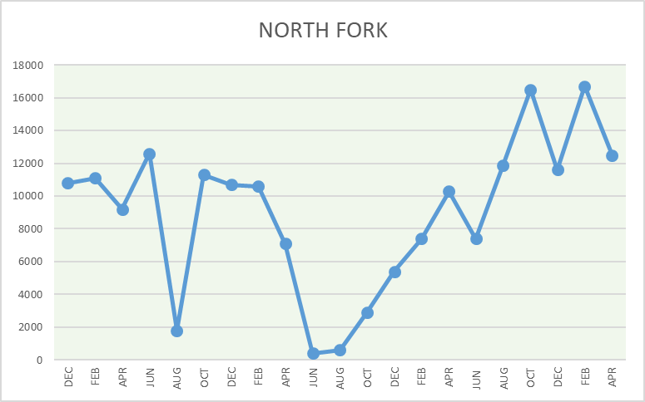
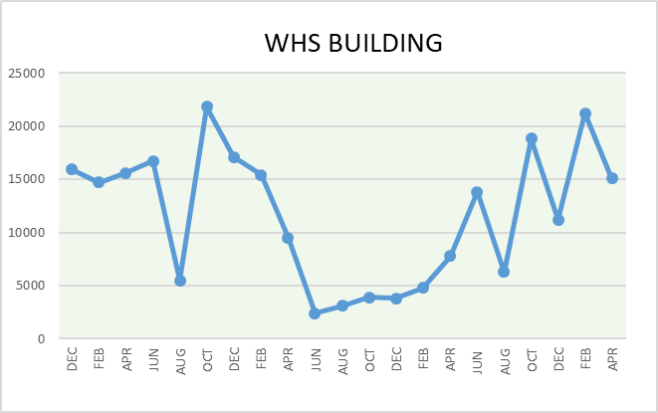
FACILITY CHARTS - WATER USAGE
WHS, NFES, WMS, CES
Note
Water charts are updated every two
months. Next update to these charts in the June 2022 report.
The WMS chart includes the following 7 meters: 755 Park high and low flow, BO and Team High, PIT house, bus barn, athletic field and DO. All of these meters are totaled on the WMS graph, but each data point is recorded separately to aid in identifying leaks.

Slide 5
Safety Summary
Staff and Student Incidents
Staff Accidents/Incidents - 4
WMS - Custodian slipped on dumpster ramp- bruised
CES - Aide lost balance playing with student, hit pavement with knees and cheekbone- no injury
NFES - Aide was pushed and grabbed by student- bruised forearm
WMS - Cook burned by hot water in kettle- burned wrist
Student Accidents/Injuries - 7
NFES - Student caught finger in closing door- no injury
NFES - Student running and looking backwards ran into tetherball pole- 10 stitches
NFES - Student ran into bar head first and hit nose- nosebleed
CEC - Student scraped knee on sharp edge of stage outlet-cut near knee
WMS - Track student running hurdles fell- no injury reported, but doctor put her in walking boot
WHS - Student cut by a pruner- 5 stitches
WHS - Student running tripped and fell onto knees and hip- bruised and scraped

