Slide 1
Woodland Public Schools
Facilities and Safety Report
April 2022

Slide 2
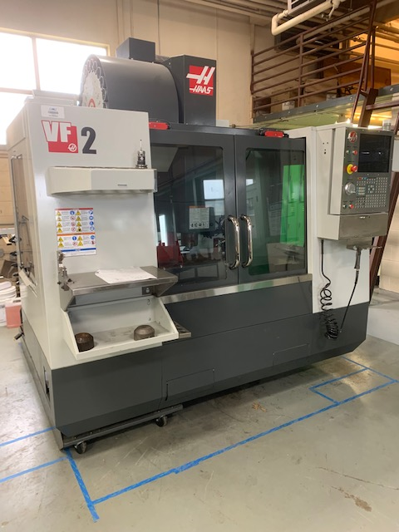
Facilities Report
Chlorine analyzer start up at Yale Elementary. The new chlorine analyzer is up and running at the Yale school. We will calibrate the pH and chlorine probes and set alarm conditions on Friday 5/20. I expect this analyzer to be fully operational at that time.
CNC for AJAC Program - A 2012 HAAS VF2 vertical milling machine was delivered
to WMS to support the AJAC program at WMS. Over the next few weeks,
we will facilitate the tool, including main electrical power, leveling, and
compressed air. Once facilitated, AJAC will complete the tool punch list. This tool
supports AJAC youth and adult apprenticeship programs.
CNC = computer numerical control (tool operating system)
AJAC = Aerospace Joint Apprentice Committee
LED signs for Columbia Elementary and WMS were installed over the past few weeks. WMS has been programmed and is fully functional. Columbia completes their program training on 5/19.
WMS Greenhouse - The work on the Middle School green house was completed on 5/6. This involved replacing all of the steel on the west side of the building, adding a new 26’ drain tray, all new media, supports and pump and other miscellaneous hardware (pictures on next slide).

Slide 3
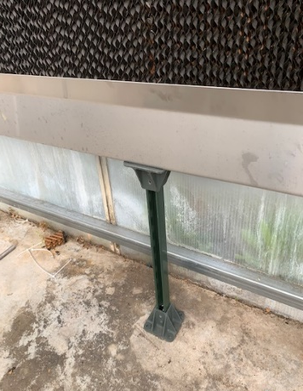
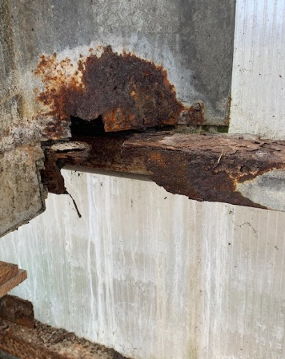
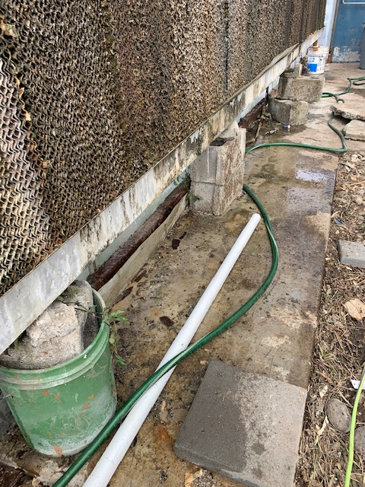
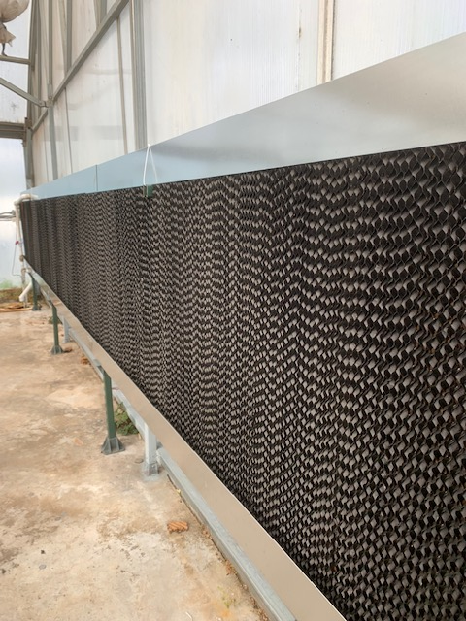
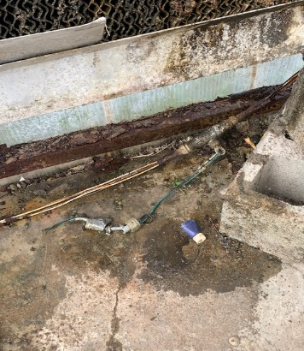
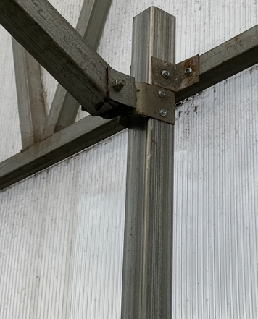
Facilities Report Continued
Completed annual review of the District Emergency Response Plan, emergency phone list for each school and started review of the Accident Prevention Program, (procedure 6511P).
Greenhouse renovation pictures
PRE-RENO
POST-RENO

Slide 4
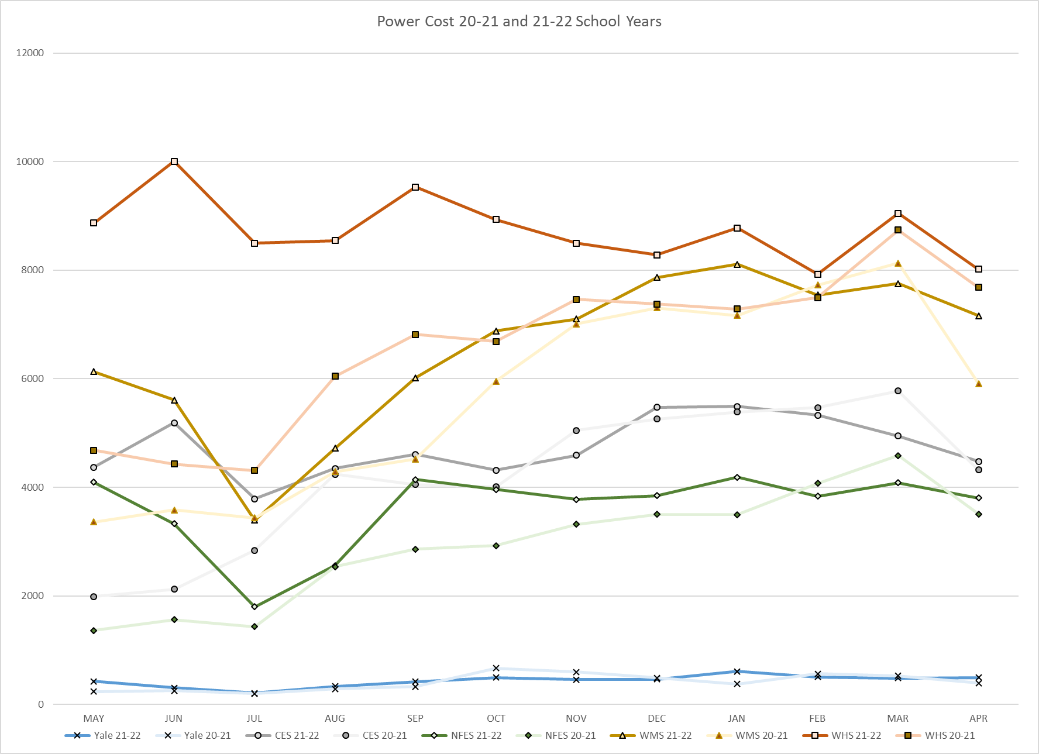
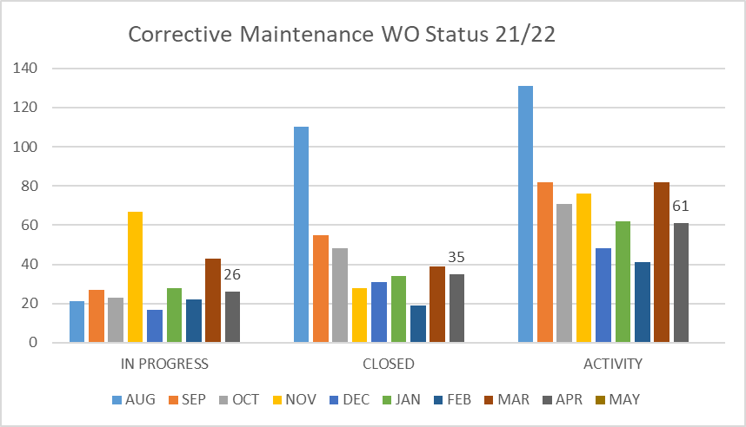
FACILITY CHARTS – POWER COST AND WORK ORDER STATUS

Slide 5
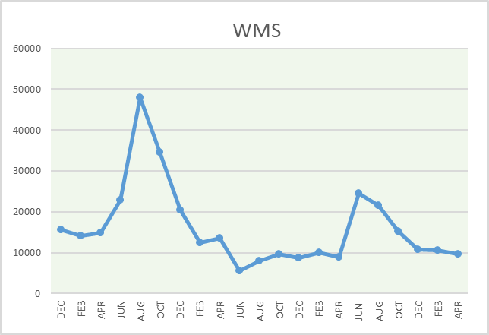
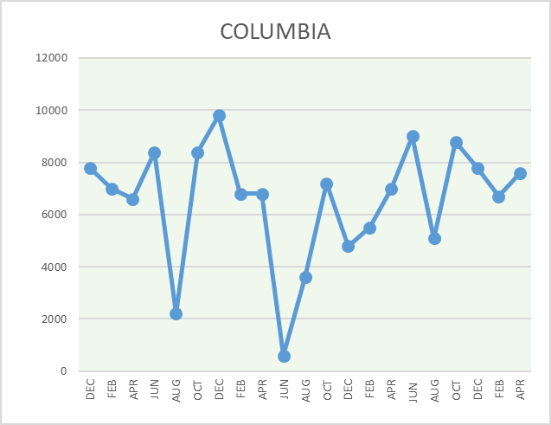
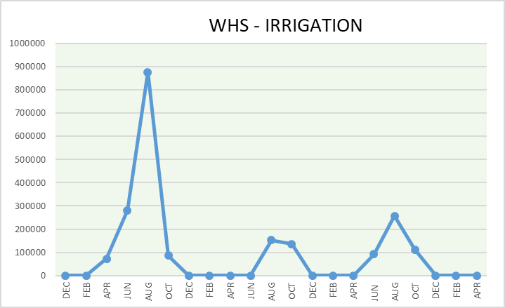
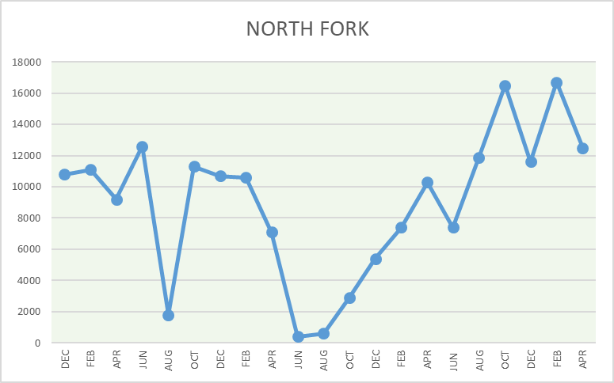
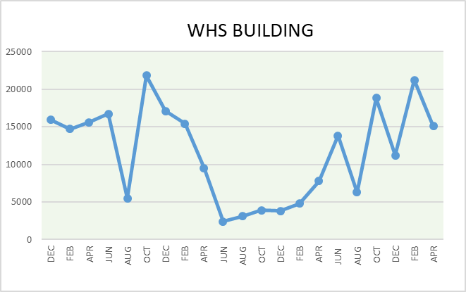
FACILITY CHARTS - WATER USAGE WHS, NFES, WMS, CES
Note
Water charts are updated every two
months. Next update to these charts in the June 2022 report.
The WMS chart includes the following 7 meters: 755 Park high and low flow, BO and Team High, PIT house, bus barn, athletic field and DO. All of these meters are totaled on the WMS graph, but each data point is recorded separately to aid in identifying leaks.

Slide 6
Safety Summary Staff and Student Incidents
Staff Accidents/Incidents - 2
CES* - Employee tripped on doorstop while directing student to bus - sprain left hand.
Yale - Escalated student kicked employee multiple times in back - strain.
Student Accidents/Injuries - 2
CES - Student running, tripped on shoe - chipped front tooth, scraped hands.
WMS – Student was struck in head by small kickball - student was picked up by parent.
*We have had several minor injuries/near misses from these door post. I have given direction to maintenance to remove these at CES and WMS (requires grinding and cutting). If an exterior door needs to be propped open, we will add a doorstop on the door instead of having a post sticking out of the ground, eliminating this trip hazard.

