Slide 1
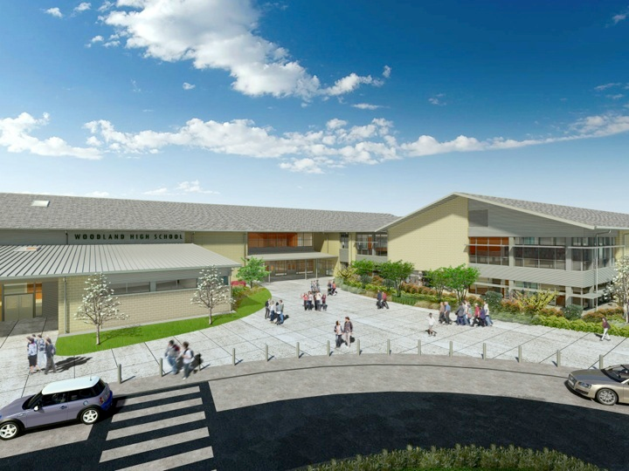
Woodland Public Schools
Facilities and Safety Report
January 2022

Slide 2
Facilities Report
ShakeAlert - The Pacific Northwest Seismic Network is a collaboration between the University of Washington, the University of Oregon, and the United States Geological Survey. They are developing and implementing the ShakeAlert Earthquake Early Warning system to immediately warn the public when a damaging earthquake starts to occur. The system rapidly detects a strong earthquake using the nearest sensors, determines the magnitude and location, and immediately sends out an alert before the destructive shaking has time to reach most of the public. This provides up to tens of seconds of warning before intense shaking hits, allowing people to take cover, drivers to pull over, tunnels and drawbridges to stop traffic, hospitals to pause surgeries, and gas valves to close. WSD volunteered to be part of this program, and our unit was installed at NFES during the holiday shutdown in late December.
HVAC Upgrades -We are waiting on the final revised proposal from Trane, and then we are ready to submit to OSPI for the HVAC upgrades. This project has many facets including, infection control, filtering improvements, environmental mitigation, asset reliability and outside air enhancements. The bulk of the equipment upgrades will occur at WMS and the Yale school with, essentially, a complete replacement of the existing equipment. All of the schools will also receive equipment to clean and purify classroom air streams.
Staffing Issues – The last facility report emphasized the struggle we had filling vacancies in our department. In the last few months, we have added some incredible new employees to our team that are already showing great potential in the execution of their duties. We are very excited to welcome Karissa, Lee, John, Jimmy, and Richard to our team! Further complicating our custodial shortage, we have also been without our maintenance technician for eight (8) weeks. Daniel Blottenberger is subbing in this position and has been doing a phenomenal job keeping up with District work orders and maintenance tasks around the District with the help of the entire team.

Slide 3
Facilities Report continued
Final repairs were made to the Business Portable and only exterior paint remains. All of the support blocks were aligned, doors trued up, exterior framing and siding were replaced, and a section of the ADA access ramp that was heavily damaged was also replaced.
Last but certainly not least…..we are very excited to see the COVID infection rates continue to fall. As the infection rates fall, we will evaluate the restrictions and work with local, state and federal agencies in removing these restrictions as soon as it is safe to do so. We are all looking forward to a more “normal” school setting. Some of these restrictions include:
  Attestations
  Lunchroom seating
  Physical distancing
  Masks and shields
  Sports restrictions
  Drinking fountains
  Additional cleaning
  Locker usage
  Classroom arrangements

Slide 4
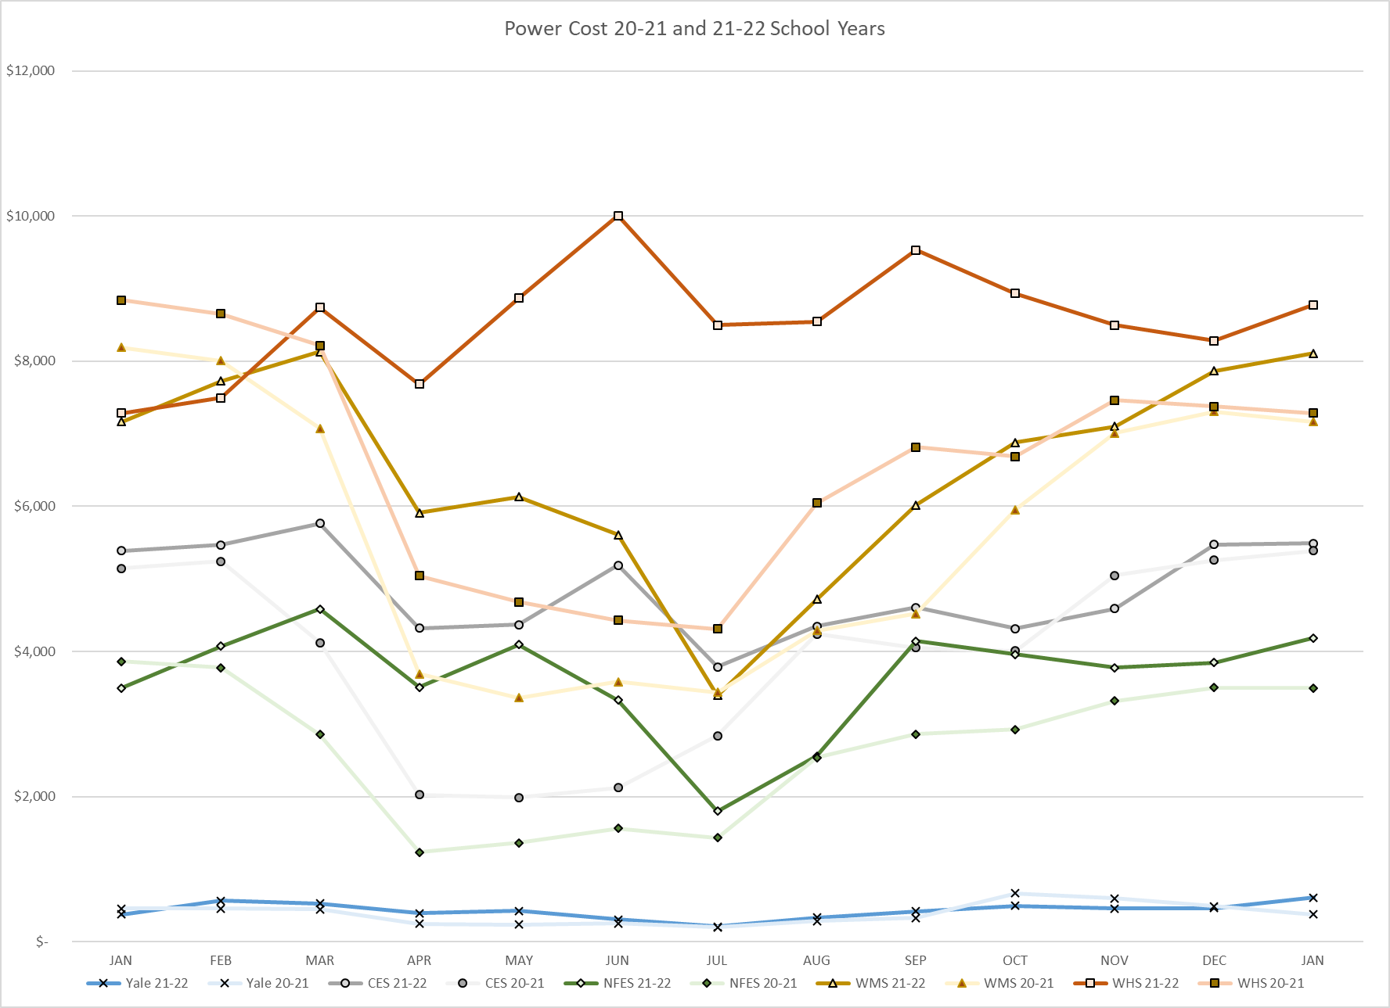
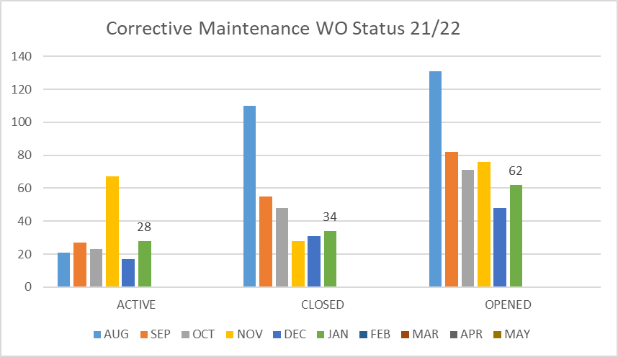
FACILITY CHARTS – POWER COST AND WORK ORDER STATUS

Slide 5
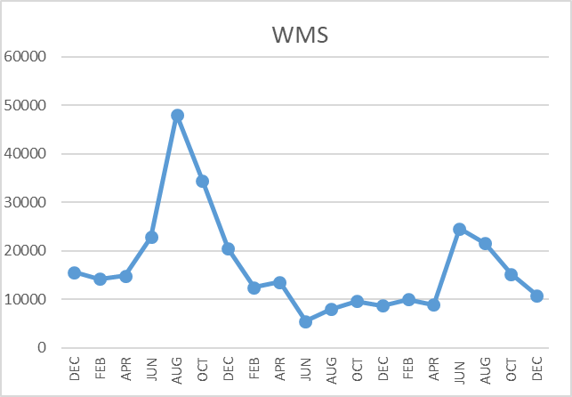
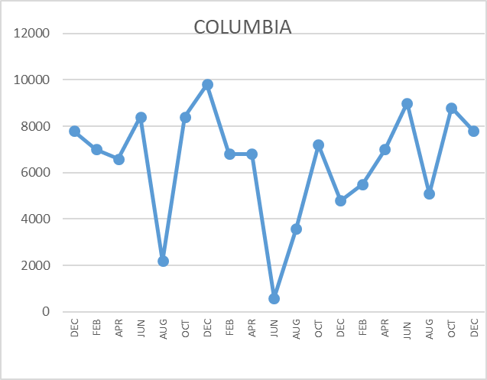
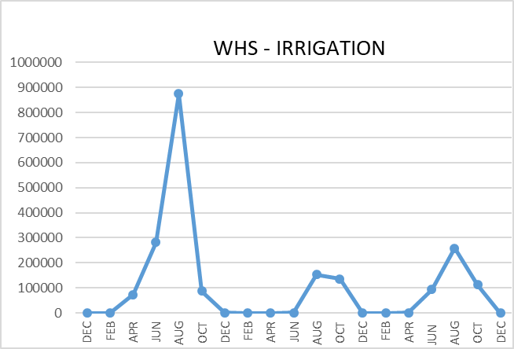
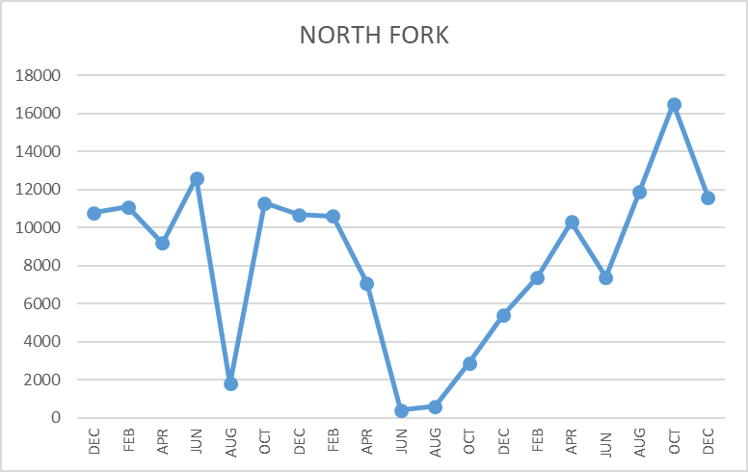
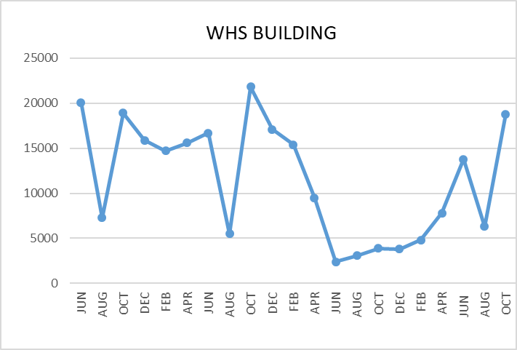
FACILITY CHARTS WATER USAGE
WHS, NFES, WMS, CES
Note
Water charts are updated every two
months. Next update to these charts in the March 2022 report
The WMS chart includes the following 7 meters: 755 Park high and low flow, BO and Team High, PIT house, bus barn, athletic field and DO. All of these meters are totaled on the WMS graph, but each data point is recorded separately to aid in identifying leaks.

Slide 6
Safety Summary
Staff Accidents/Incidents
WMS – Employee slipped on ramp at trash can, hit head on ramp, bruise.
WMS – COVID outbreak in classroom, entire classroom quarantined.
NFES – Employee tripped over student bench, bruised leg.
CES – Employee strained back moving tables.
Student Accidents/Injuries
NFES – Student swinging on bar, hit chest, pain in both arms.

