Slide 1
Bond Refunding Briefing January 27, 2022
Serving

Slide 2
Discussion Topics
Bond Market Update
Bond Refunding Goals
Preliminary Refunding Results
Key Decision Points and Next Steps

Slide 3
I Bond Market Update
While there is recent upward pressure on interest rates, municipal bond interest rates remain near the lowest point in history.
This is still a very good time to refinance eligible bonds to provide savings to District taxpayers.
Volatility warrants prudent planning.

Slide 4
II Refunding Goals
Evaluate and potentially refund the District’s 2012 UTGO Bonds, if a refunding would result in significant interest savings for taxpayers
Tax-exempt bonds – this is the first opportunity to refund this issue using tax-exempt bonds under current Federal tax laws
Minimum present value savings of 3.00% of the bonds being refunded
Target savings to meet District goals
Minimize savings in 2022 to manage Debt Service Fund Balance
Update that credit rating from Moody’s Investors Service
Current rating “A1”
Participate in the Washington State School District Credit Enhancement Program (“State Guarantee Program”)
Current rating “Aaa”

Slide 5
III Preliminary Refunding Results
Refunding Bond Candidates
Bonds Issued: | 2012
Principal Amount of Refunding Candidates: | $22,100,000
Callable Maturities: | 2022-2036
Average Coupon: | 3.47%
Call Date: | 6/1/2022
Projected Refunding Results
Date of Analysis | 1/20/22
Dated Date of Refunding | 5/17/2022
Interest Rates | Current
Maturities Included | All
Principal Amount of New Bonds | $19,040,000
Final Maturity | 12/1/2036
True Interest Cost | 1.81%
Total Savings – Net of costs | $3,338,882
Present Value of Savings as % of Old Bonds | 13.46%

Slide 6
IV Key Decision Points and Next Steps
Date | Event | Responsibility
January | Finalize bond sale goals | District, FA, UW
January February | Develop legal and other documents | District, BC, UW, FA
January 27 | Brief Board on refunding plan | District, FA
February 24 | Board consideration of Bond Resolution | District, BC
March 25 | Conference call with rating agency | District, FA
April 26 | Financing Team commences bond sale if refunding goals may be met Update Board on results | District, FA, UW, BC District, FA
May 17 | Bond closing | BC, UW
FA: Financial Advisor BC: Bond Counsel UW: Underwriter

Slide 7
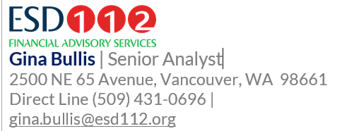
Contact Information:

