Slide 1
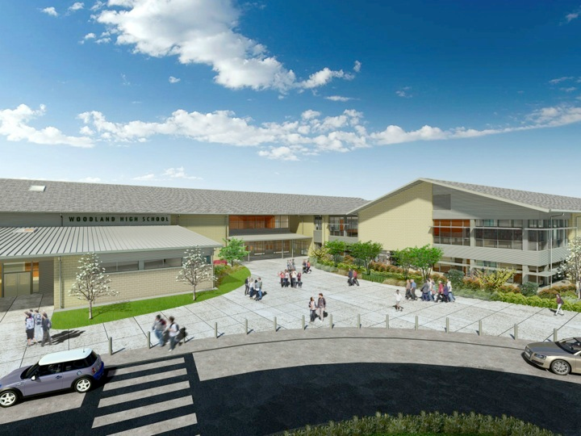
Woodland Public Schools
Facilities and Safety Report
November 2021

Slide 2
Facilities Report
Although slightly improved from the last report, staffing continues to be an issue. We are currently three custodians short across the District and are currently filling this loss with overtime and subs, when available. We have had requisitions open since September, with only two potential fills.
An unusual odor in portable P2 at NFES required us to temporarily move the students and teacher to a different classroom. Air samples were taken by PBS Environmental to rule out volatile organic compounds (VOC’s) and airborne fungal and nonfungal particulate. Measured VOC and particulate levels and (fungal and nonfungal) reflected a well-functioning HVAC system without any obvious problems. Further investigation revealed a small hole in the roof originating from a branch. Rainwater entered into the cellulose insulation, which created the “wet paper” odor.
We will be meeting with OSPI this week to understand the process moving forward for the HVAC upgrades at all schools. This is potentially a very promising project that will modernize and improve the District’s HVAC systems from a performance and reliability standpoint. The four areas include;
  Infection control
  Filtering improvements
  Reliability improvements
  Outside air and air exchange improvements
On December 8, a young driver lost control of her vehicle around midnight and struck the business portable with enough force to knock over computer screens and other items in the building. There is minor damage to the entire structure, but some alignments and repairs need to be made to the building and access ramp.

Slide 3
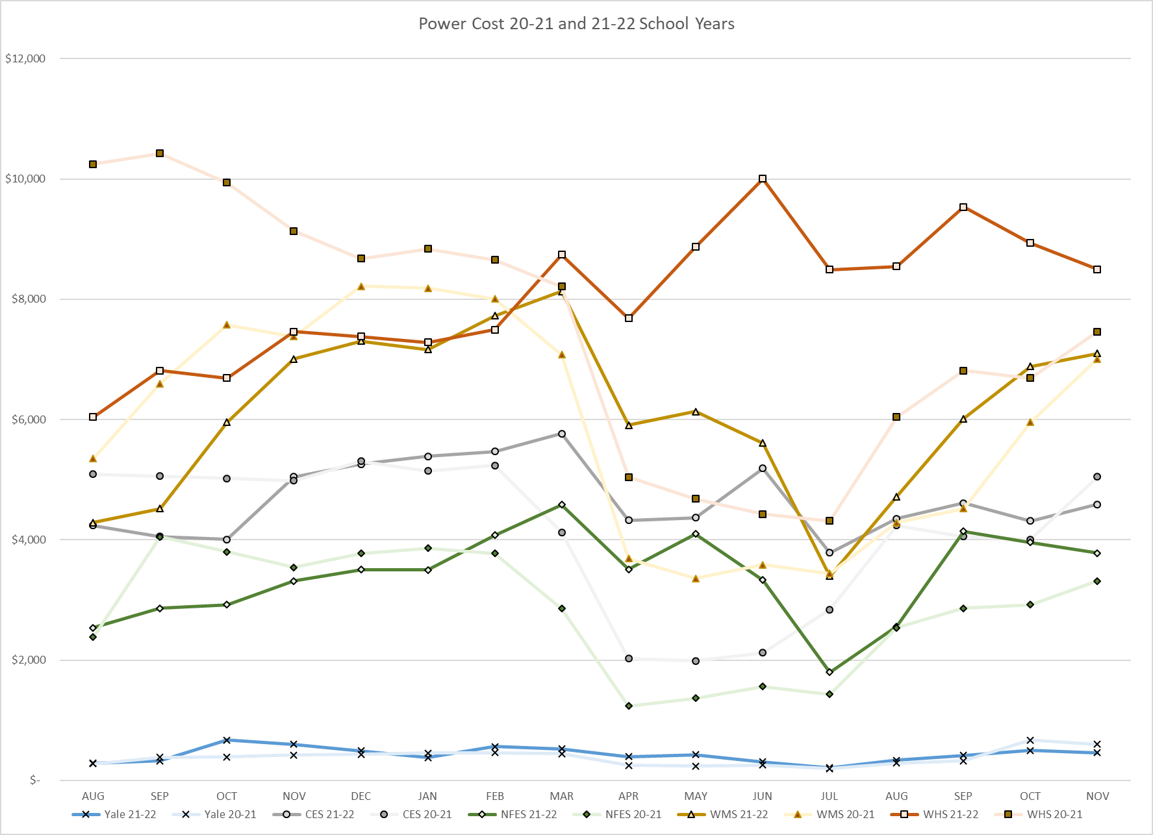
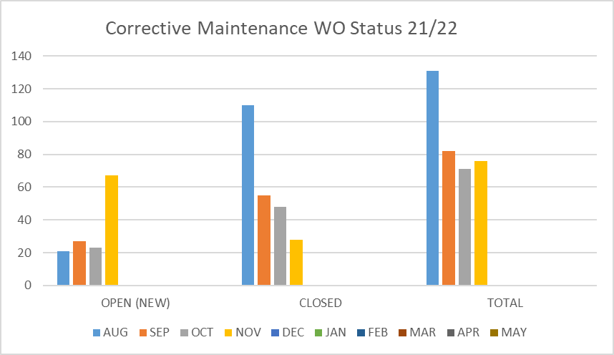
FACILITY CHARTS – POWER COST AND WORK ORDER STATUS

Slide 4
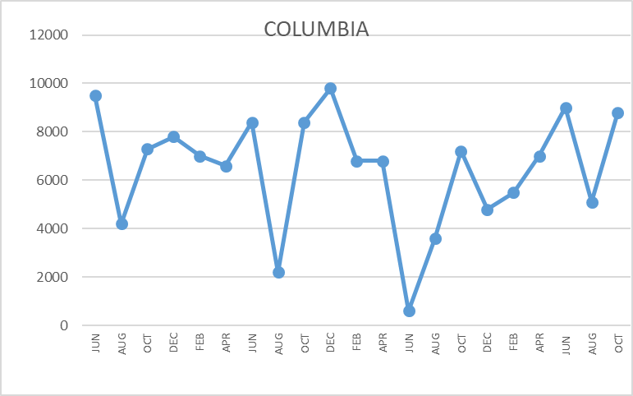
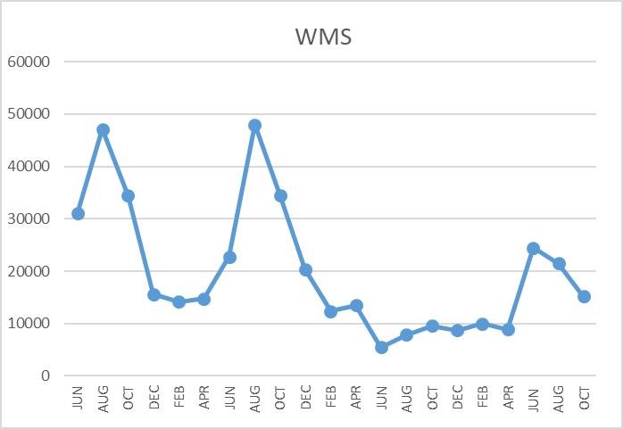
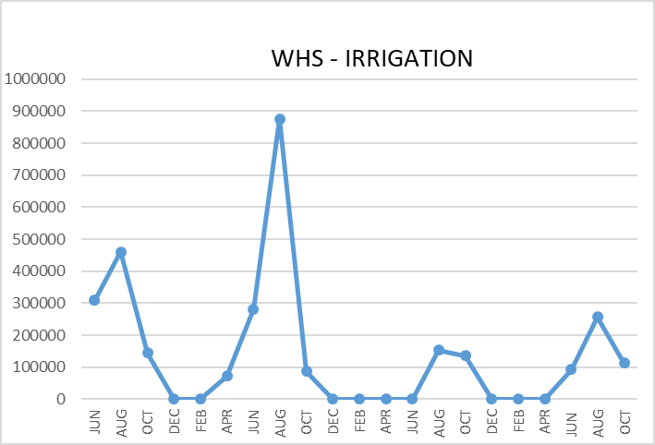
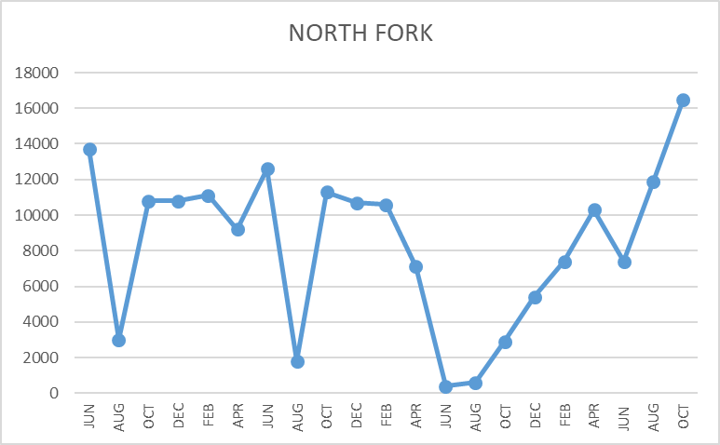
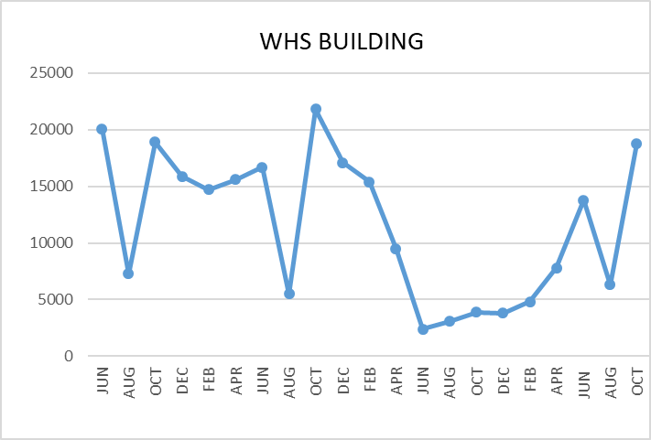
FACILITY CHARTS WATER USAGE
WHS, NFES, WMS, CES
Note
Water charts are updated every two
months. Next update to these charts in the December 2021 report
The WMS chart includes the following 7 meters: 755 Park high and low flow, BO and Team High, PIT house, bus barn, athletic field and DO. All of these meters are totaled on the WMS graph, but each data point is recorded separately to aid in identifying leaks.

Slide 5
Safety Summary for October and November
Staff Accidents/Incidents
Yale – Para Pro got cleaning chemical in eye, resulting in eye irritation.
NFES- Escalated student threw stapler at employee, struck jaw received bruise.
NFES – Escalated student punched employee in the chest, resulting in a strain.
NFES – Escalated student kicked employees leg and threw object creating a blood blister.
NFES – Employee stepped on rock and twisted ankle while entering the building.
CES – Escalated student kicked employee in the elbow, creating a bruise.
Student Accidents/Injuries
NFES – Student standing on chair, fell off and struck back.
NFES – Student fell off uneven bars, chipped tooth and contusion under eye.
CES – Student fell off play structure hit head, released to parent for observation.

