Slide 1
WOODLAND SCHOOL DISTRICT 2020-2021 YEAR END FINANCIAL SUMMARY
Presented by:
Stacy Brown
Exec Director of Business Services

Slide 2
Historical Fund Balance Summary
History of total fund balance at year-end and the percentage of budgeted expenditures
Year Ended | % of Expenditures | Budget | Total Fund Balance
2014 | 11.8% | $ 23,652,108.00 | $ 2,785,917.00
2015 | 11.4% | $ 25,016,430.00 | $ 2,842,390.00
2016 | 9.5% | $ 28,233,915.00 | $ 2,676,560.00
2017 | 9.1% | $ 30,270,375.00 | $ 2,764,560.00
2018 | 7.9% | $ 33,573,646.00 | $ 2,636,629.00
2019 | 7.2% | $ 37,468,437.00 | $ 2,695,935.00
2020 | 9.9% | $ 40,114,208.00 | $ 3,953,697.00
2021 | 10.6% | $ 42,894,083.00 | $ 4,542,036.00

Slide 3
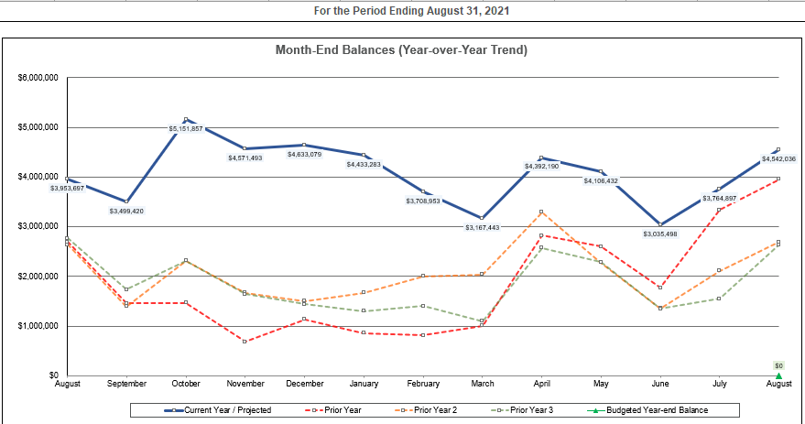
Monthly FB Summary

Slide 4
Fund Balance/Enrollment
 | August 31, 2021 | August 31, 2020
Total Ending Fund Bal – NEW 19-20 (SF0/SF1) | $4,542,036 $2,859,880/$1,682,156 | $3,953,697 $2,769,175/$1,184,523
Restricted for Pgm Carryover | $ 0 | $ 2,714
Nonspendable for Prepaid Exp | $ 190,879 | $ 218,073
Assigned for Building/Dept CO | $ 304,918 | $ 243,020
Unassigned Fund Bal | $4,046,239 | $3,489,890
Unreserved FB Increase 19-20 to 20-21 | $ 556,349 | $1,412,271
Budgeted Inc/(Dec) in FB | ($ 259,219) | ($ 213,031)
Actual Inc/(Dec) in FB | $ 588,339 | $1,257,763
Budgeted Enrollment | 2,366.00 | 2,406.00
Actual Enrollment | 2,291.39 | 2,387.68

Slide 5
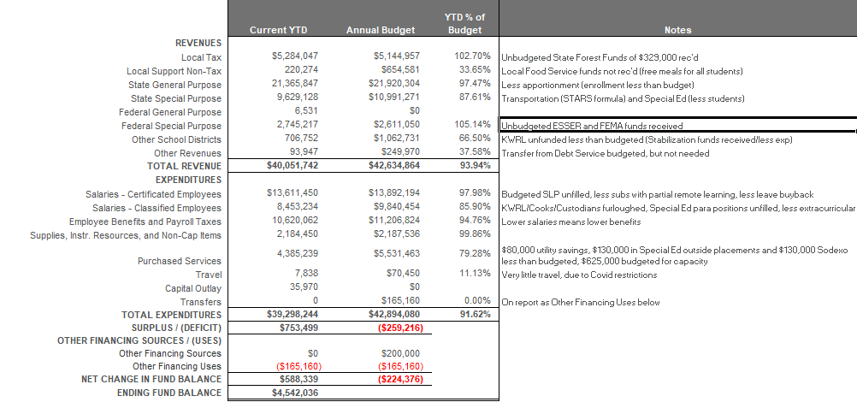
GF Financial Summary-YTD % of Budget

Slide 6
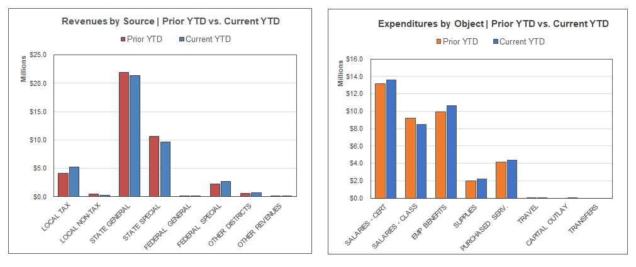
Revenues/Expenditures By Object, Compared to Prior Year (does not include transfers)

Slide 7
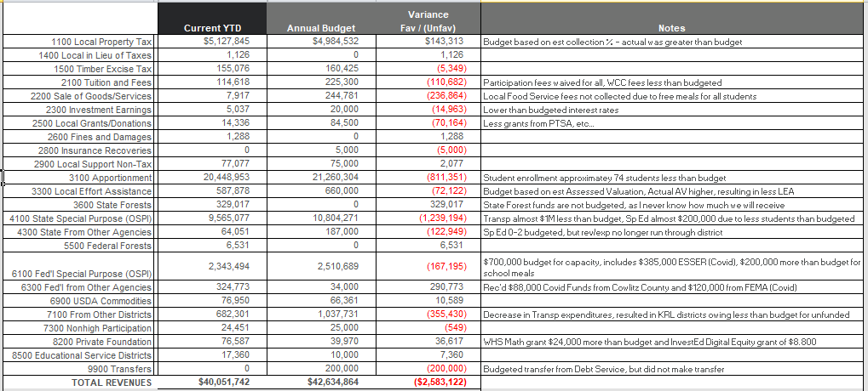
Detail Revenues Compared to Budget

Slide 8
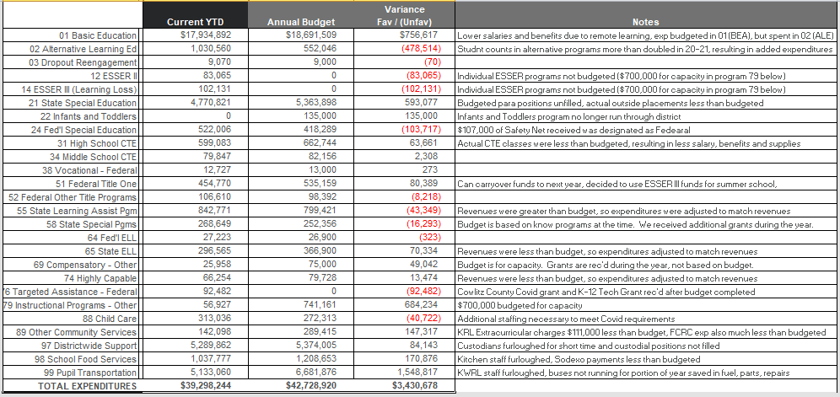
Detail Expenditures Compared to Budget

Slide 9
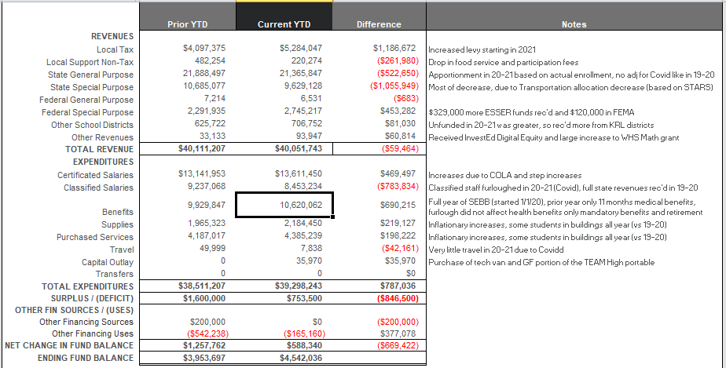
GF Financial Summary Comparison to Prior Year

Slide 10
Levy/Local Dollars
Expenditure Type | Levy Dollars 2020-2021 | Levy Dollars 2019-2020
Certificated Salaries | $ 675,000 | $ 701,000
Classified Salaries | $1,458,000 | $1,293,000
Administrator Salaries | $ 452,000 | $ 170,000
Benefits | $1,042,000 | $ 916,950
Supplies/Services/Travel/Utilities/Insurance | $ 780,000 | $ 71,000
Extracurricular | $ 486,000 | $ 541,000
Special Education | $ 419,000 | $ 287,000
Food Service Program | $ 99,000 | $ 206,000
To/From Transportation/Bus Purchase | $ 355,000 | $ 279,000
Daycare | $ 86,000 | $ 64,000
Family Resource Center | $ 2,000 | $ 6,000

Slide 11
Transportation & Food Service
Transportation
Food Service
Total Students transported = Approx 4,000 Basic average per day and 300 Special Ed/Homeless per day average (for only part of the year, depending on the district)
Total Expenditures (inc Utilities) = $5,187,000
Total Revenues = $4,577,000
Total Unfunded = $610,000 Budgeted unfunded plus utilities was $1,096,000.
District received funds from other districts based on budgeted unfunded through April. This resulted in $121,000 total received, greater than the annual costs. This will be carried forward into 21-22 (decreasing what the districts owe for next year).
Woodland’s portion of unfunded plus CPF Transfer is $355,000, which represents 36.11% ownership of the Co-Op (using 19-20 hours/miles until we have a full normal Transportation year)
Due to the pandemic, the Summer Food Service Program was run for the entire year. This means that meals were served free of charge to all students all year.
We continued delivery to homes through the end of February (during hybrid) and through mid-April (Mondays only). We also served at the buildings when the students returned and also had pick-up available at WMS all year.
The traditional summer program (pick up at WMS only) was run in July and August.
Because all meals were free and we continued with delivery, district participation increased. We served an average of 480 breakfasts and 760 lunches per day.
Sodexo Guarantee was ($256,750) and the actual for this year was ($98,650). This means that the guarantee was met. This did not include the driver and bus costs of delivering (approx $75,000)as we were allowed to keep these costs in program 99 and they kept some of the driver employed when we weren’t providing to/from transportation.

Slide 12
Before and After School Care
The WCC and YCC programs add opportunities for parents and students in a small community without many daycare options for families
Programs served about 130 families throughout the year and also provided summer care. Although the schools were closed at the beginning of the school year, WCC was open all year. They also extended their hours to provide service to families during the school day so that students had a place to go during hybrid learning on their days off.
WCC program is licensed by the state and able to provide options for low income families
Daycare programs ran at a loss of $86,000. Last year they had a loss of $64,000. With the extended hours and additional staffing, we were thankful for $58,000 in grants from the Cowlitz Tribe and DSHS to help cover the additional costs.
The program continues to provide an important service in a community with very little daycare available and providing convenience for parents (now at both schools). WCC was a great help to families this year as they continued to provide before, after and full-day care during remote and hybrid learning.

Slide 13
Other Funds
Capital Projects
Debt Service
ASB
Transportation vehicle

Slide 14
Capital Projects Fund
Beginning Fund Balance $ 777,272
Revenues/Other Fin Srce $ 478,704
Expend/Other Fin Uses $ 585,739
Ending Fund Balance $ 670,237
Expenditures were for the completion of the WMS water project (state grant), the KWRL tank project and the TEAM High portable. Total Fund Balance is made up of $223,487 in Impact Fees, $94,940 Designated for Future Capital Projects, and $351,810 for KWRL projects.

Slide 15
Debt Service Fund
This fund is used to collect tax revenue and pay the principal and interest on bonds. Payments are made twice a year, December and June.
 | Debt Balance 9/1/20 | Debt Issued/ Increased | Debt Redeemed/ Decreased | Debt Balance 8/31/20
Voted Debt | $48,990,000 | $ 0 | $ 1,300,000 | $47,690,000
Pension Liability** | $11,576,115 | $ 0 | $ 9,746,206 | $ 1,829,909
Compensated Absences** | $ 656,746 | $ 0 | $ 26,123 | $ 630,623
Total | $61,197,158 | $ 0 | $11,072,329 | $50,150,532
** Required to be reported, per accounting rules. Not debt owed.
Amount available for principal/interest at August 31, 2021 = $1,430,000

Slide 16
ASB FUND
ASB funds are for the extracurricular benefit for the students. Their involvement in the decision-making process is an integral part of associated student body government.
Beginning Fund Balance $257,528
Revenues $ 56,761
Expenditures $ 57,978
Ending Fund Balance $256,311

Slide 17
TRANSPORTATION VEHICLE FUND
This fund is used to replace buses. Revenue comes from the State (in the form of depreciation payments), interest earned on the investments and the annual levy payments made by the for Co-Op districts (district payments for 20-21 were made to the Capital Projects Fund).
Beginning Fund Balance $3,146,340
Revenues $ 738,428
Expenditures $1,420,397
Ending Fund Balance $2,464,371

