Slide 1
Woodland Public Schools
Facilities and Safety Report
September 2021

Slide 2
Facilities Report
Staffing continues to be an issue moving forward. We are currently four short (two at WHS and two at WMS) and filling this loss with overtime and subs when available. We have had requisitions open for weeks with only one potential sub.
Small smoldering fire in the early morning hours at NFES. Source identified as burning wood chips in an aquarium housing a snake. This required a fire department response and cleaning over the weekend to remove smoke odors. The on duty custodian (Ken Knight), responded quickly which helped to minimize the potential damage.
The HVAC compressor install for the lower wing of Columbia is near completion, currently waiting for a terminal block that was damaged as a result of the failed compressor. Repairs are expected to be completed by 10/29.
Getting equipment proposals for HVAC improvements with Trane of Oregon. This equipment improves outside air exchanges and provides ultraviolet (UV) and dry hydrogen peroxide (H202) technology to kill viruses, bacteria, molds, odors, and insects.
Two water heater failures occurred during September, a small unit for Yale and a large unit for the yellow gym and locker rooms. The yellow gym water heater will be replaced with a smaller more cost effective unit aligned with current yellow gym usage.
A leak developed on the fire system in the yellow gym, resulting in rusty water spraying out near the ceiling over the top of the bleachers. The source of the leak was a rotted steel pipe that was incorrectly sloped, allowing water to pool in the joint. The pipe was replaced and piping was adjusted to drain correctly.

Slide 3
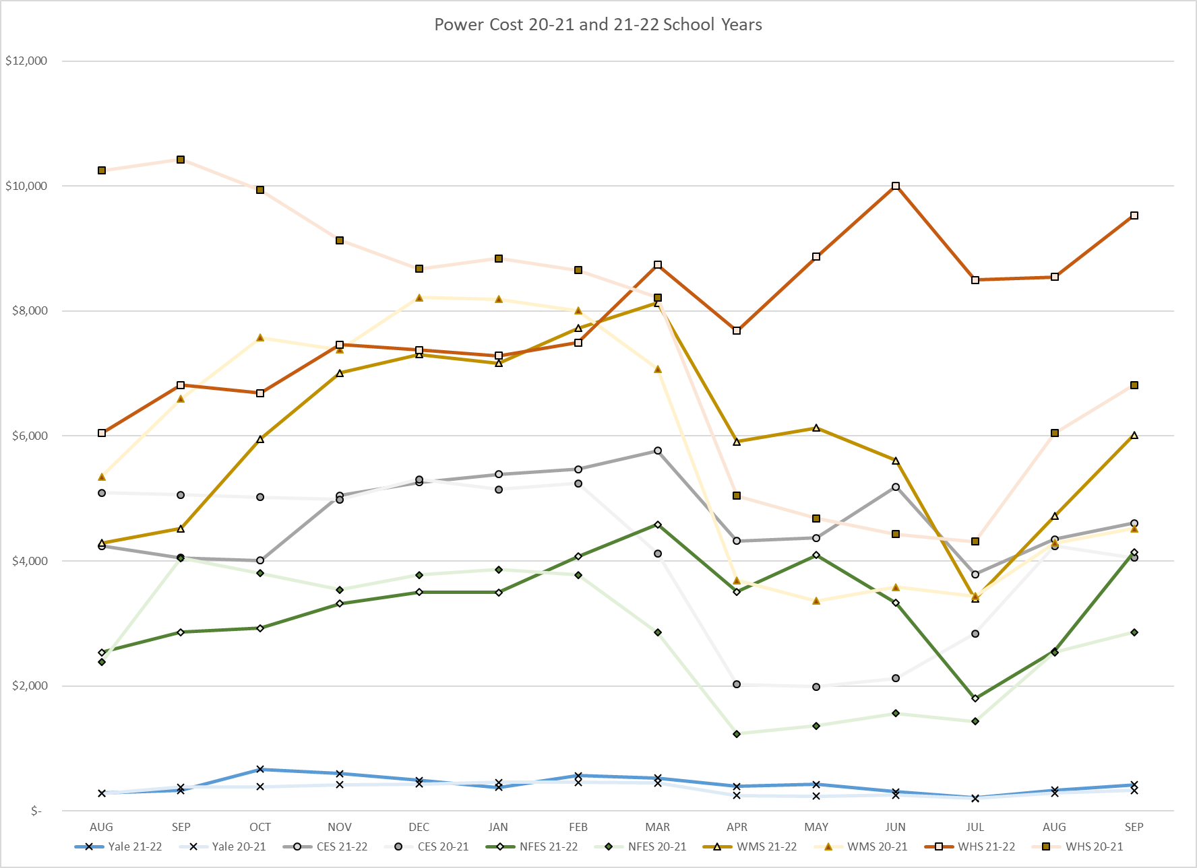
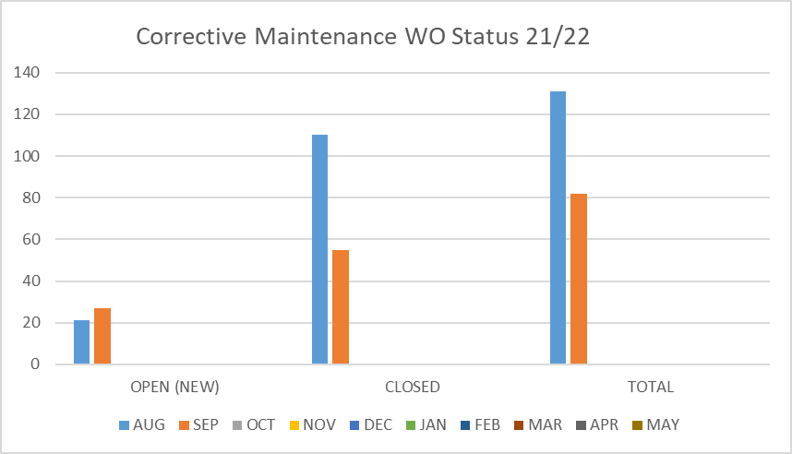
FACILITY CHARTS – POWER COST AND WORK ORDER STATUS

Slide 4
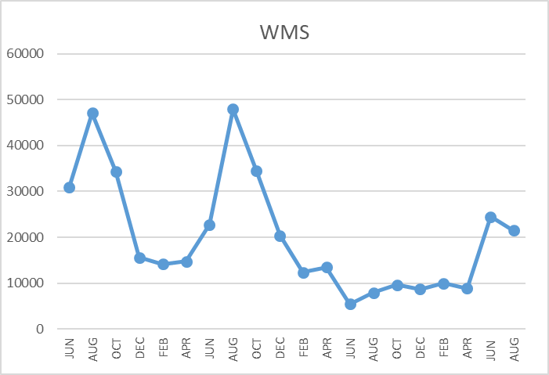
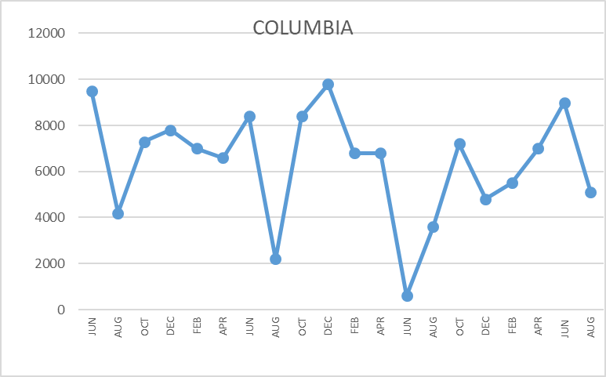
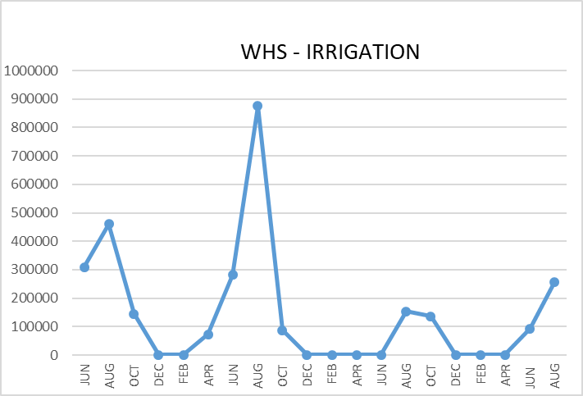
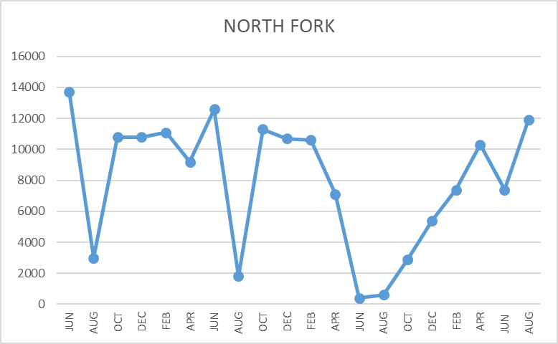
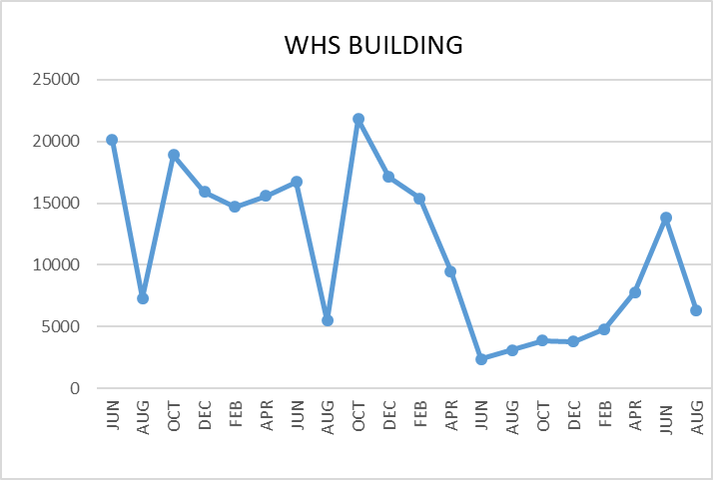
FACILITY CHARTS WATER USAGE WHS, NFES, WMS, CES
Note
Water charts are updated every two
months. Next update to these charts in the October 2021 report
The WMS chart includes the following 7 meters: 755 Park high and low flow, BO and Team High, PIT house, bus barn, athletic field and DO. All of these meters are totaled on the WMS graph, but each data point is recorded separately to aid in identifying leaks.

Slide 5
Safety Summary
Staff Accidents/Incidents
WMS – Para had accidental collision with student (bruise to heel).
WMS – Substitute teacher cut finger while cleaning scissors (minor laceration to finger).
NFES – Kitchen employee struck head on cooler rack (bruise to head).
NFES – Soccer coach was hit with a rogue ball striking her head, neck and chest (upper back pain for 1 hour).
Student Accidents/Injuries
Yale – Student fell off monkey bars landed on back (sore back and recovered quickly).
Yale – Student fell off swing, face first to ground (minor scratches and bruise).
CES – Student jumped off rock wall, and hurt his foot (fractured).
CES – Student slipped on slide, arm struck rails (fractured arm).
CES – Student was non-responsive in class, slightly responsive to sternal rub (sent to hospital and cleared).

