Slide 1
Woodland Public Schools
Facilities and Safety Report
August 2021

Slide 2
Facilities Report
The AC compressor for the lower wing of Columbia failed during the summer. The replacement compressor received was found to have a defect in the casting and is being returned to the manufacturer. Unfortunately, this will push this repair most likely into October.
Trane of Oregon will be on site next week to look at technologies and to improve classroom IAQ (indoor air quality). We had a preliminary meeting with them 9/16 to discuss emerging technologies.
Pacific Northwest Seismic Network will be installing equipment at NFES to aid in the development of an early warning earthquake system, “Shake Alert”. This project is funded by the UW.
We stocked up early on PPE at the end of last school year and through the summer. We currently have adequate supplies to support the 21—22 school year, in almost all areas.

Slide 3
Facilities Report
In addition to the scheduled deep cleaning activities in all buildings, the following significant items were completed:
New architectural composition roof installed on the P.I.T. house.
WMS commons roof coated with GE Enduris silicone roof coating.
Blacktop repairs and line stripping completed at 2 schools.
Concrete curb and sidewalk work completed at 3 schools.
Bottle fill stations and new filtered PEX drinking lines now installed at all schools.
Gutters replaced at WMS Green and Yellow Halls.
Carpets replaced in several classrooms at CES and WMS.
Covered play area NFES completely restored (LED lights and complete canopy restoration).
Removed islands in rooms 212/213 at CES.
Fire Marshal completed annual inspection of the schools.

Slide 4
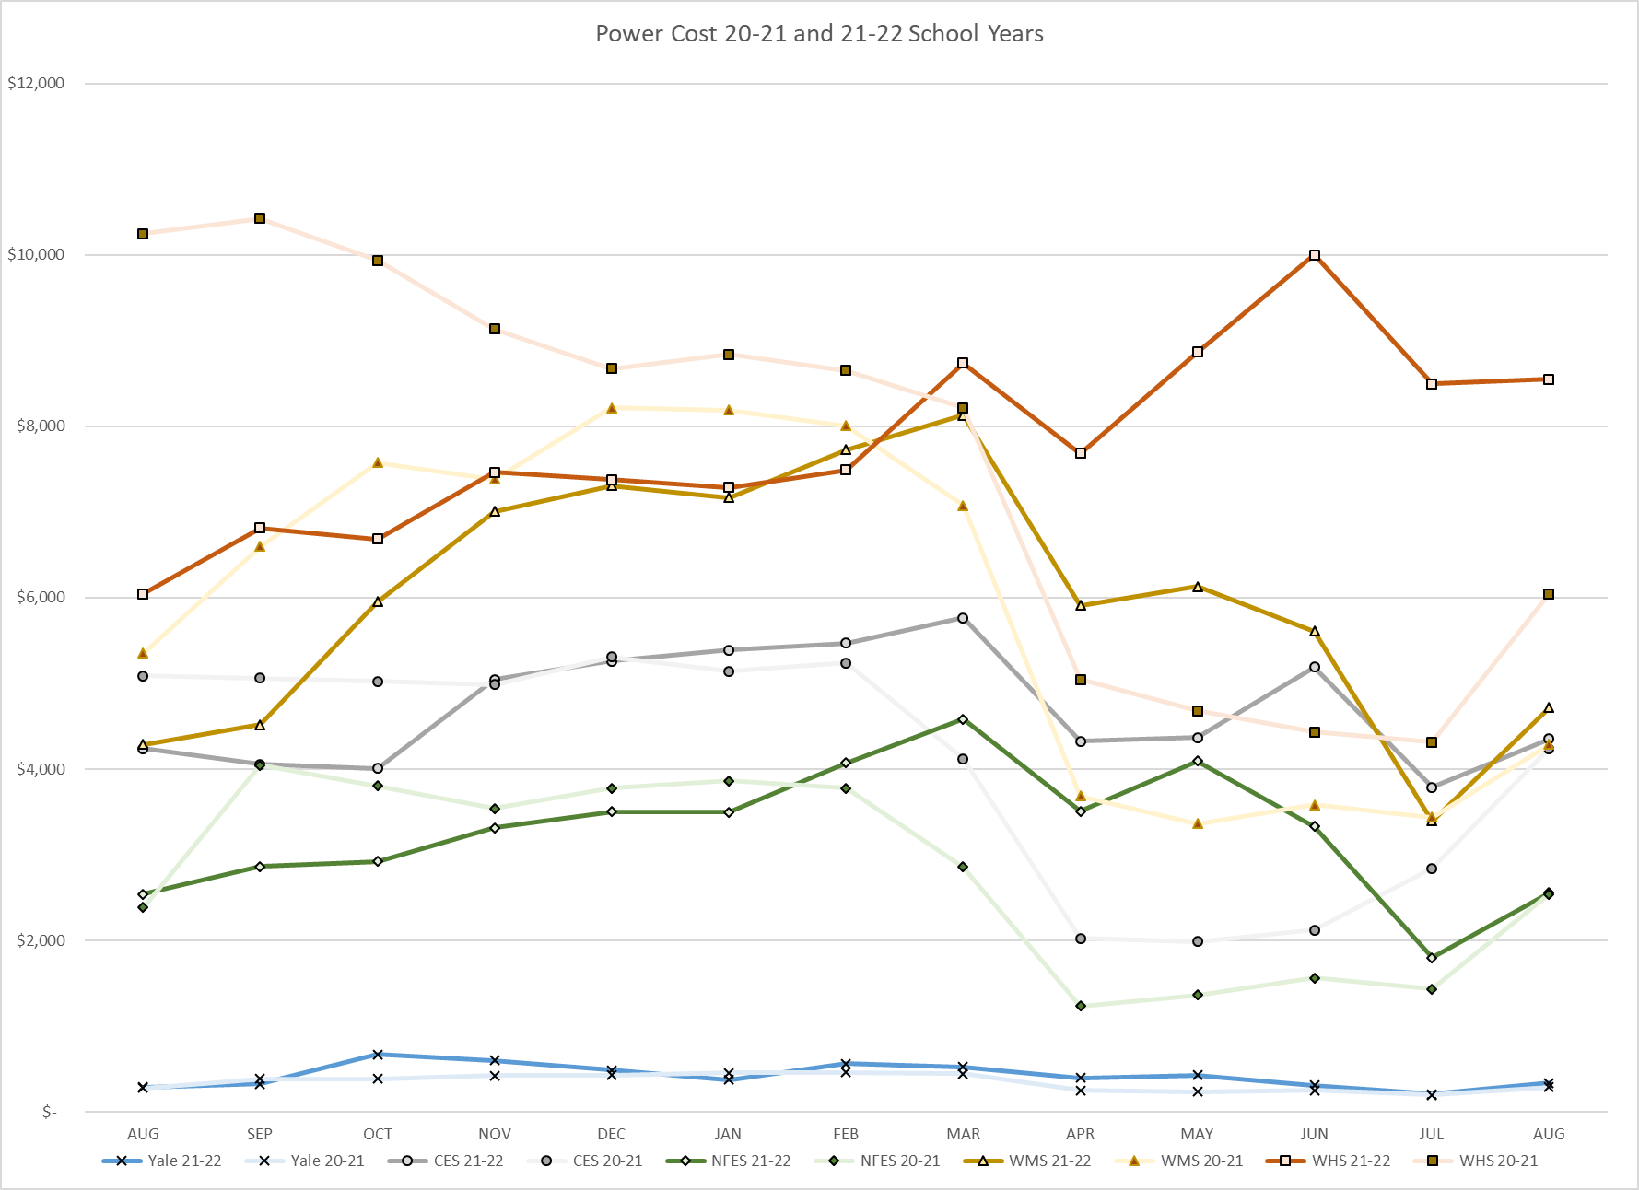
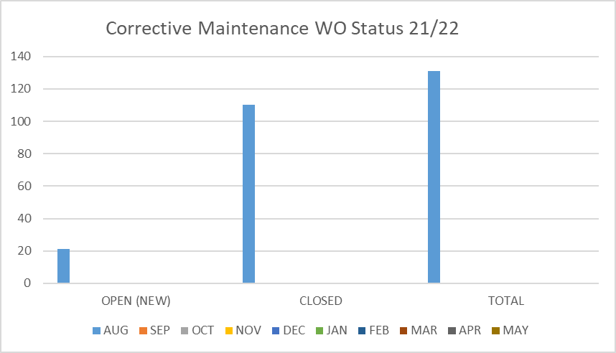
FACILITY CHARTS – POWER COST AND WORK ORDER STATUS

Slide 5
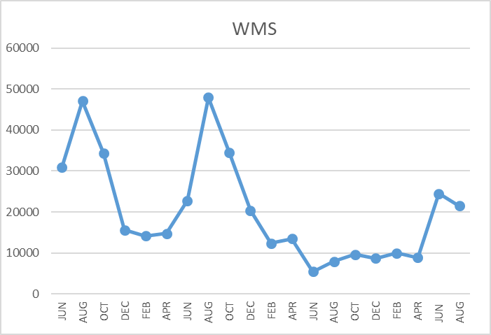
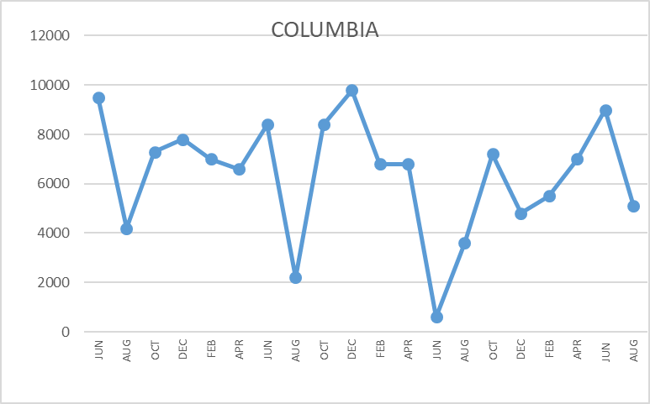
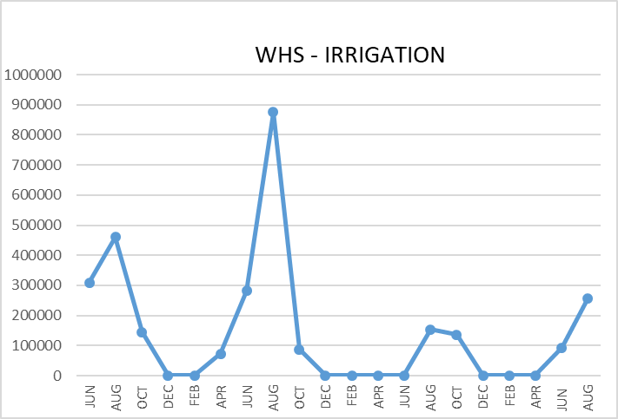
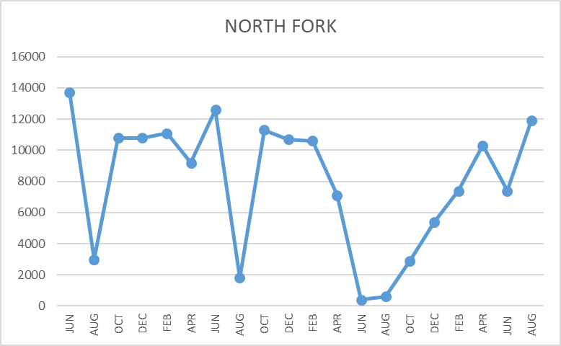
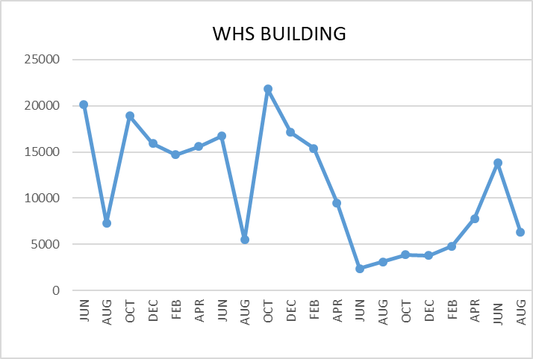
FACILITY CHARTS WATER USAGE WHS, NFE, WMS, CES
Note
Water charts are updated every two
months. Next update to these charts in the October 2021 report
The WMS chart includes the following 7 meters: 755 Park high and low flow, BO and Team High, PIT house, bus barn, athletic field and DO. All of these meters are totaled on the WMS graph, but each data point is recorded separately to aid in identifying leaks.

Slide 6
Safety Summary
Staff Accidents/Incidents
NFES – 8/30 teacher tripped in middle of hallway. No assignable cause. Injured knee.
Student Accidents/Injuries
No accidents reported (only 1 school day in this August report).

