Slide 1
July 2021 Financial Report
Board Meeting – August 25, 2021

Slide 2
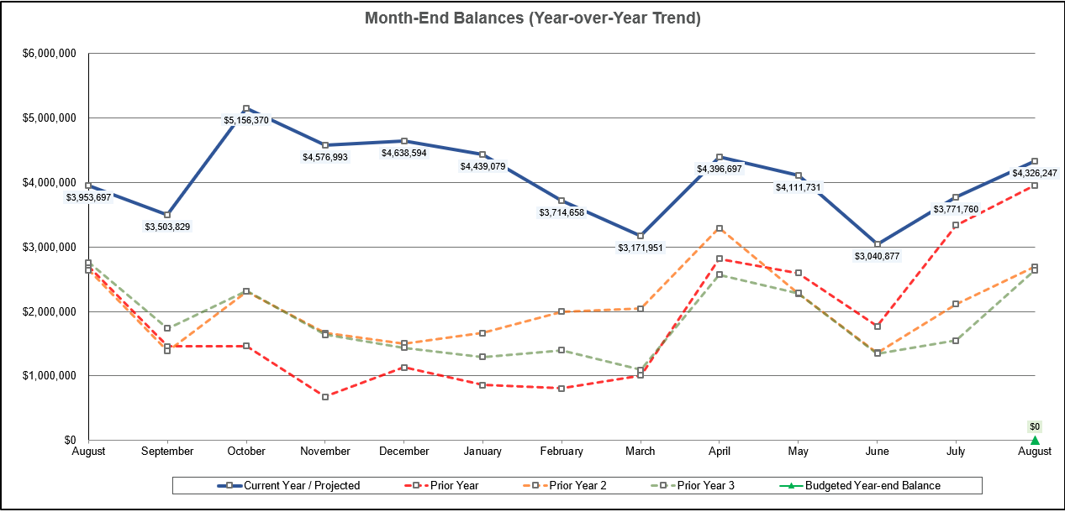
Month-End Fund Balances – Actual and Projected (through 8/31/21)

Slide 3
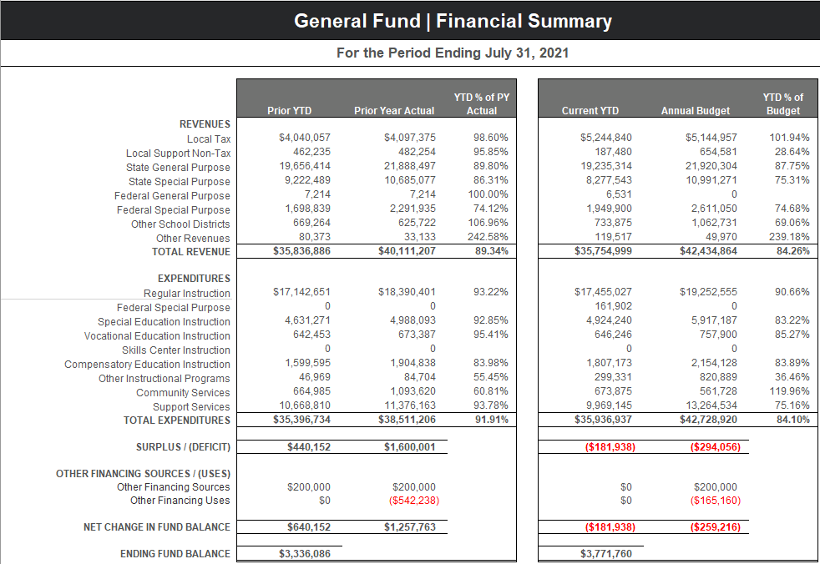
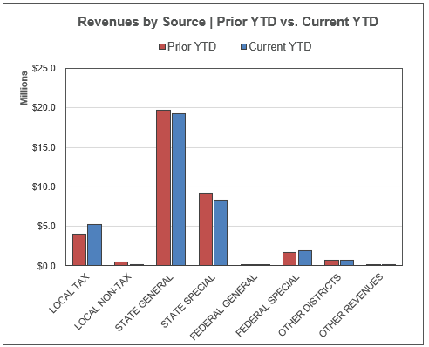
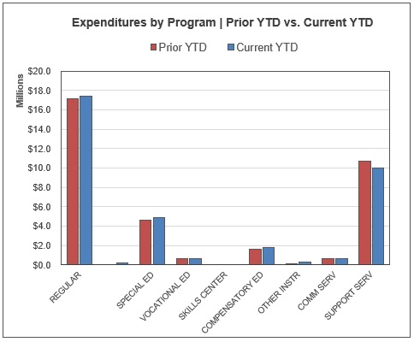
General Fund – Prior YTD and Current YTD Comparison

Slide 4
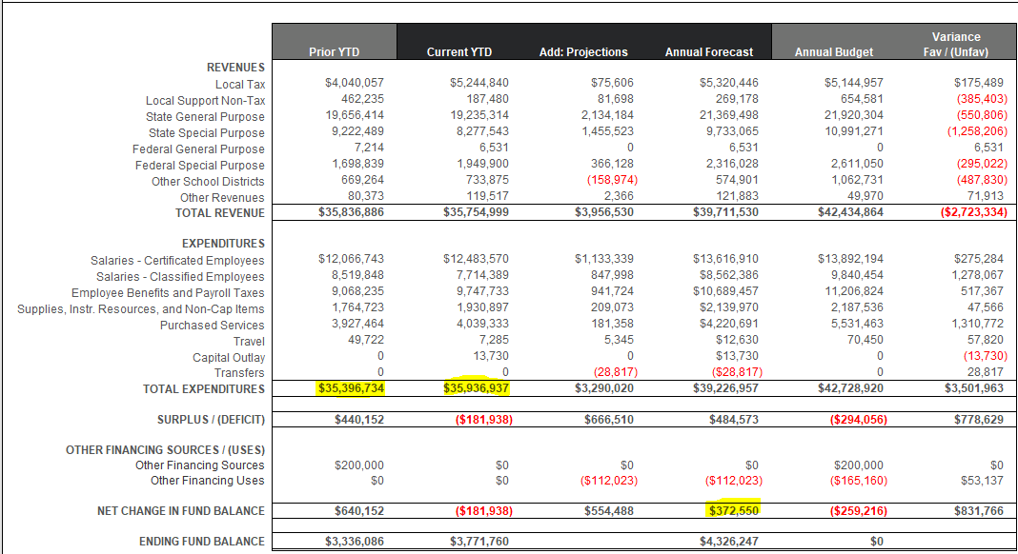
Financial Forecast – Actual thru 7/31/21 and Projections thru 8/31/21

Slide 5
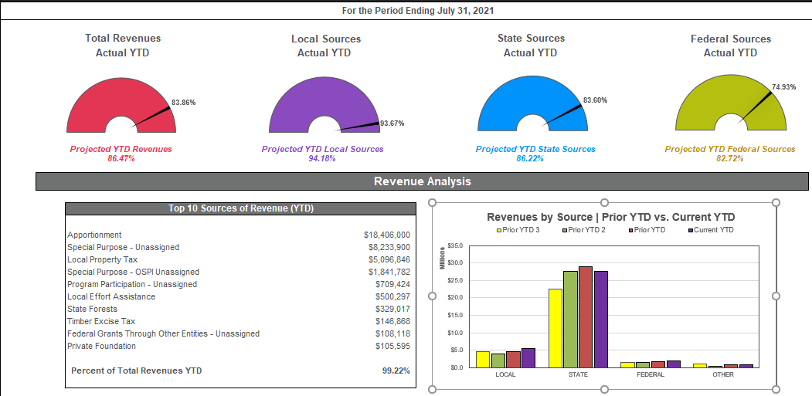
General Fund Revenue Summary

Slide 6
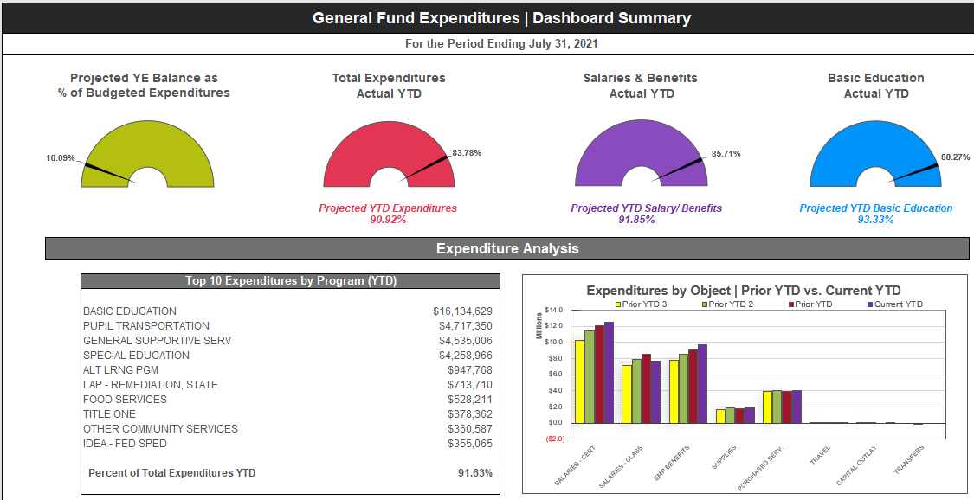
General Fund Expenditure Summary

Slide 7
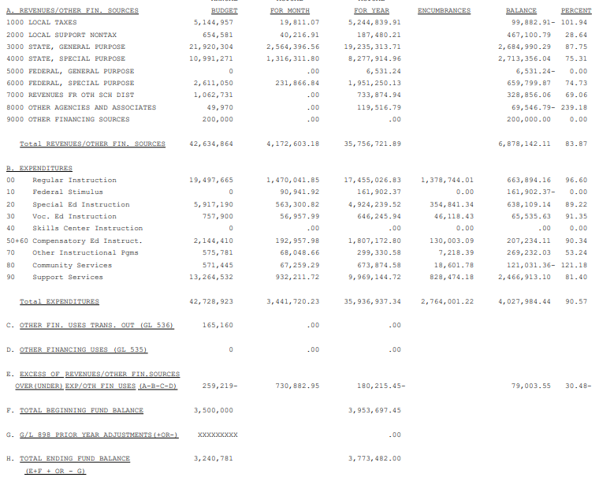
July 2021 Budget Status Report – General Fund

Slide 8
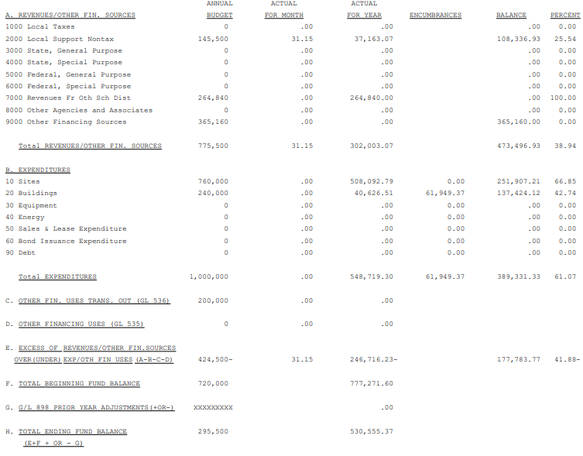
July 2021 Budget Status Report – Capital Projects Fund

Slide 9
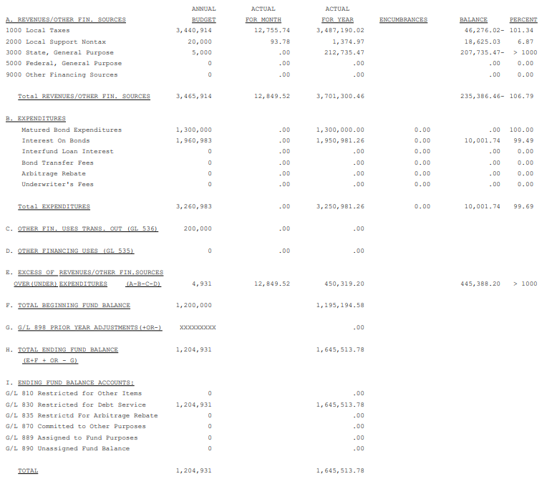
July 2021 Budget Status Report – Debt Service Fund

Slide 10
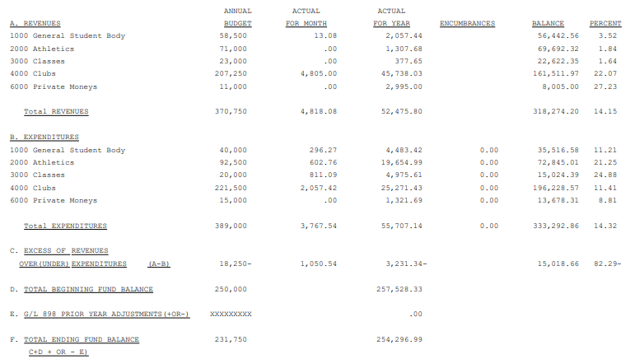
July 2021 Budget Status Report – ASB Fund

Slide 11
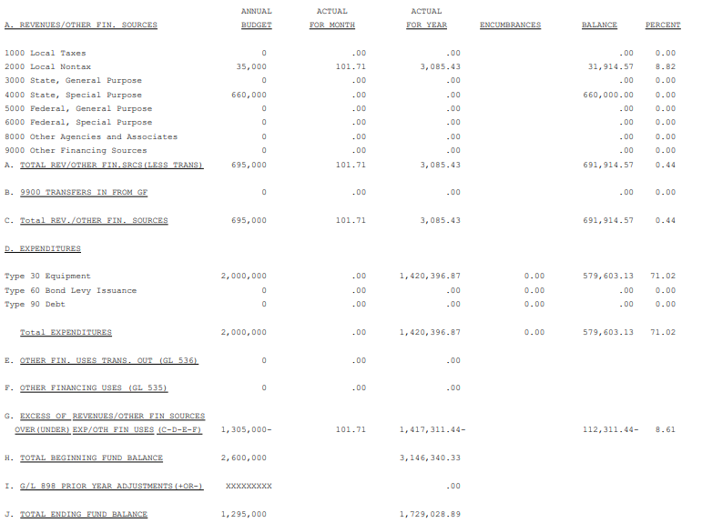
July 2021 Budget Status Report – Transportation Vehicle Fund

