Slide 1
Woodland School District
2021-22 BUDGET APPROVAL
Presented by:
Stacy Brown
Executive Director of Business Services
August 25, 2021

Slide 2
GENERAL FUND
Beginning Fund Balance $ 4,500,000
Revenues/Other Financing Source $ 43,663,277
Expenditures $ 43,998,820
Other Financing Uses $ 158,265
Ending Fund Balance $ 4,006,192

Slide 3
Enrollment History – Budget to Actual
Actual enrollment for 20-21 is 82 students less than budget. The estimated enrollment for 21-22 is 68 students less than the 20-21 budget and only 14 students more than the 20-21 actual average FTE.

Slide 4
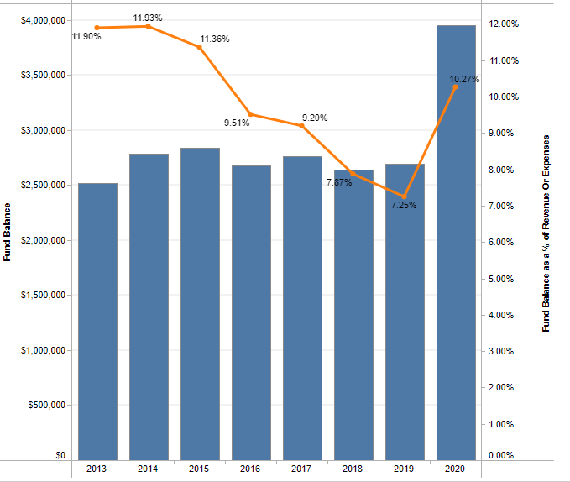
21-22 Budget
Historical Fund Balance/FB as a % of Expenditures Summary
This slide shows a history of actual ending fund balance and historical FB as percentage of expenditures. We often budget a decrease in FB, but if you look at the historical year-end FB, you see that we have increased FB in each of the past 2 of the past 3 years. Due to the pandemic, 20-21 is projected to have another increase in Fund Balance (between $500,000 and $600,000), with a % of 10.6% The projected increase in fund balance allows us to budget a much higher deficit than in past years ($494,000), while still maintaining a fund balance that is approximately 9.7% of expenditures.

Slide 5
Uses of Levy/Enrichment Funds
Expenditure Type | Enrichment Funds 2021-2022
Certificated Salaries | $ 890,000
Classified Salaries | $1,732,000
Administrator Salaries | $ 567,000
Benefits | $1,050,000
MSOCS (Maerials/Supplies/Operating Costs) | $ 150,000
Extracurricular | $ 660,000
Special Education | $ 630,000
Food Service Program | $ 105,000
Family Resource Coordinator | $ 10,000
To/From Transportation | $ 361,000
KWRL Bus Purchase/Capital Allocation | $ 118,000

Slide 6
CAPITAL PROJECTS FUND
Beginning Fund Balance $ 690,000
Revenues/Other Financing Source $ 342,000
Expenditures/Financial Uses $ 700,000
Ending Fund Balance $ 332,500

Slide 7
DEBT SERVICE FUND
Beginning Fund Balance $ 1,683,000
Revenues/Other Financial Source $ 3,537,450
Expenditures/Other Financial Uses $ 3,940,000
Ending Fund Balance $ 1,280,450
Debt Outstanding 9/1/21 = $47,670,000

Slide 8
ASB FUND
ASB funds are for the extracurricular benefit of the students. Their involvement in the decision-making process is an integral part of associated student body government.
Beginning Fund Balance $ 250,000
Revenues $ 357,250
Expenditures $ 375,500
Ending Fund Balance $ 231,750

Slide 9
TRANSPORTATION VEHICLE FUND
This fund is used to replace buses for the KWRL Cooperative districts. Revenue comes from the State (in the form of depreciation payments), interest earned on the investments and the annual payments made by the four member districts (Kalama, Woodland, Ridgefield and La Center) to cover options and buses necessary for growth. This fund is fully self-supporting with state depreciation funds.
Beginning Fund Balance $ 2,474,000
Revenues $ 1,070,000
Expenditures $ 2,000,000
Ending Fund Balance $ 1,544,000

Slide 10
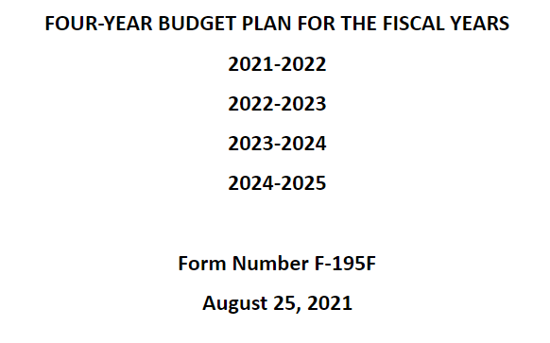
4-YEAR BUDGET

Slide 11
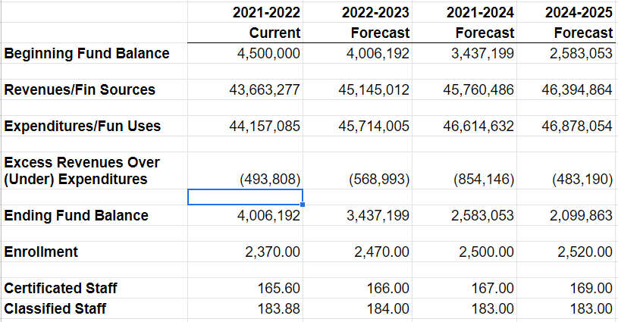
4-YEAR BUDGET – GENERAL FUND SUMMARY

Slide 12
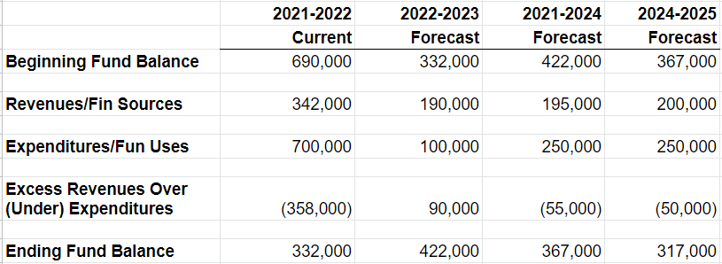
4-YEAR BUDGET – CAPITAL PROJECTS FUND SUMMARY

Slide 13
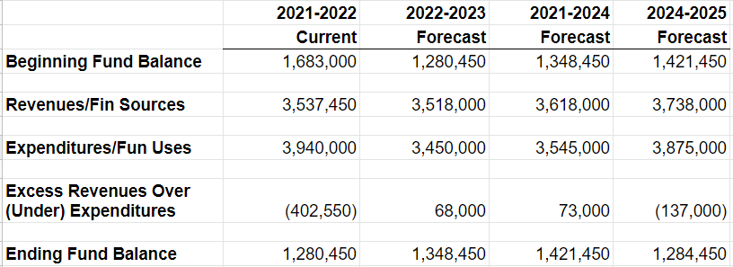
4-YEAR BUDGET – DEBT SERVICE FUND SUMMARY

Slide 14
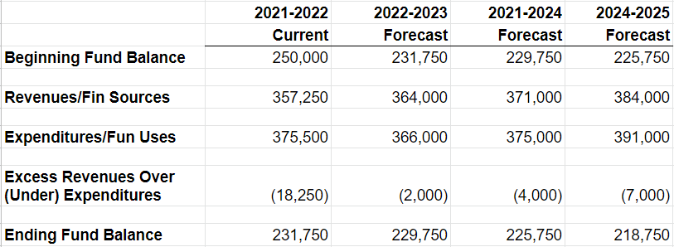
4-YEAR BUDGET – ASB FUND SUMMARY

Slide 15
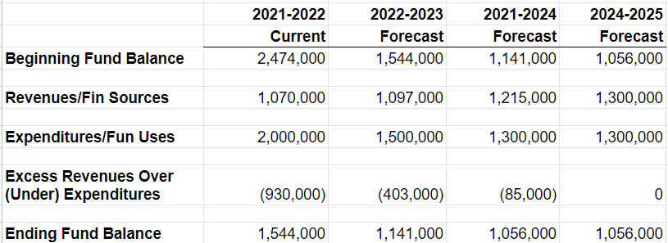
4-YEAR BUDGET – TRANSPORTATION VEHICLE FUND SUMMARY

