Slide 1
Woodland Public Schools
Facilities and Safety Report
August 2018

Slide 2
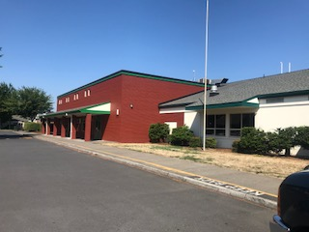
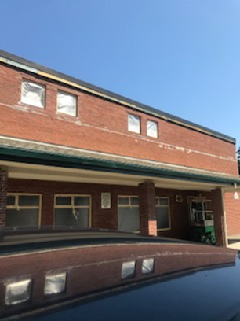
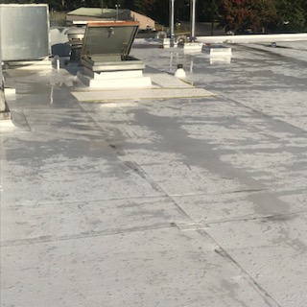
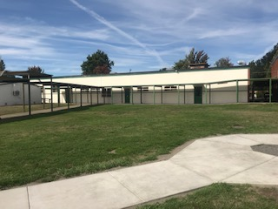
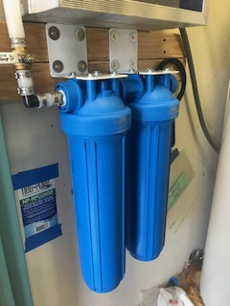
Summer Shutdown Activities Below is a brief summary of items completed or still in progress from 2018 summer break. This is in addition to our standard annual cleaning and maintenance activities.
FACILITIES REPORT
Portable 5/6 Install WIS – Completed the install of portable classrooms 5/6 at WIS. The building was delivered on July 19th, and was ready for occupancy August 9th. Our contractors did a great job working over the top of each other to ensure there was adequate time for the teachers to set up their rooms.
Painted Buildings A, B, C WMS – Completed exterior painting of the woodshop, metal shop , Green Gym and auditorium at the Middle School.
Commons Building Mortar Repair and Building Paint – The entire Commons building was painted, and all missing mortar in joints were repaired.
Re-roof WMS Green Gym – A new TPO roof was installed on the Green Gym.
WPS Drinking Lines - All drinking water lines at WPS were replaced with filtered HDPE Wirsbo-Pex lines. This will provide WPS students and staff the purest drinking water.
Middle School commons before and after
New TPO roof Green Gym
Building A,B,C repaint (building A shown)
New filter
assembly
for drinking
water At
WPS

Slide 3
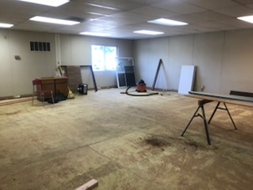
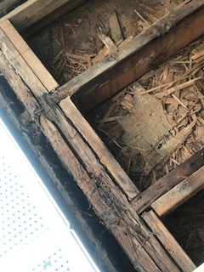
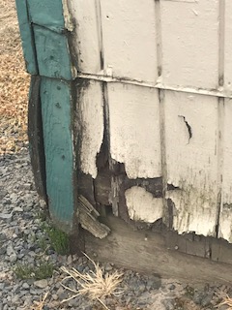
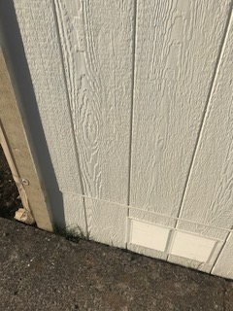
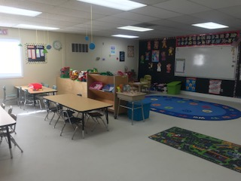
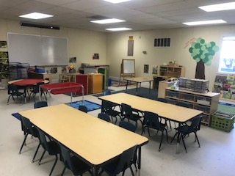
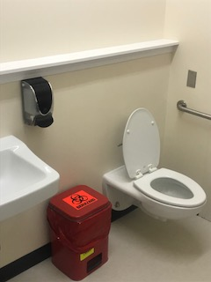
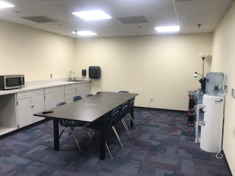
Summer Shutdown Activities (Continued)
FACILITIES REPORT
Rebuild P11/12 WPS – In order to provide ECEAP and COOP preschool room to grow, P11/12 at the Primary School received a ground up renovation. This included the installation of two restrooms, new siding, flooring, windows , ceiling work and ramps to name a few items.
New Conference Room WMS – To support growth at the Middle School, the existing conference/break room was turn into an office. The room across the hall (old dark room) was converted into a new conference and break room.
Bathroom Install WMS Nurses Office – In order to provide a germ free space for WMS staff, a new bathroom was installed in the Middle School Office. This room was an old storage closet for the adjoining classroom.
SPED Room Relay-out - The Special Education room at WMS was modified to accommodate new staff, and provide a more functional space for staff and students. This included installation of multiple cabinets, countertop changes, painting and converting the old reading room bathroom for ADA access and changing table.
P11/12 Before and After
New restroom
WMS nurses
office
New
Conference
Room WMS
P12 COOP Preschool
P11 ECEAP

Slide 4
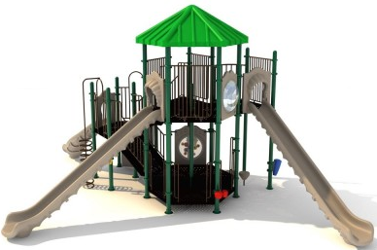
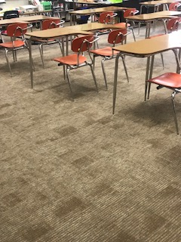
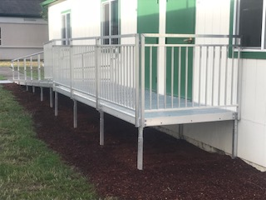
Summer Shutdown Activities (Continued)
FACILITIES REPORT
New ADA Ramps P11/12, P4/5 – New ADA compliant aluminum ramps replaced the old wood ramps on two of the portable buildings at WPS.
New Carpet WMS/WPS/ WIS - 4 rooms at WMS, 2 rooms at WIS and the lobby of the Primary School received new carpets.
Yale Play Structure – The new Yale play structure arrived nearly a month late. The system arrived Monday, September 17th , and is in the process of being installed.
New “Neck of the Woods” play structure
being installed over the next two weeks.
New ADA ramps installed
at 3 locations.
New carpeting installed
in 6 classrooms and the
Primary school lobby.

Slide 5
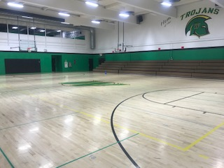
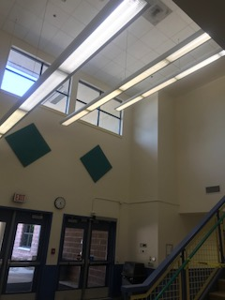
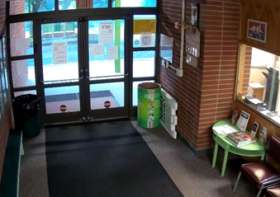
Summer Shutdown Activities (Continued)
FACILITIES REPORT
Interior Paint WMS Green Gym – The WMS Green Gym is now wearing the new WMS Trojan Green. This paint job definitely brightened up the space and gave ownership to the Middle School.
Cove Base Replacement WIS - New cove base was installed throughout the Intermediate school hallways. Coupled with a new lobby paint job and LED lights, the school has been given a fresh look.
Camera Install Yale School and WPS Exterior – 12 new cameras were installed at the Yale School (6 interior, and 6 exterior) additionally, 14 exterior cameras were installed at the Primary School.
Re-key WPS Exterior – Both WPS and WMS have now been re-keyed rendering rogue “A” keys virtually useless. We will finish the Intermediate School this fall, completing the task.
Pin Oak Removal WMS – 14 of the 21 Pin Oaks have been removed. This fall we will begin planting the new Celebration Maples in the same location. Next summer, the balance of the Pin Oaks will be removed.
Green Gym
With new
Trojan green
Paint.
Newly painted Intermediate
lobby with LED light retrofit.
New Yale School lobby camera (camera 1 of 12).

Slide 6
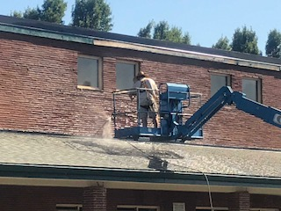
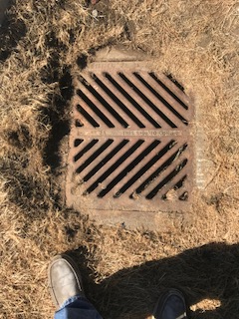
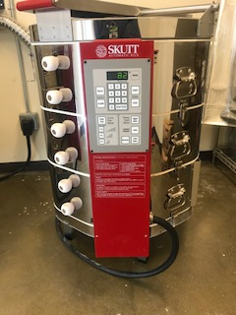
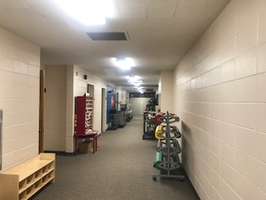
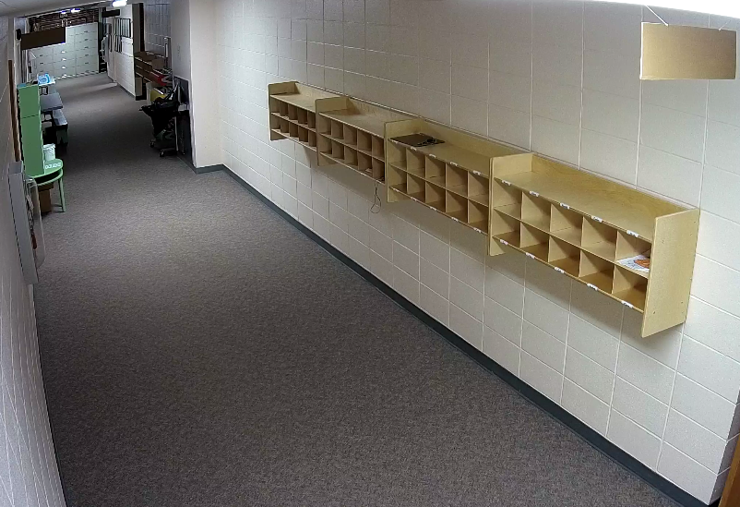
Summer Shutdown Activities (continued)
FACILITIES REPORT
All brick work at
WMS power washed
and inspected.
Power Wash/Repair All Masonry - All of the brick work and masonry at the Middle School was pressure washed, and faulty joints repaired.
Exterior Window Clean WHS – A high lift was rented, and a crew of 2 spent 3 days cleaning windows at WHS.
2nd Kiln Install WHS – A second kiln was installed in the High School ceramics lab to accommodate class size increases.
Resurface WHS Aux Gym Floor – The Aux gym at WHS was resurfaced.
Drain Elevation WMS – The storm drain grate at WMS, in front of the school office was elevated 12 inches to remove the existing trip hazard.
LED Light Install Yale School – Yale school entrance lobby and main hallway were retrofitted with new led lights, and cubbies were added for each classroom.
Storm drain raised
12 inches to remove
Trip hazard.
New LED lights Yale
entry and main hallway.
New Yale cubbies
New Kiln WHS

Slide 7
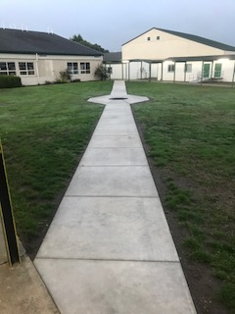
Summer Shutdown Activities (continued)
FACILITIES REPORT
Sidewalk to Green Gym and Testing Portable – 120 linear feet of sidewalk was installed to the Green Gym to improve accessibility and reduce dirt loading on the gym floor. An additional 45 feet of sidewalk was installed at the testing portable to improve access and reduce the slip hazard.
Rewire Fire Systems WPS Portables - During last year, false alarms at the Primary School were tracked down to the portable building’s underground wiring system. All fire horn strobes and pull station wiring was replaced.
The Mazak Mill – This tool final set up will be complete the week of 9/17. Once complete, I will schedule a start up of the tool with USNR and school staff.

Slide 8
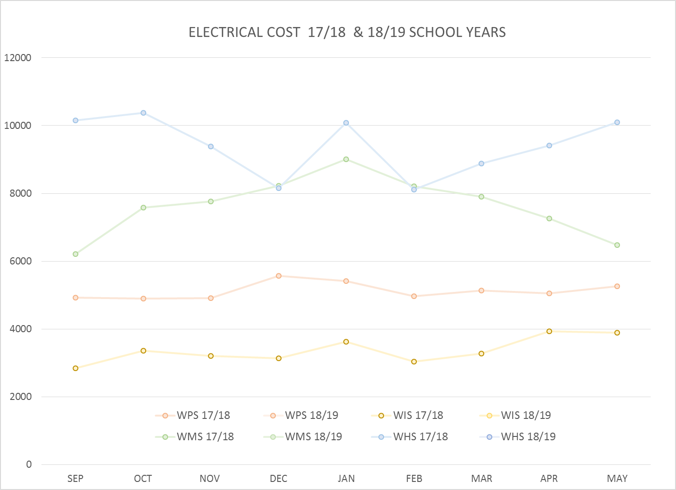
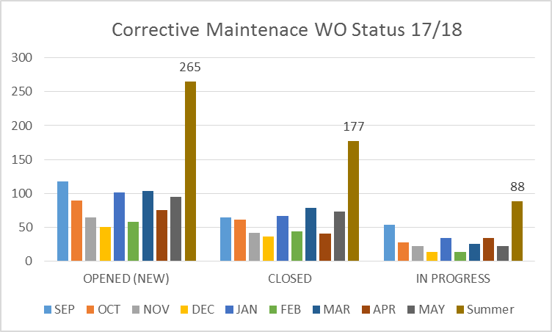
FACILITY CHARTS – POWER COST AND WORK ORDER STATUS
This chart only has historical from 17/18
school year. 18/19 school year will start populating in the September report.
Summer data includes WO’s from June 1st through August 31st.
Chart will refresh in September for school year 18/19

Slide 9
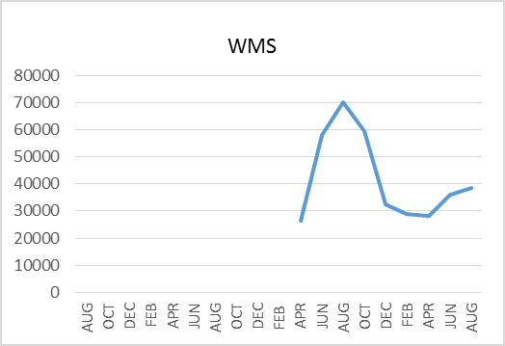
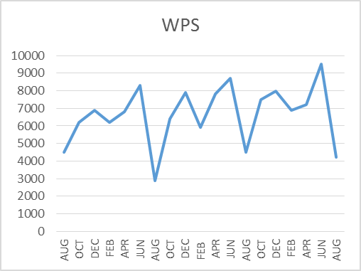
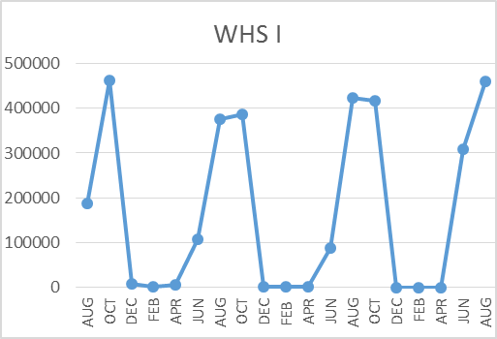
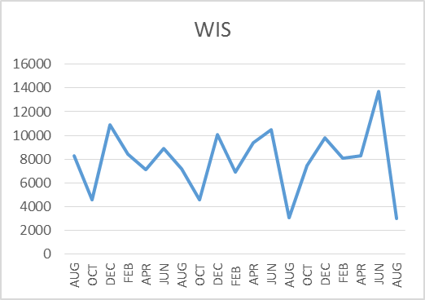
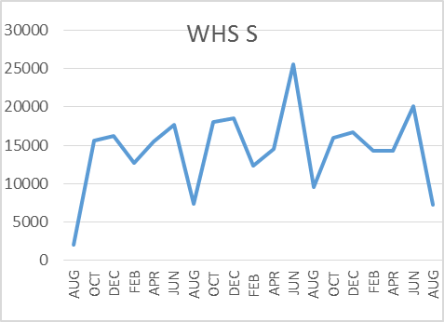
FACILITY CHARTS – WATER USAGE WHS, WIS, WMS, WPS
Note
Water charts are updated every two
months. Next update to these charts
in October 2018.
The WMS chart has been reconfigured to include the following 7 meters: 755 Park high and low flow, BO and Team High, PIT house, bus barn, athletic field and DO. All of these meters are totaled on the WMS graph, but each data point is recorded separately to aid in identifying leaks.

Slide 10
SAFETY REPORT
Accidents for the Month
There were no accidents listed for the first 4 days of school. Reporting will continue next month with charts.
Staff Accidents/Incidents
None.
Student Accidents/Injuries
None.

