Slide 1
NUTRITION SERVICE HIGHLIGHTS sy 17-18
A QUICK RECAP OF SOME FUN AND PROUD ACCOMPLISHMETNS IN OUR KITCHENS THIS PAST SCHOOL YEAR.

Slide 2

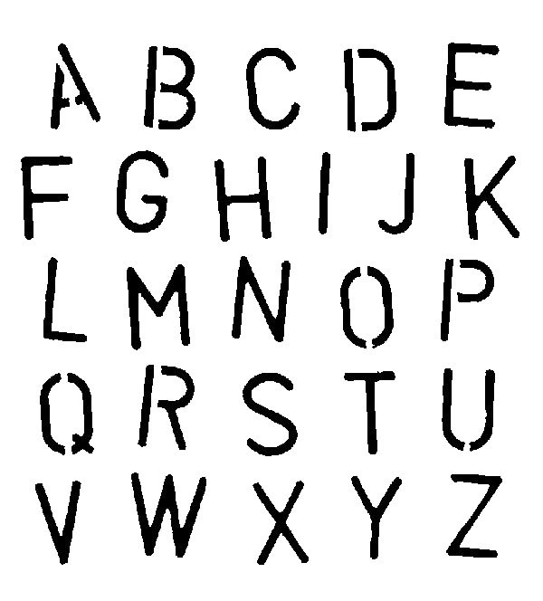
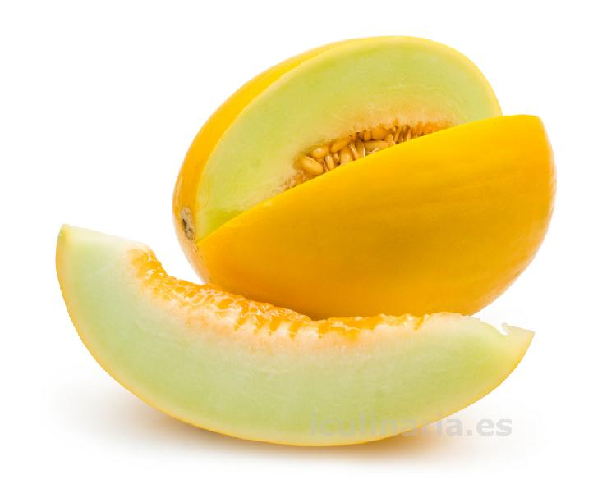
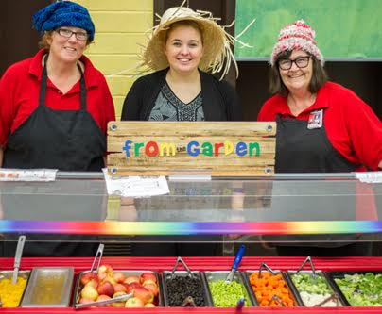
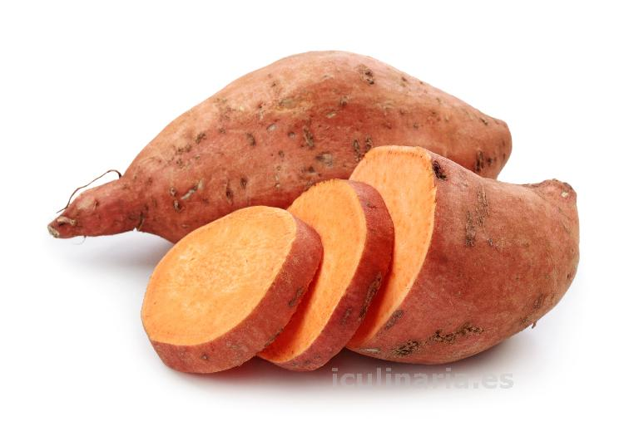
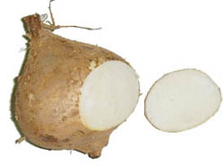
A-Z SALAD BAR
FIG!
HONEYDEW!
We continued our A-Z Salad bar this year at all three elementary schools. We highlighted a fruit or vegetable starting at the end of September with A for Apricots and ending the last week of May with Z for Zucchini.
Some other fun letters we explore for F for Fig, H for Honeydew Melon, J for Jicama and Y for Yams.
We are looking forward to trying new fruits and vegetables again next year!
JICAMA!
YAM!

Slide 3
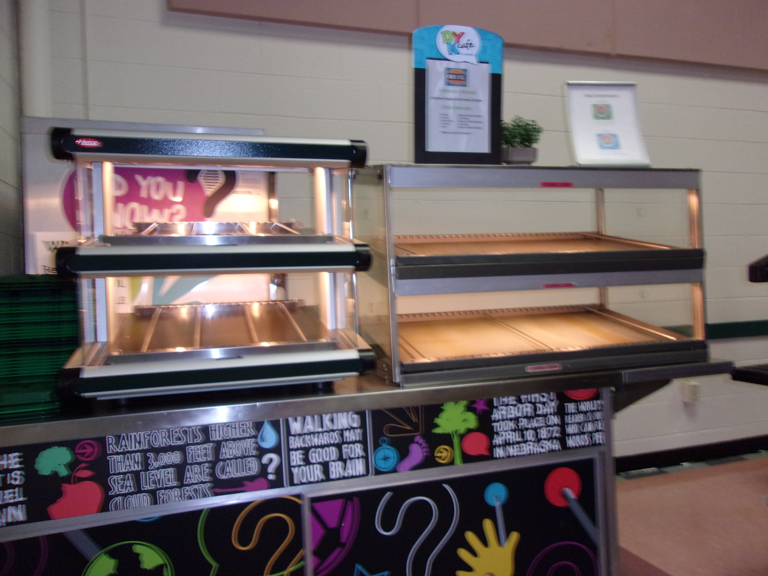
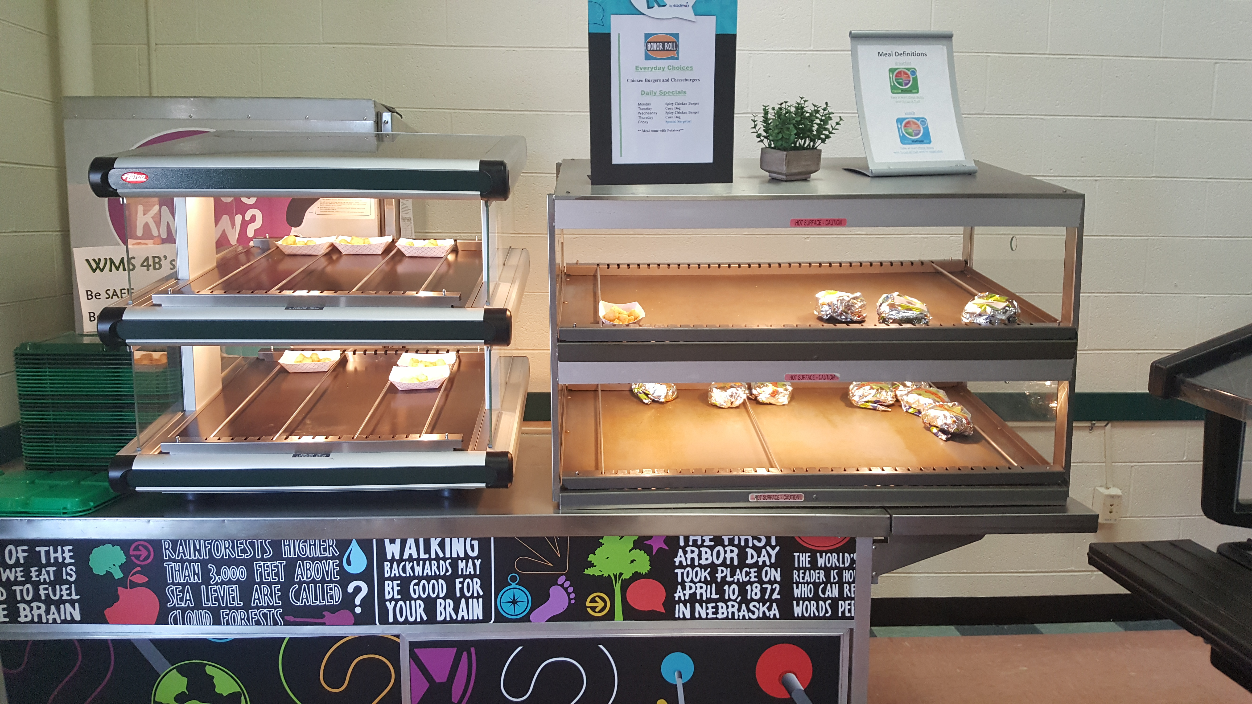

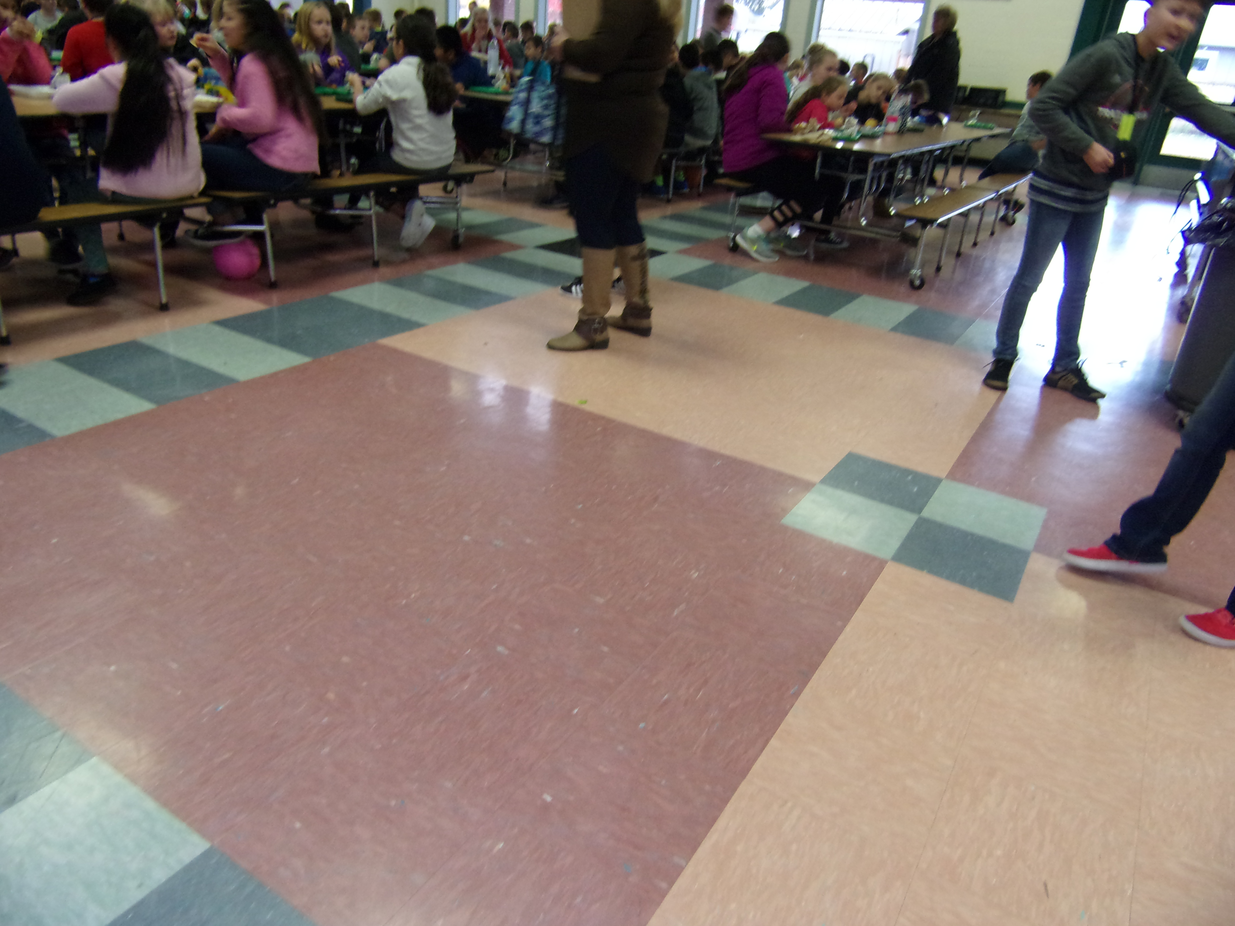
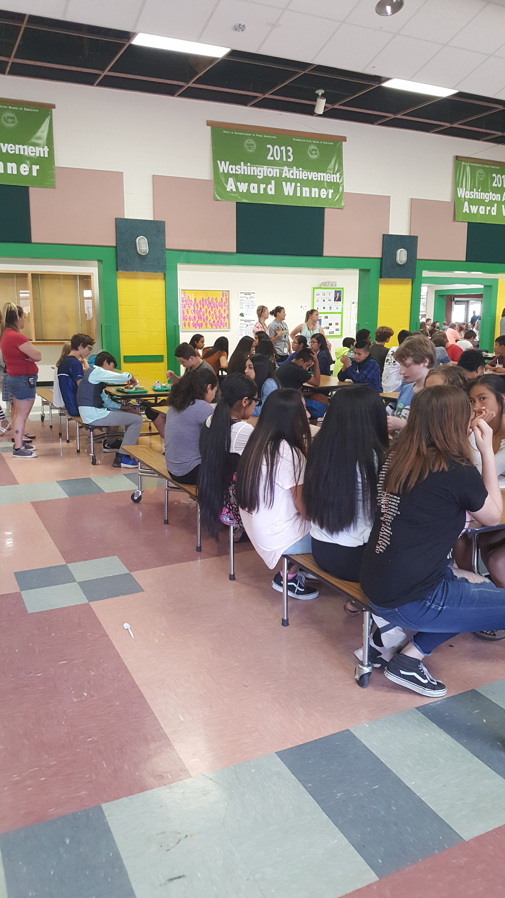
Captured wms
The WMS kitchen staff did a great job re organizing their schedule to make sure that the food didn’t run out.
This year we did our first ever photo survey at Woodland Middle School. Students from each lunch period were invited to take digital cameras around the lunch room and highlight both positive things and things that could be improved.
We took their observations, and worked on creating solutions for their concerns. The Middle School staff did an amazing job correcting issues buy analyzing their procedures and tweaking their schedules and job duties in order to hear and fix the students comments.
The WMS administrative staff were great in getting more tables so that there were more options to sit.

Slide 4


Book give away day!
We did 2 book give-a-ways this year. November 8th and March 2nd. We gave away a cook books to help encourage the connection between cooking and reading and a Dr. Seuss book to connect food and reading. All students had to do was to get hot lunch that day and then the winners were pulled randomly from a Skyward report after lunch. The winners were really excited for their brand new books!

Slide 5

FREE BREAKFAST WEEK!
National School Breakfast Week was March 5th – 9th 2018. We celebrated by making lunch free to all students regardless if they were free, reduced or paid.
It gave students a chance to try breakfast without worrying about the cost.
Schools saw an increase but the biggest increases were WPS and WHS feeding about 100 additional students a week!
We saw an increase in breakfast counts for the rest of the year after doing this promotion.

Slide 6
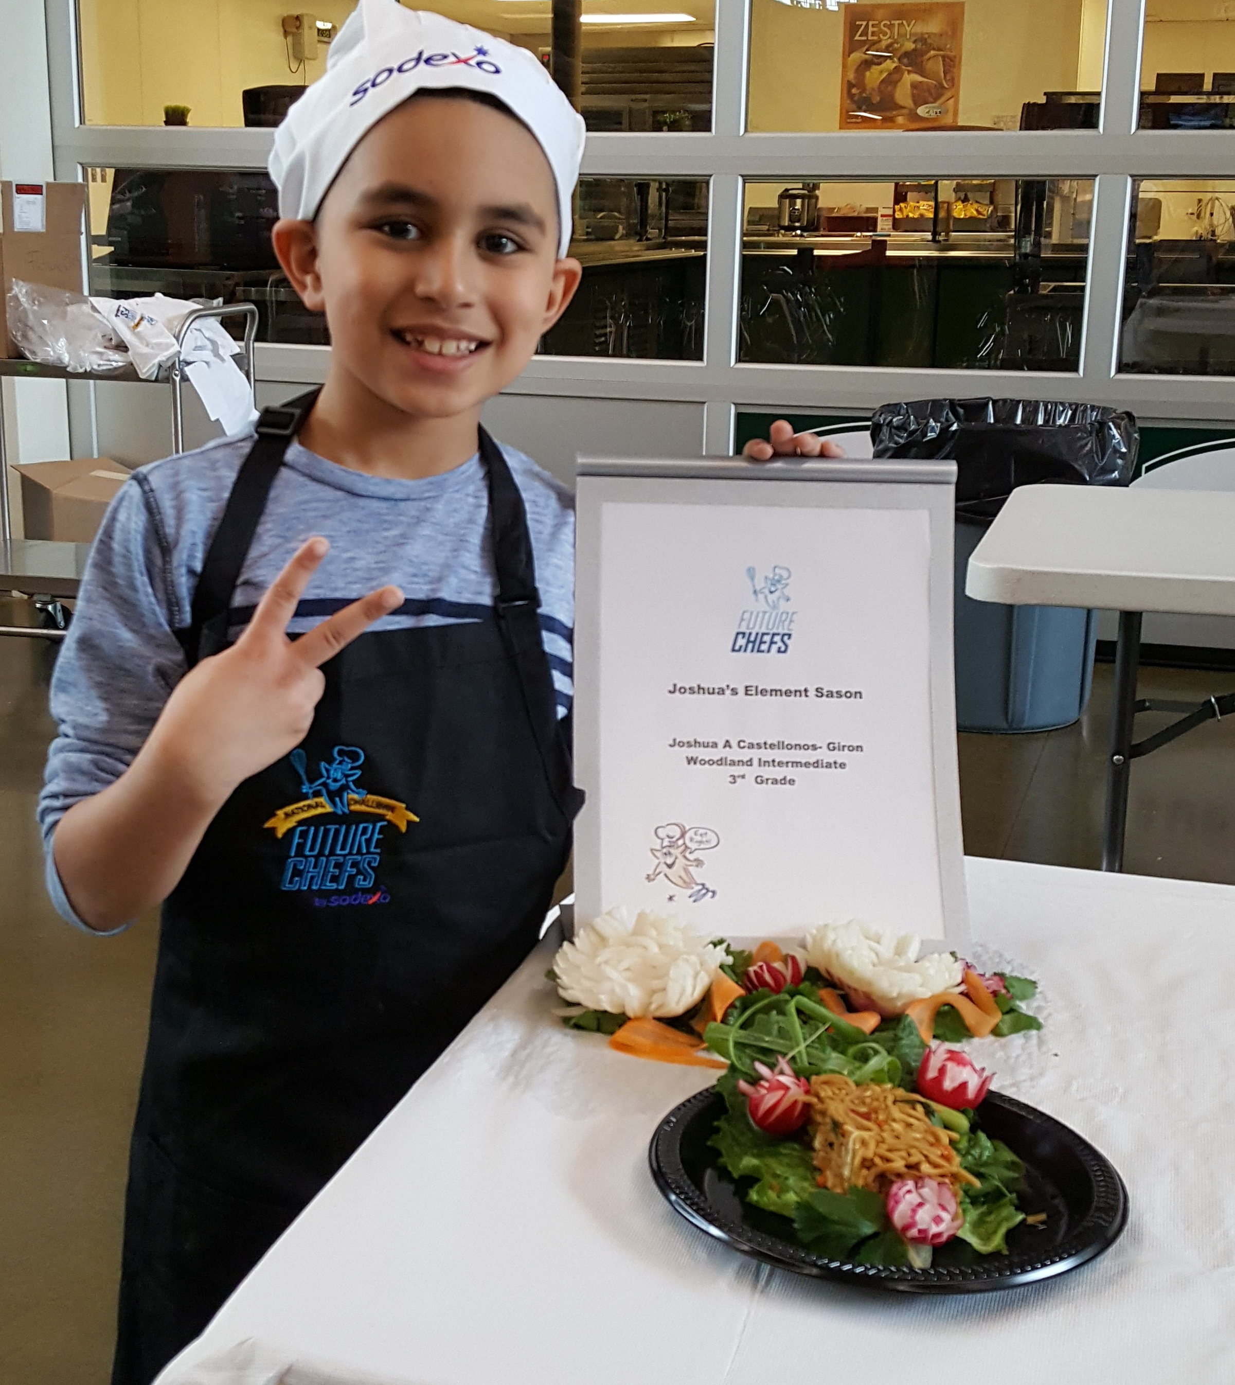
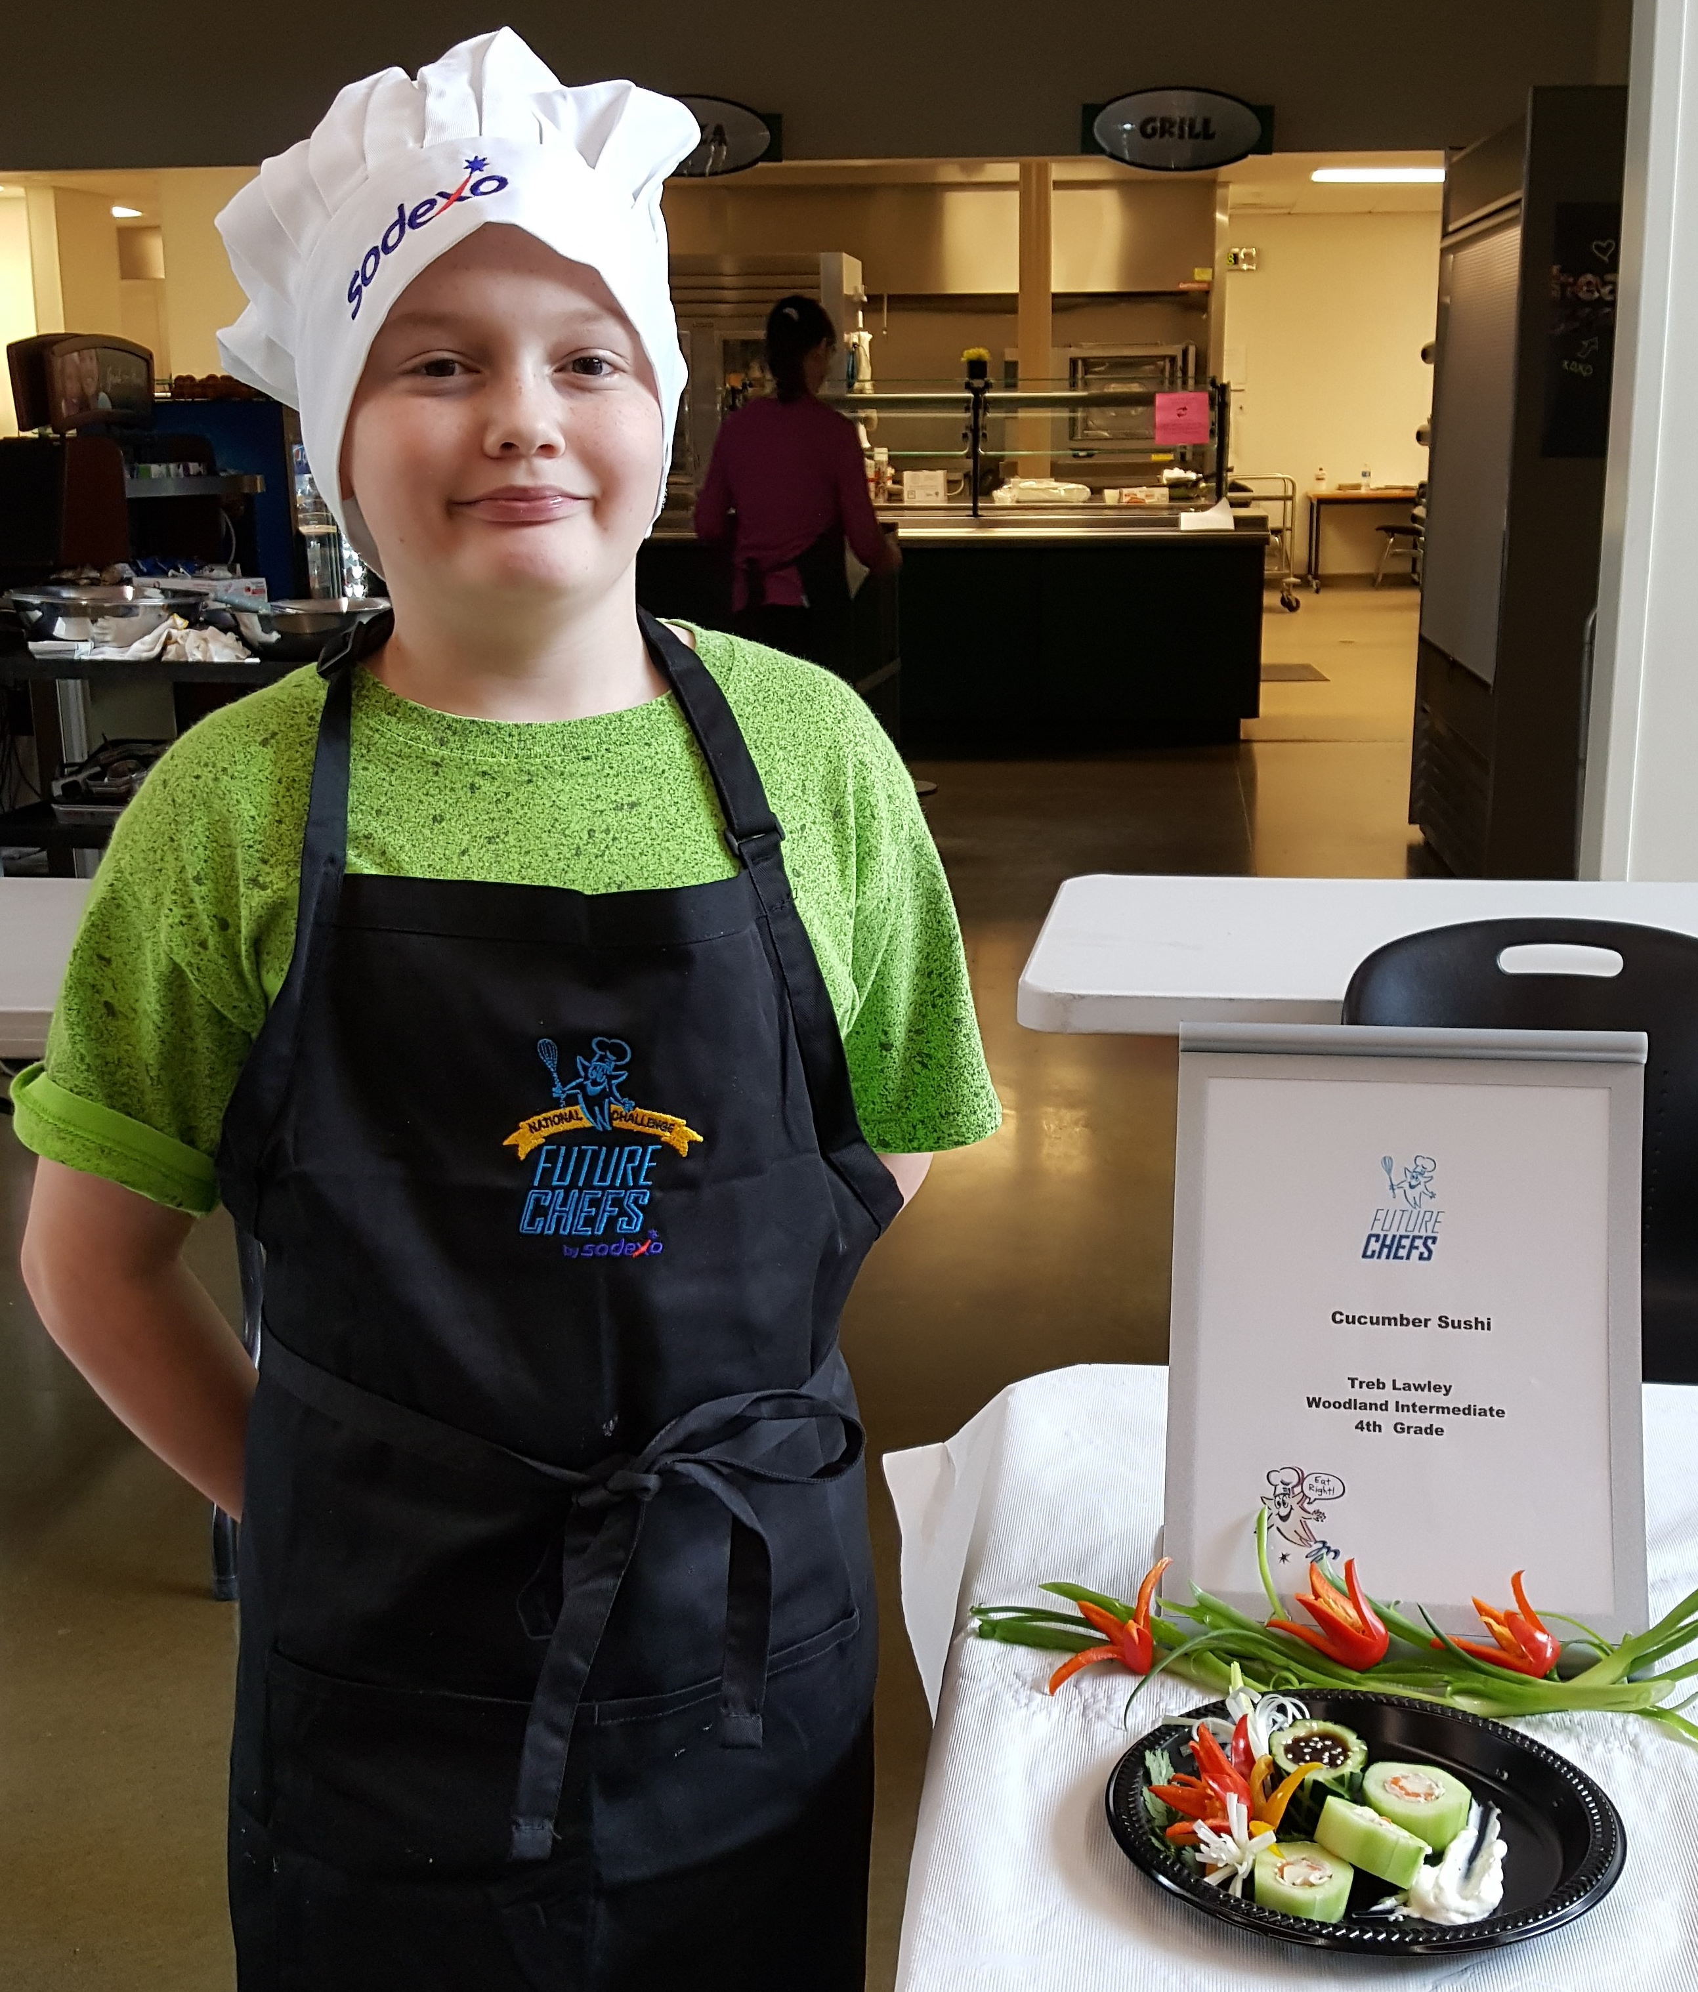
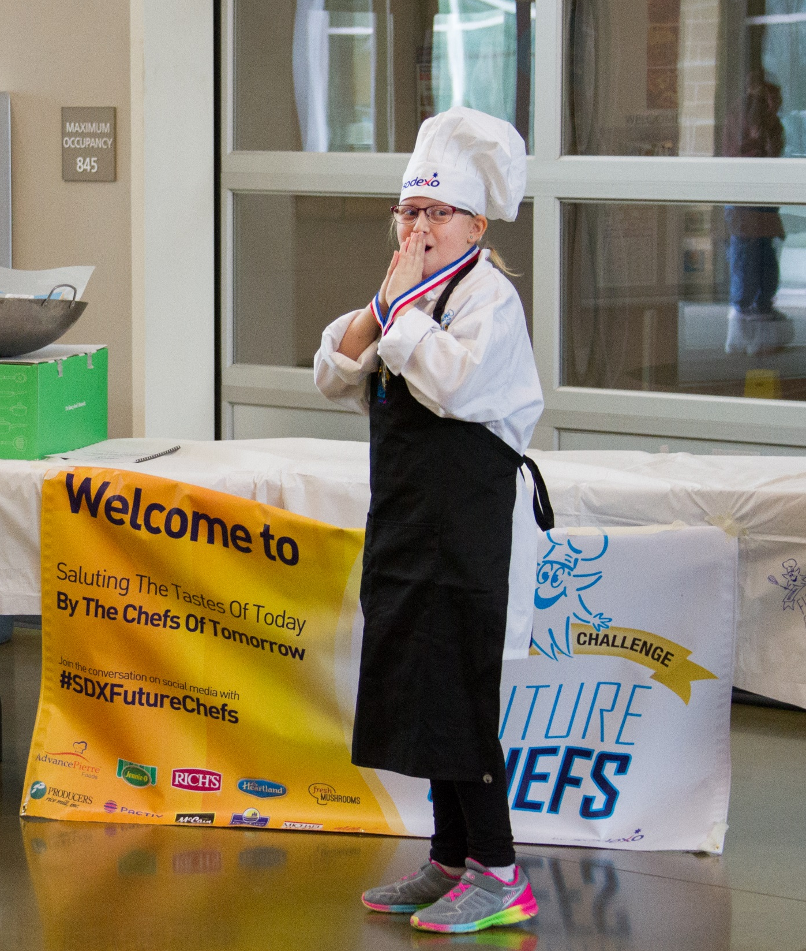
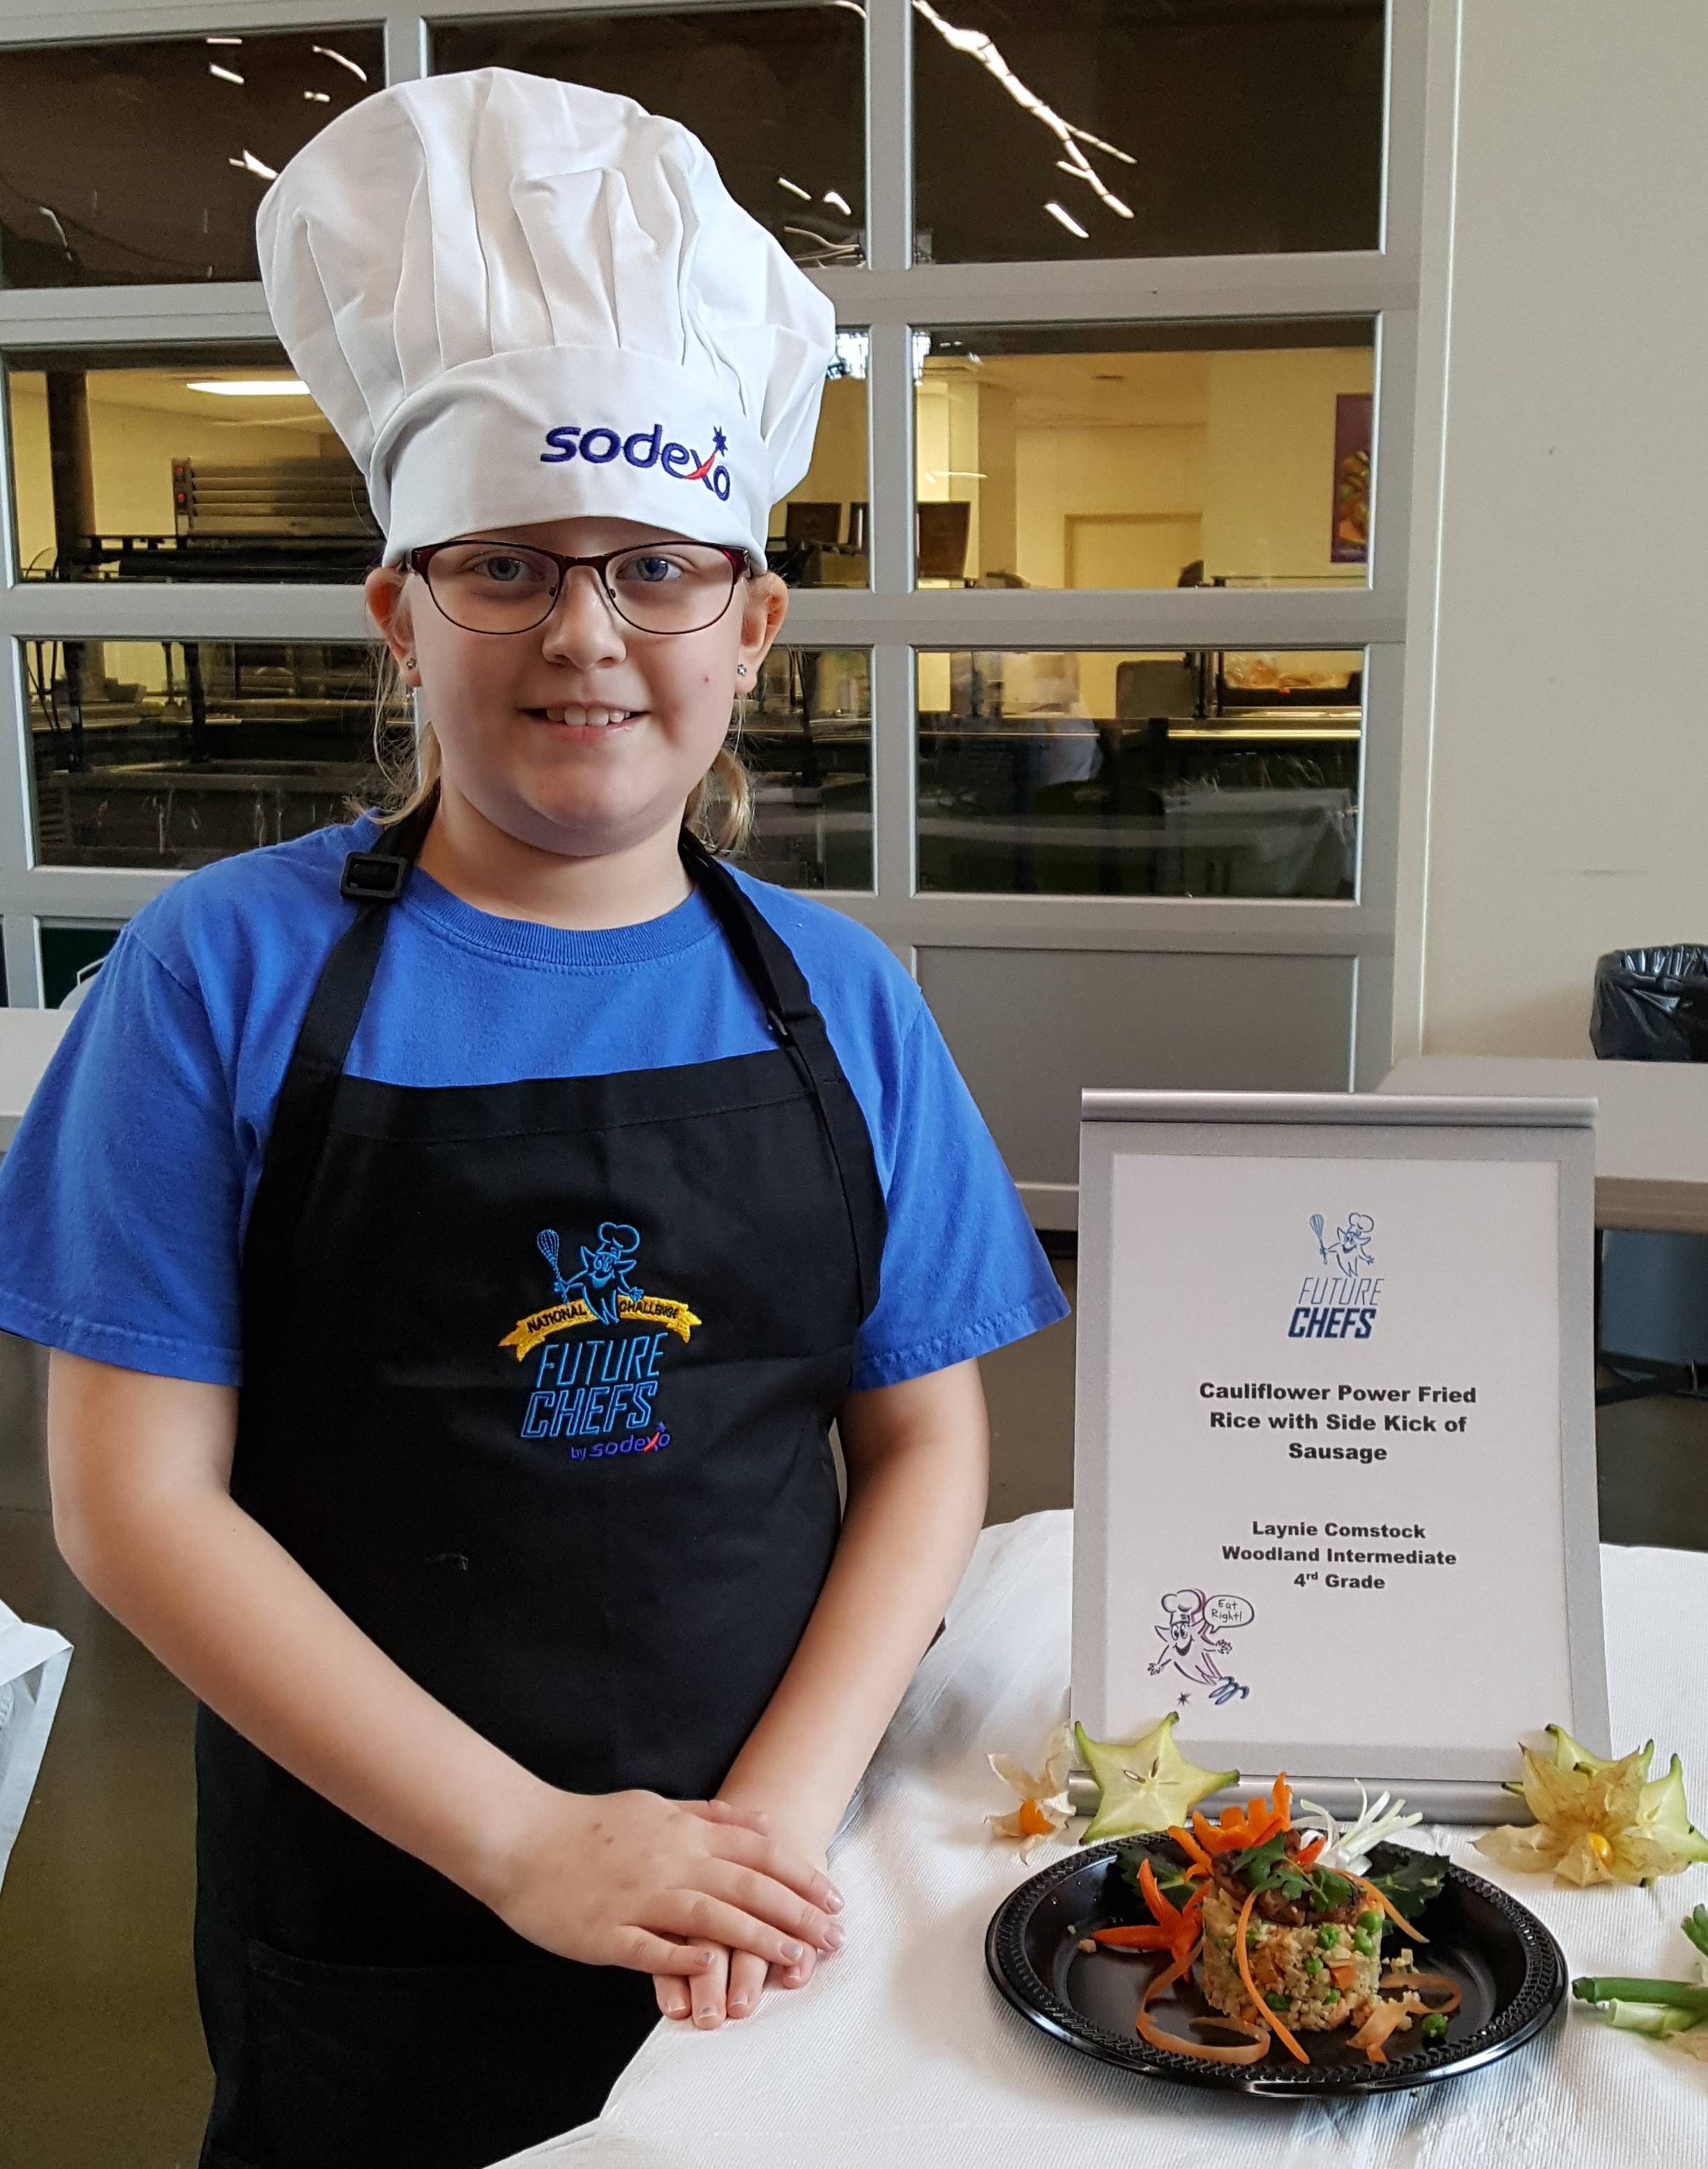
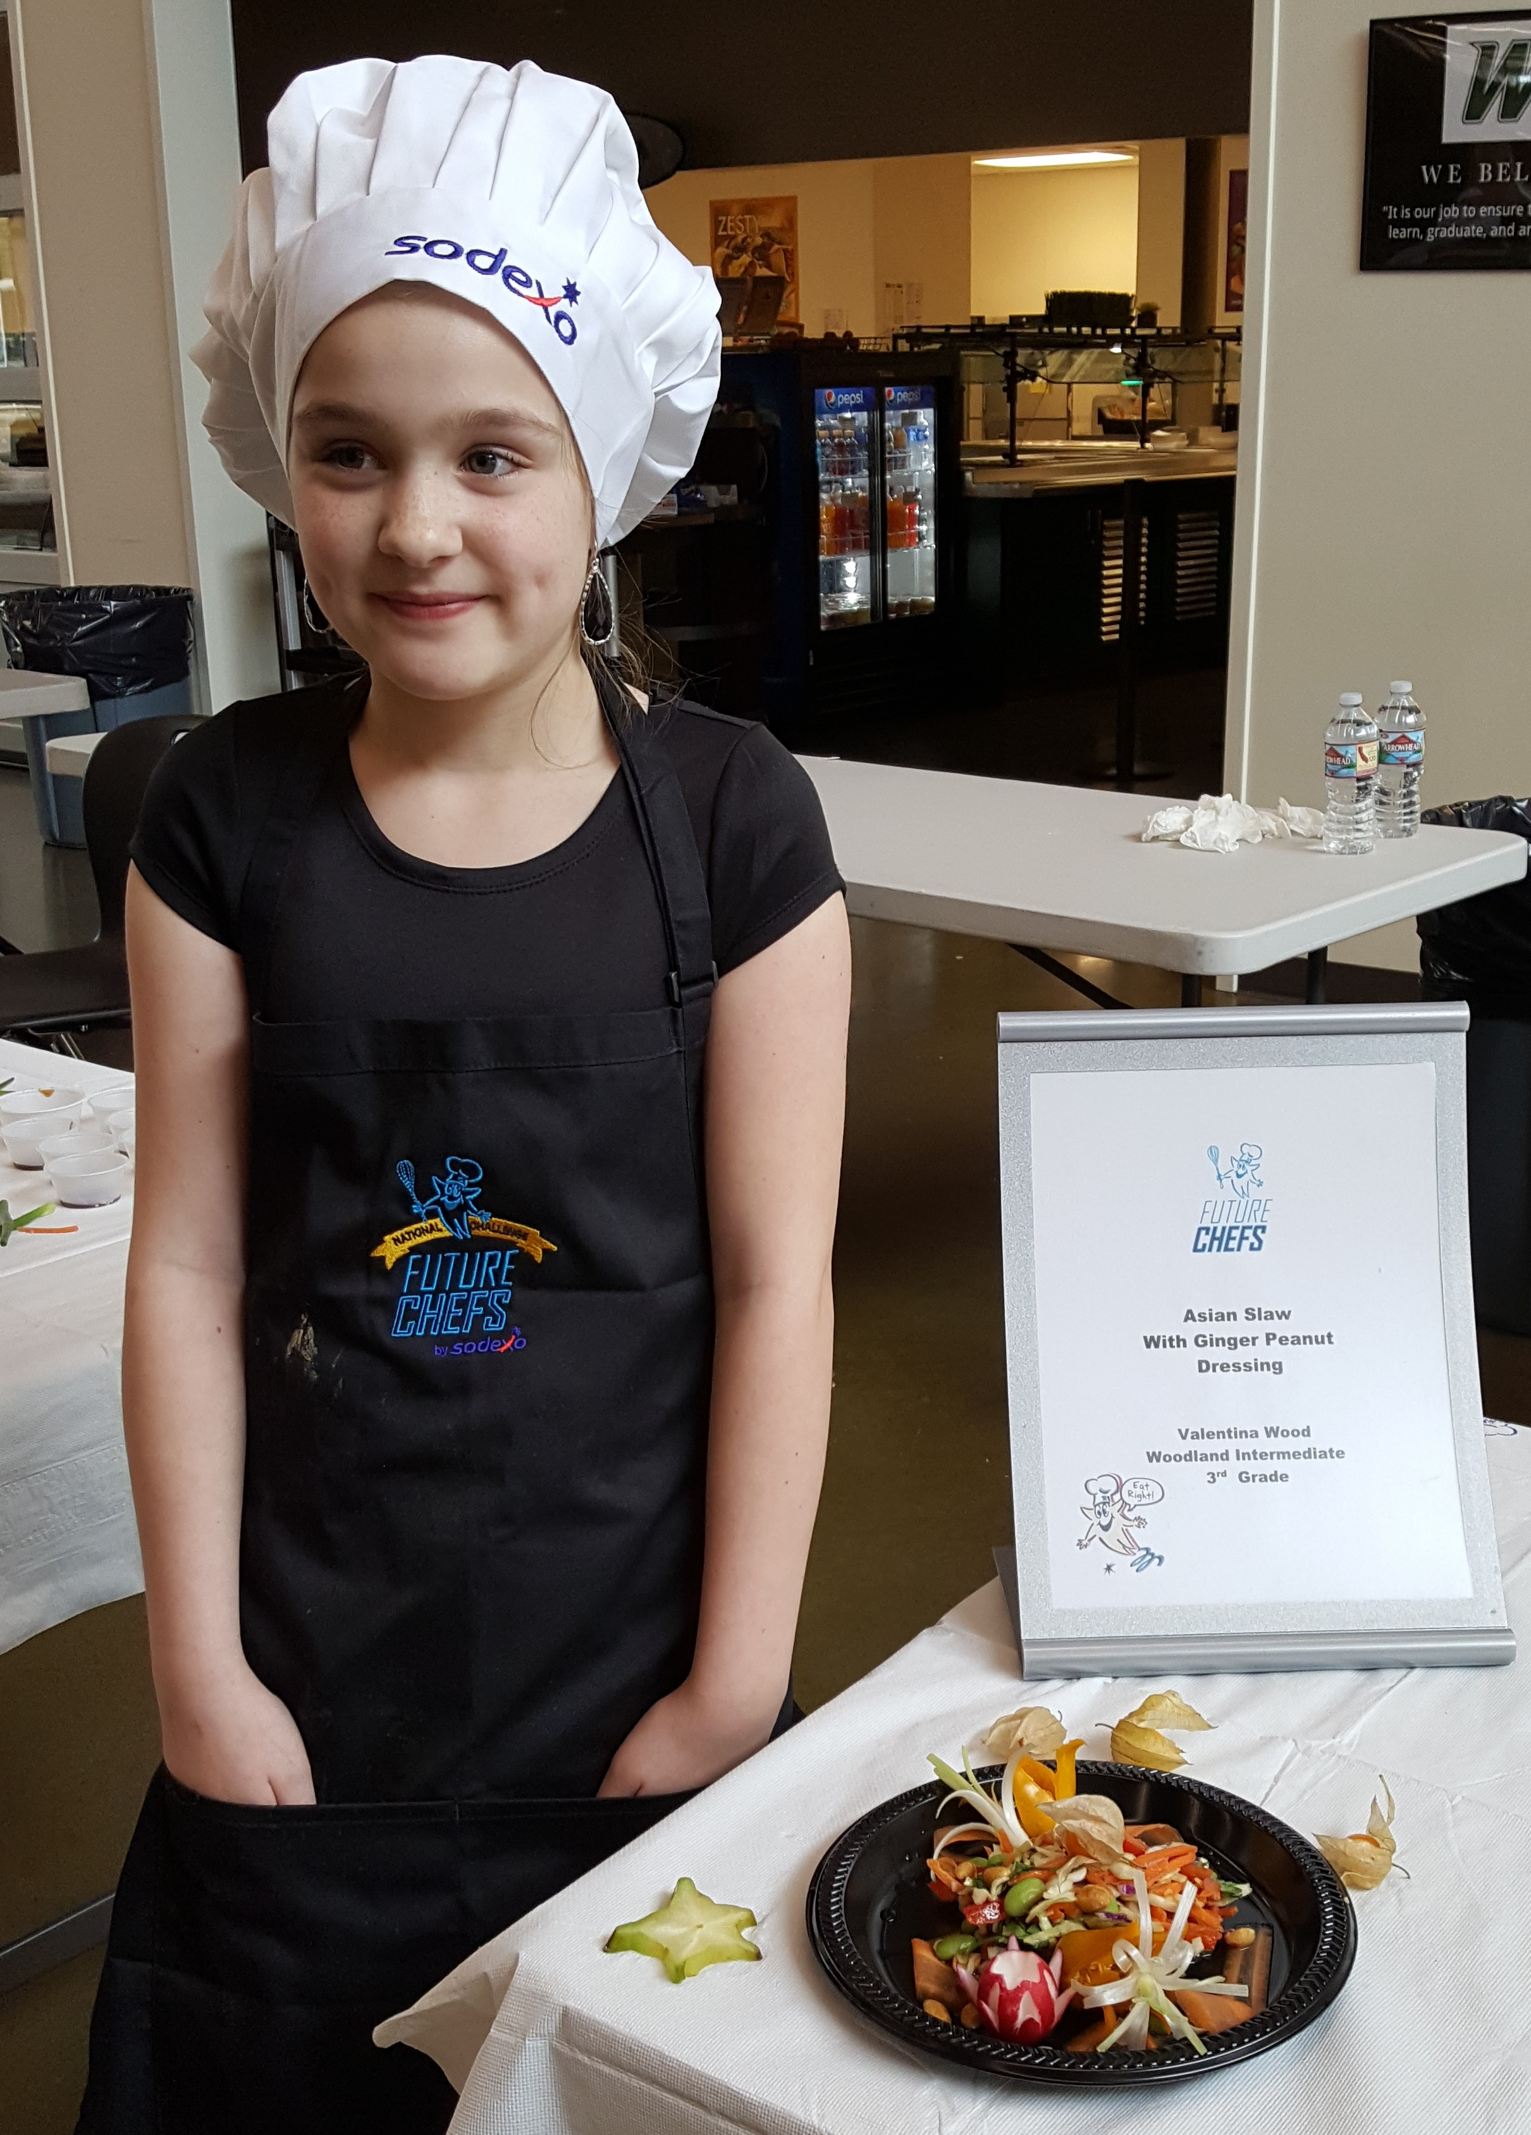
Future chef
3rd grader Joshua A. Castellonos-Giron with “Joshua’s Element Sason”
4th grader Treb Lawley with “Cucumber Sushi”
This year we also did our annual Future Chef cooking competition. Student Chef’s from WIS submitted recipes with an “Asian Fusion” theme.
They then came to WHS and with the help of our kitchen staff and Culinary Students being their Sous Chef’s they cooked their recipes for our judges.
The judges named 4th grader Laynie Comstock the winner with her recipe of “Cauliflower Fried Rice with a Sidekick of Sausage”
Laynie also won 3rd place for a “Hit me with your best shot” contest for best photo of all the schools across the country who participated in Future Chef and received a $25 gift card!
4th grader (and winner) Laynie Comstock with “Cauliflower Fried Rice with a Sidekick of Sausage”
3rd grader Valentina Wood with “Asian Slaw with Ginger Peanut Dressing”

Slide 7

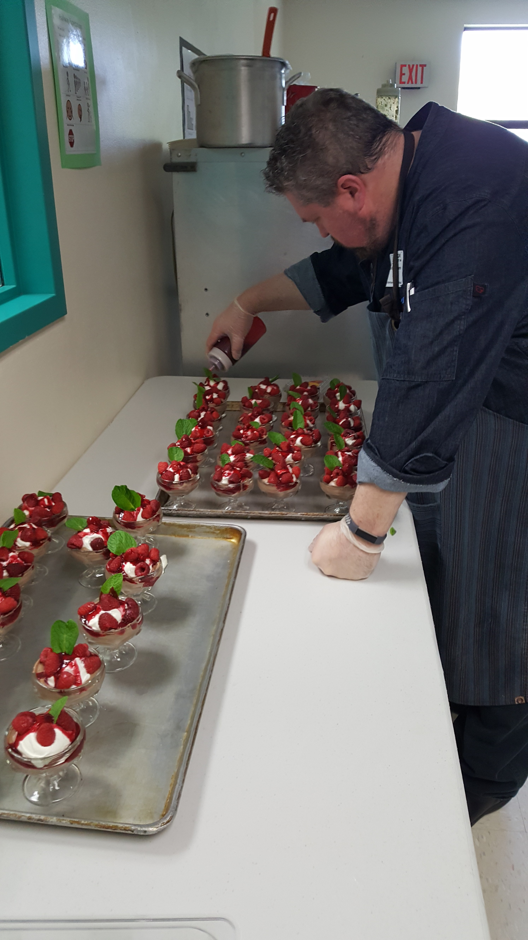
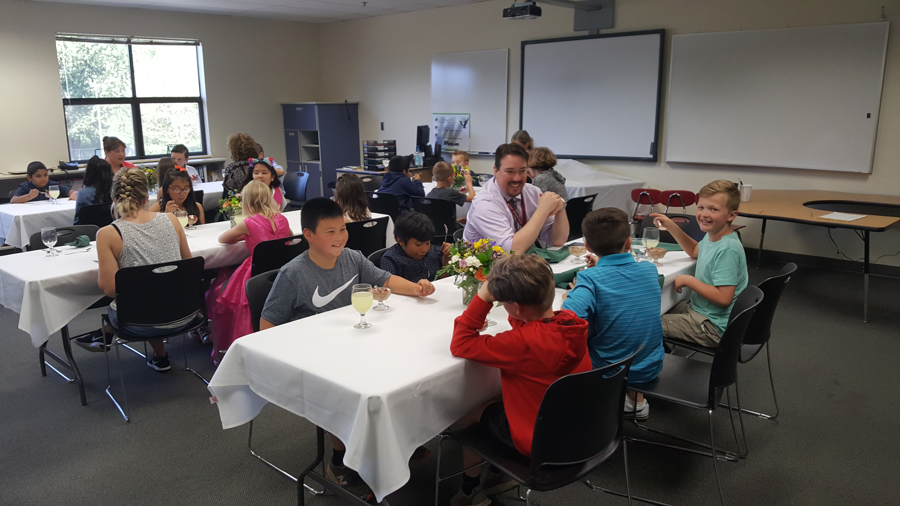
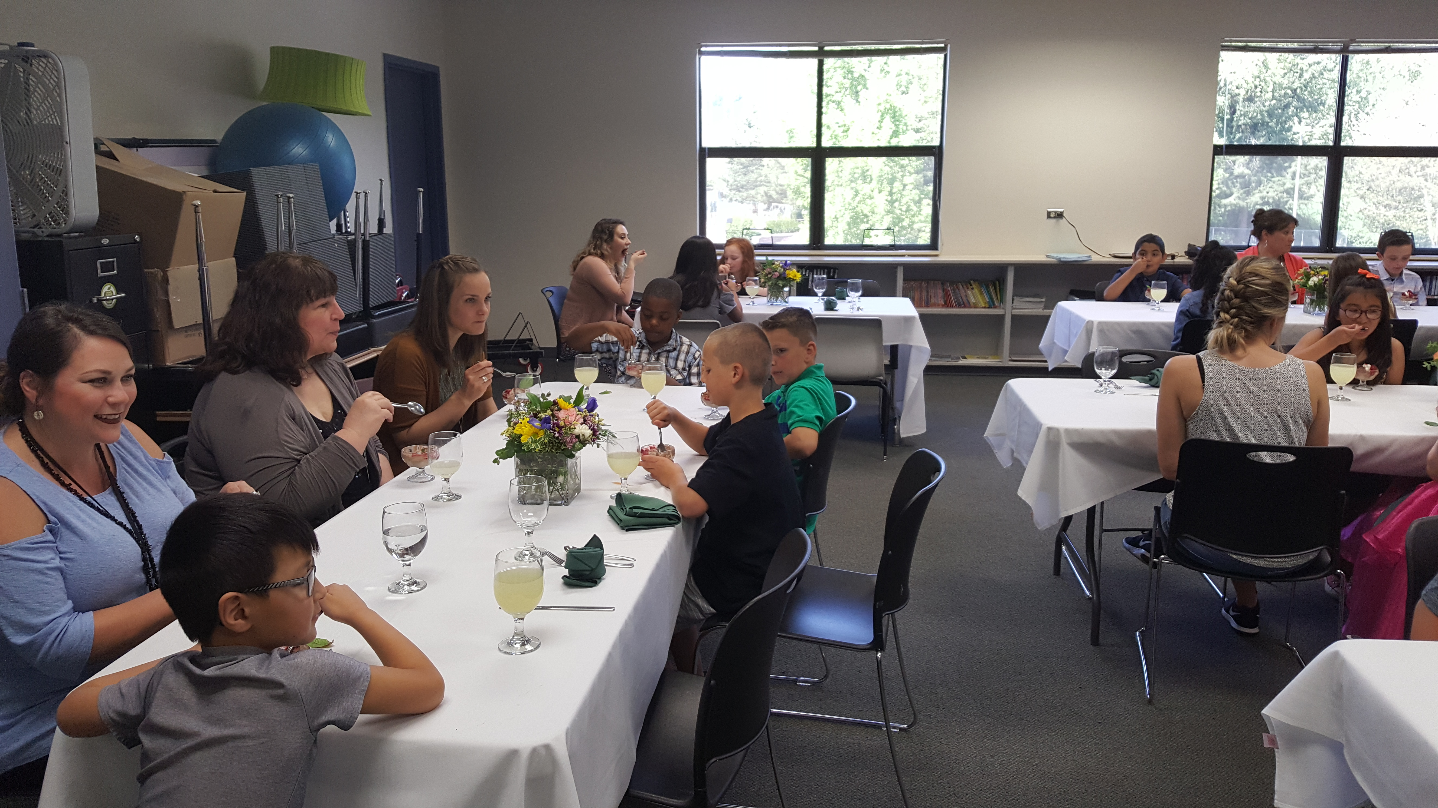
FINe dining at wis
This year Adrianne Blankevoort’s 3rd grade class was selected to participate in the years Fine Dining experience.
Our Sodexo regional Chef, Chef Dave came down to create an exquisite meal consisting of creamy parmesan rice soup for the appetizer, chicken saltimbocca with pesto alfredo and broccoli for the main entrée and for dessert everyone had chocolate raspberry mousse.
The students (and adults) enjoyed their fine dining meal and a chance to use their manners as well.

Slide 8

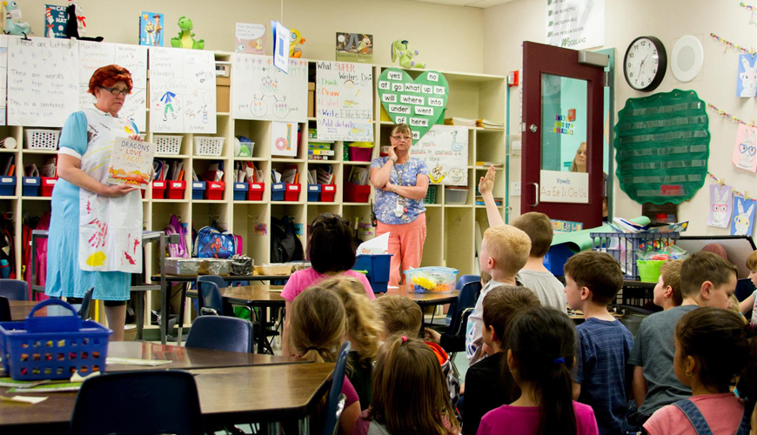
Chef in the classroom
This year we started a new program called Chef in the Classroom. For this experience we took a book that was centered around food, went to a classroom and read the book, then did a food activity.
For this year we chose the book “Dragons Love Tacos” and after the reading we invited the students to come up and create their own salsa for an afternoon snack!
The students really enjoyed this experience and even tried some new food items as well!

Slide 9
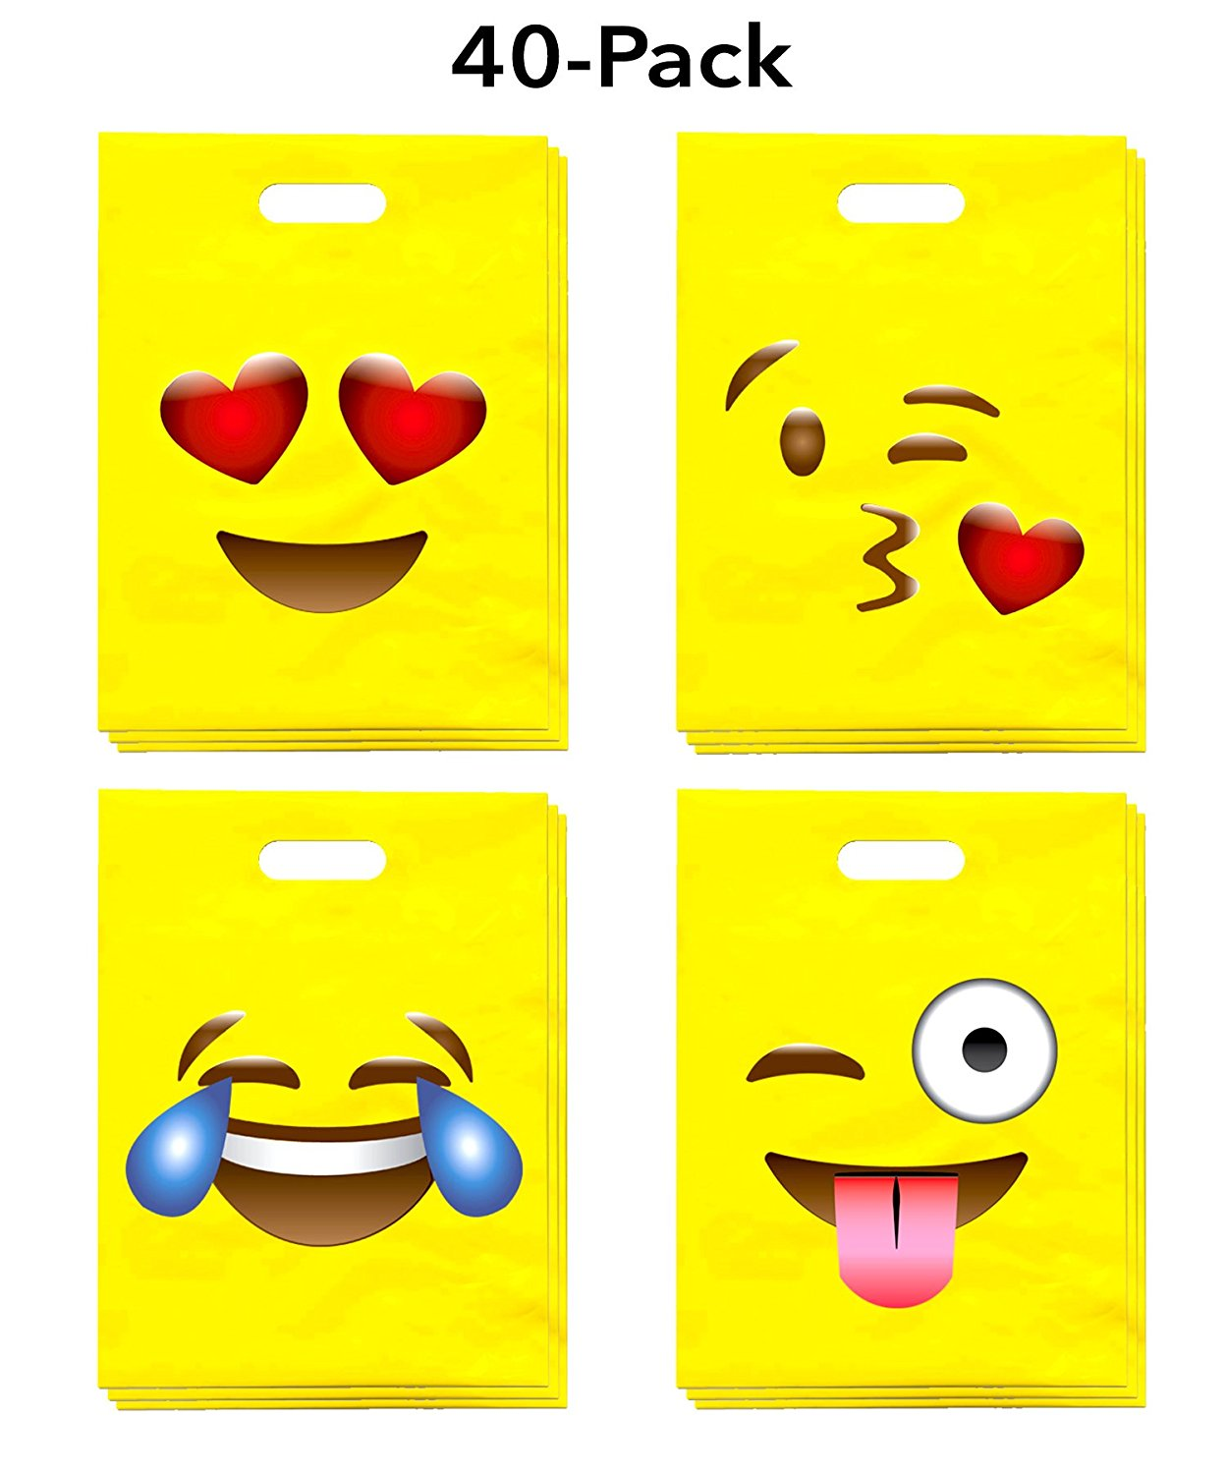


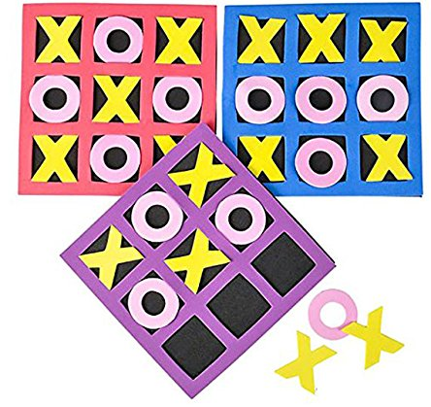
Lucky tray day!
As per the requests of some of our kitchen staff, we did Lucky Tray Day this spring at all elementary schools! All students had to do was come through the lunch line and if there was a sticker on their tray they won an emoji bag with the prizes pictured on the side.
The students were very surprised to win and enjoyed all of their gifts!

Slide 10
Plans for next year…
Continue A-Z bar at all elementary schools
Complete Captured at WIS and WHS
More Book give-a-ways and Lucky Tray Days for the elementary schools
Continue Future Chef Competition, open it up to 5th and 6th graders
Fine Dine event at WIS and WMS
Chef in the Classroom at Yale, WPS and WIS
Go Foam Free throughout the district
New WHS menu and design concept Taste4 to refresh WHS
Continue feeding kids with smiles on our faces ☺

