Slide 1
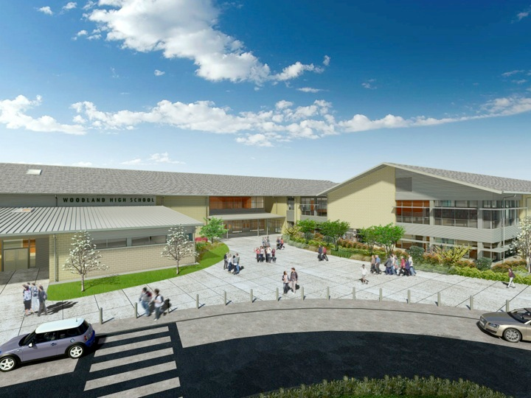
Woodland Public Schools
Facilities and Safety Report
April 2018

Slide 2
FACILITIES REPORT
Posting Drills on Social Media We started notification to parents on social media to make them aware when the District is performing school drills. This allows parents to discuss the drill with their children to see how they felt about the experience. We are also adding more information on school safety programs, so the parents have a better understanding of the District procedures and what they mean.
Kalama Reunification Drill We completed the reunification drill, partnered with the Kalama School District, on May 3^{rd.} The drill included an evacuation of the entire school to the football stadium. All students were returned to class except for the 7th and 8th graders, who were part of the exercise. The students being reunified were brought to an off-site location, and the exercise was conducted there. Approximately 25 parents were part of the exercise and had varying prescribed roles. We learned a lot of valuable lessons, as some of the WSD staff were also present as observers. Our school will conduct the drill next school year. Angela has graciously volunteered the Middle School to be the test school, and Dan volunteered WHS as the reunification point.
Continued Security Improvements We added panic alarms to the TEAM portable and are going to extend that same service into the Business Services portable in May. The team portable is also getting an additional entry control system and camera, so the identification of persons entering can be verified.

Slide 3
Facilities Report Continued
Solar System, Inching Forward…..still We finally have our panels coming, and they should arrive the week of 5/28. My initial plan to have the first array up and running by April was obviously much too aggressive. Understanding the summer work schedule and difficulty in getting the panels here, I have now targeted the end of summer for the first array.
New Portable WIS We are moving along well with the next portable install. Contractors are being aligned to meet the schedule. Modern building slipped a wrench into the work by delaying the delivery date by 3 weeks, due to manufacturing delays. We should still meet the promised delivery to the school by the week of August 6th . This will require a good alignment of contractors to ensure the teachers have time to set up their spaces.

Slide 4
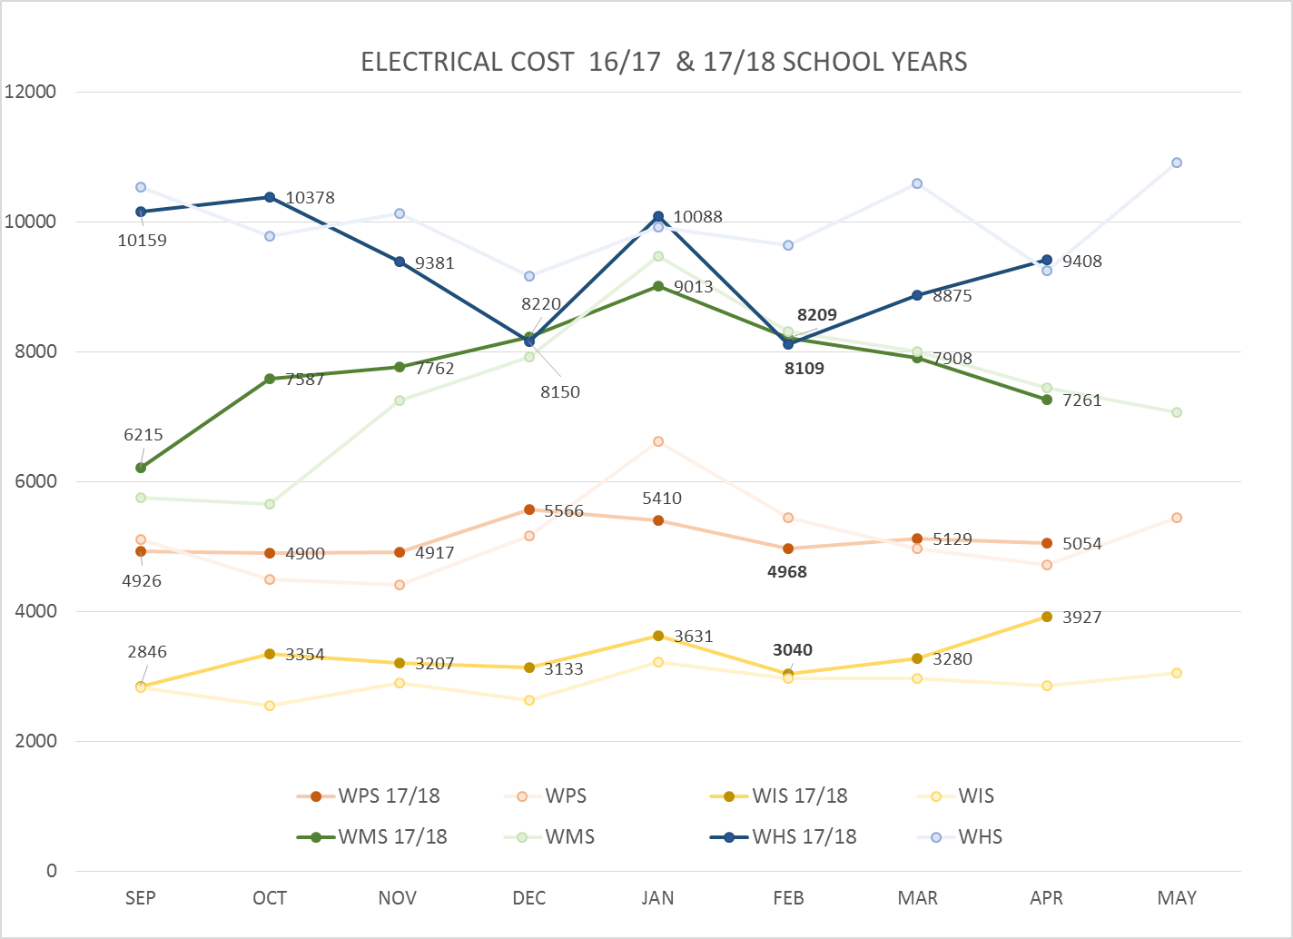
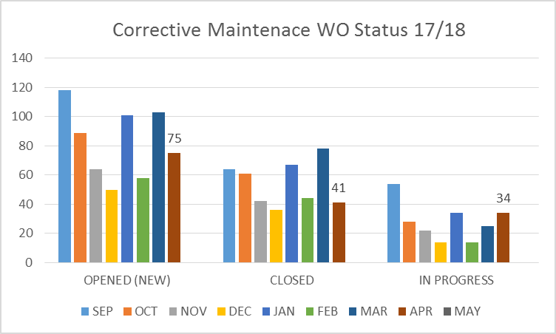
FACILITY CHARTS – POWER COST AND WORK ORDER STATUS
Excessive power consumption WIS due to HVAC processor failure

Slide 5
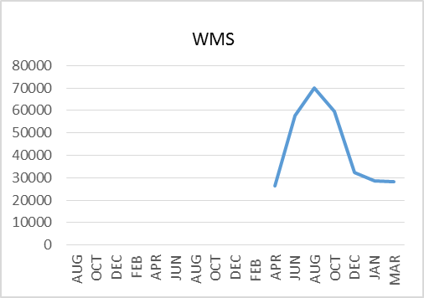
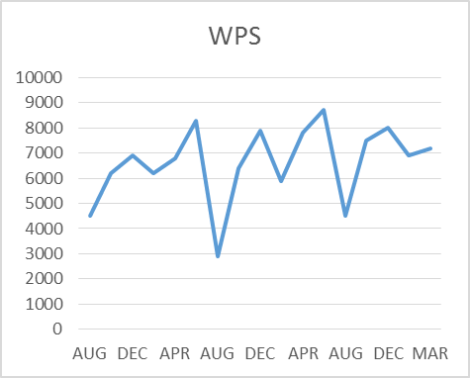
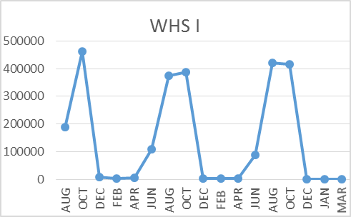
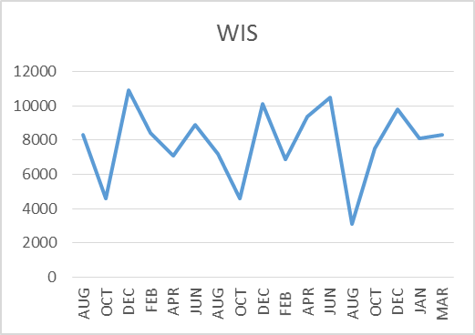
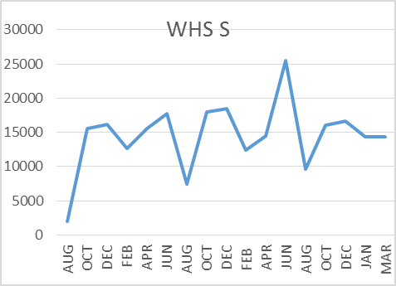
FACILITY CHARTS –
WATER USAGE
WHS, WIS, WMS, WPS
Water charts are updated every two
months. The next update to these charts
is in July 2018
The WMS chart includes 755 Park St. high and low flow, BO and TEAM High, PIT House, bus barn, athletic field and DO. All of these meters are totaled on the WMS graph; but, each data point is recorded separately, to aid in identifying leaks.

Slide 6
SAFETY REPORT
Accidents/Incidents
There were 5 student and 5 staff accidents/incidents for the month.
Staff Accidents/Incidents (5)
WPS - All staff incidents were the result of student behavior at the primary school.
Student Accidents/Injuries (5)
WPS - Student tripped playing jump rope – Scraped knee
WIS – Student pushed into tree during soccer – bump and scratches
Yale – Student slipped on play structure hit head – no injury noted
WHS – Soccer players collided - one student chipped tooth
WHS – student warming up - twisted ankle

Slide 7
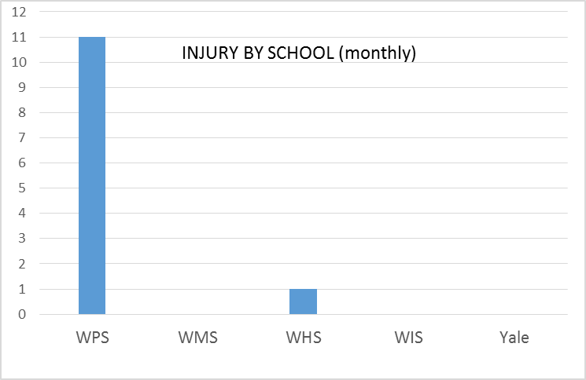
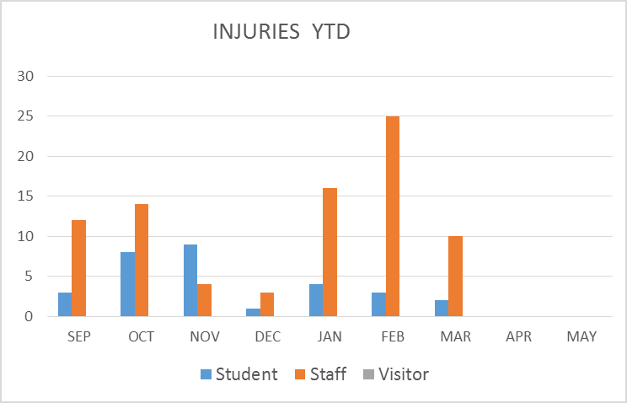
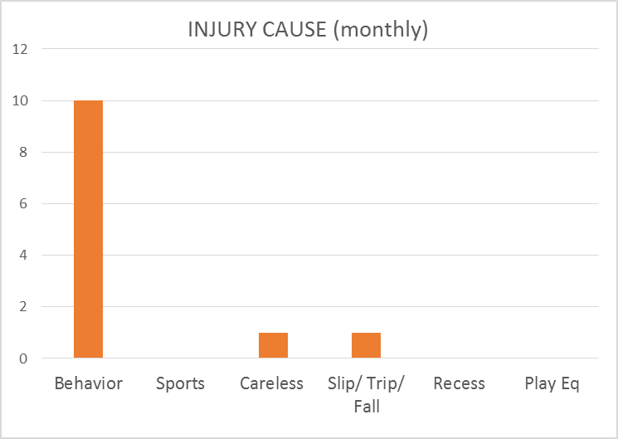
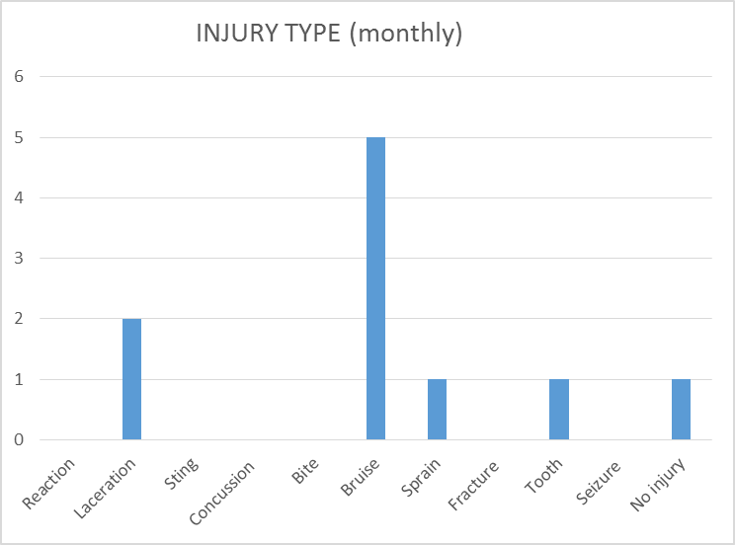
SAFETY CHARTS

