Slide 2
Welcome &
thanks for being a part of this!
Group Protocols:
You have all of lunch time to take pictures of anything you see.
The overall goal is to narrow down all the pictures you take to five pictures.
Of these five pictures, one should focus on what we do well, the other four should focus on what we can improve.
Tomorrow we will discuss why you took the photos and how we can make your experience better.

Slide 3
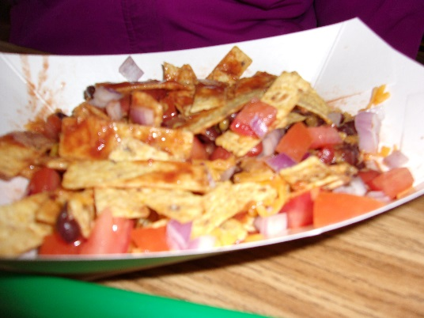
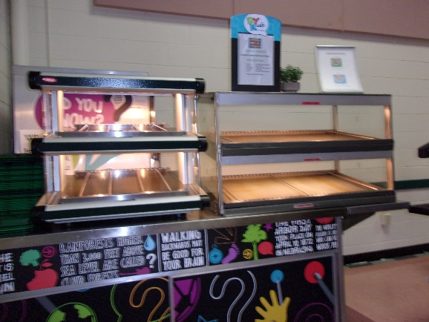
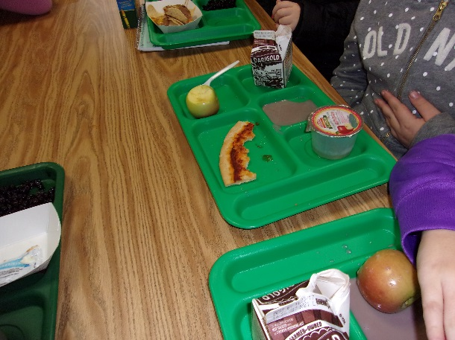
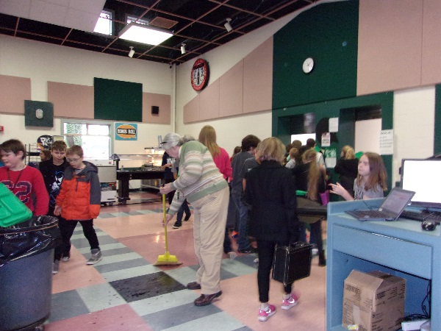
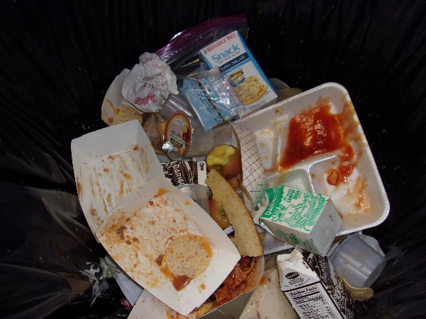
Team 3
Jersey and Harland
What we’ve done well
Opportunity for improvement
Opportunity for improvement
Opportunity for improvement
Opportunity for improvement

Slide 4
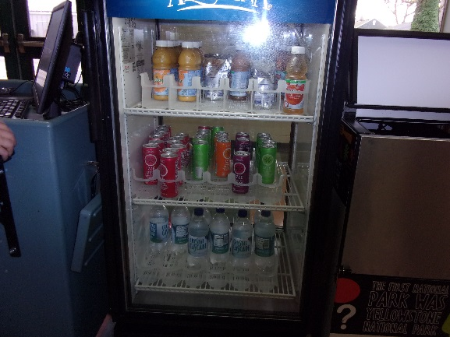
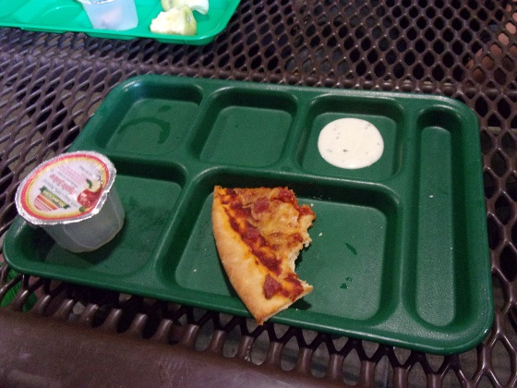
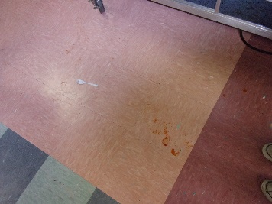
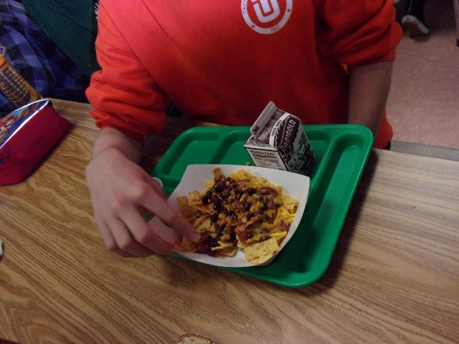
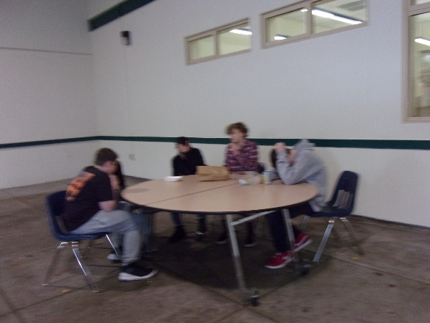
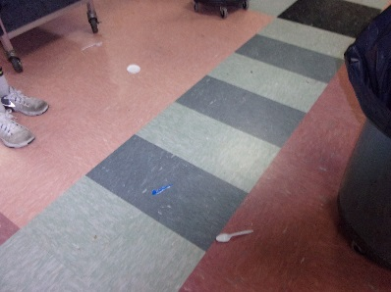
Team 1
Bella and Elli
What we’ve done well
Opportunity for improvement
Opportunity for improvement
Opportunity for improvement
Opportunity for improvement

Slide 5
Welcome &
thanks for being a part of this!
Group Protocols:
Open dialogue – what’s said in this room will not be attributed to individuals
Feel free to chime in even if it’s not your photo
25 photos in 45 minutes = need to focus on what’s important related to improving your experiences
Doesn’t end here ~ we’ll improve what we can!

Slide 6
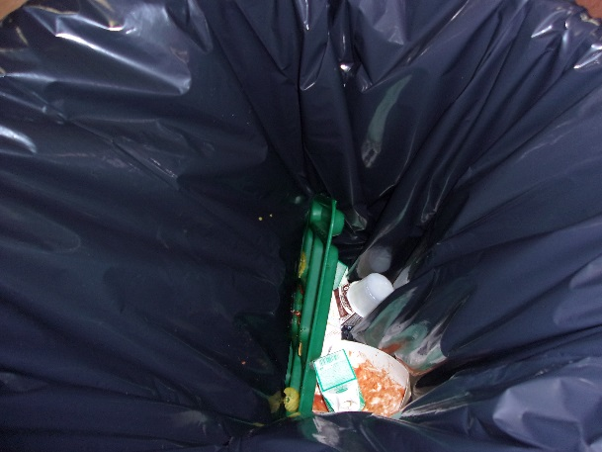
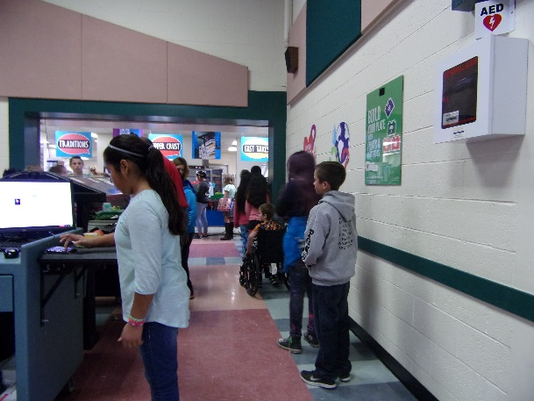
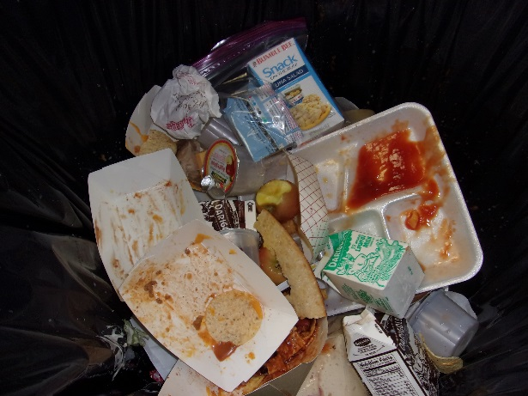
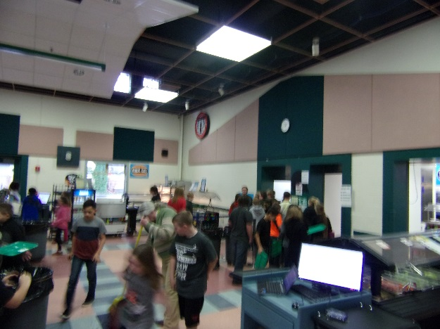
Key
Photos
5th and 6th
^{Food/Service Issues}
Tray in trash
Lines too long
Lots of waste
Running out of food
Tray Return Hectic
Notes:
GM Instruction – submit a copy of the completed Action Plan to Lindsay.Christensen@sodexo.com. We will be gathering this information to monitor national trends.

Slide 7
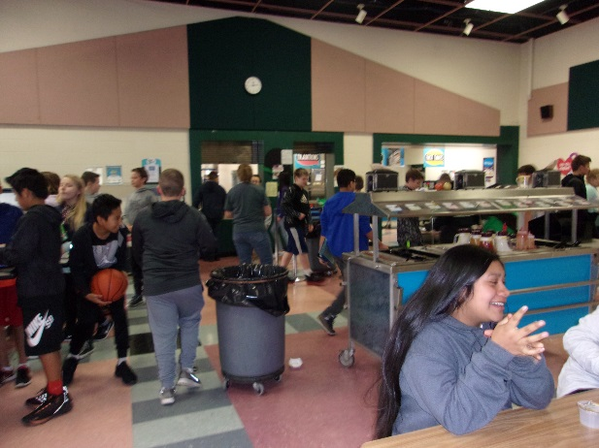
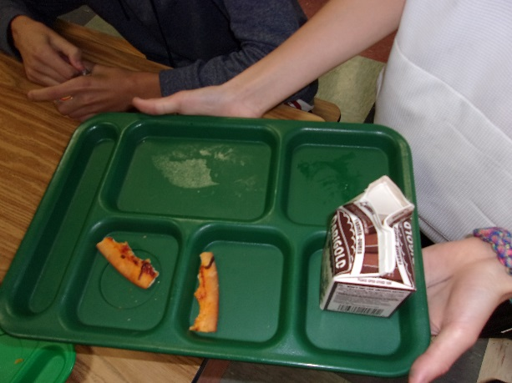
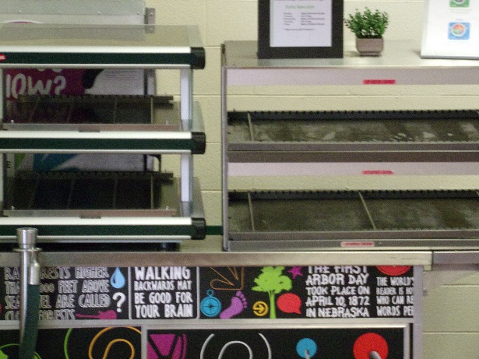
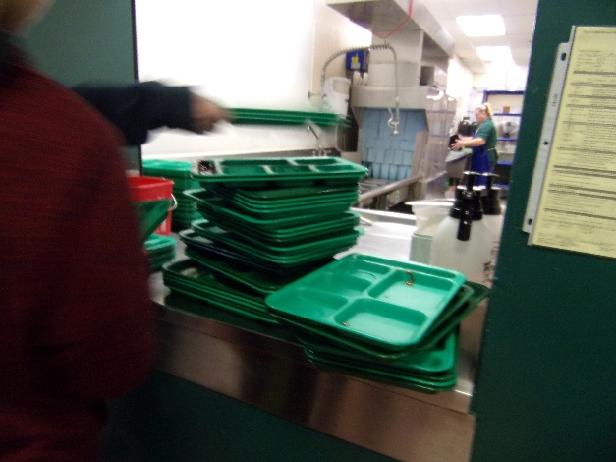
Key
Photos
7th and 8th
^{Food/Service Issues}
Pizza tastes like cardboard
Disorganized lines
More food per person
Running out of food
Tray Return Hectic
Notes:
GM Instruction – submit a copy of the completed Action Plan to Lindsay.Christensen@sodexo.com. We will be gathering this information to monitor national trends.

Slide 8
What we’ve done so far:
Running out of food
We have increased the number of pizza's being made. - We are doing a trial run adjusting start times, freeing up someone else to cook more food in-between lunches.
Vegetarian Options - We have added parfaits to the fast takes, they are very popular! -Adding vegetarian identifiers to the menu so students can plan ahead.
Seating
- Stacy has ordered 3 more tables to help create more seating for the students.

