Slide 1
Woodland Public Schools
Facilities and Safety Report
For April 2016

Slide 2
FACILITIES REPORT
Water Sampling
Water samples from all of the schools were delivered to BSK labs in Vancouver. The Samples were drawn at strategic locations throughout the schools based on the physical arrangement of the piping systems. Samples were drawn in accordance with the Washington State Department of Health guidelines outlined in a service bulletin issued in March 2016 titled “Testing for Lead in School Drinking Water Systems”. Sample results will take approximately 2 weeks to process. Upon completion of the test, I will issue a report on the findings.
Mezzanine Roof WMS
A Purchase Order was issued for the mezzanine roof at WMS. Roofing options ranged from $38K up to $147K. The roofing material selected was Thermoplastic polyolefin (TPO). This is a newer version of roofing material and far different from the standard built-up roofing systems. The advantage of TPO is primarily financial, as it comes in at less than half the cost of built-up roofing product. It also has no adverse environmental installation effects (no hot tar), and offers greater cooling in the summer. This project should be done over the next few weeks. With the poor condition of the decking, we will need a reasonable period of dry weather to remove the rotted material. Once the decking is removed, it places the building in a somewhat vulnerable condition. If it rains with the decking off, insulation and finished interior ceilings would be subject to damage; so, a careful watch of the weather is a must.
Walk –Thru’s Summer Work
Summer work schedules are shifting into high gear as we approach the midway through May. I’ve completed a walk-thru of each campus with the administrative staff, to help identify areas of concern. We are in the process of issuing PO’s for materials and contractors needed to complete projects out of the Districts capabilities.

Slide 3
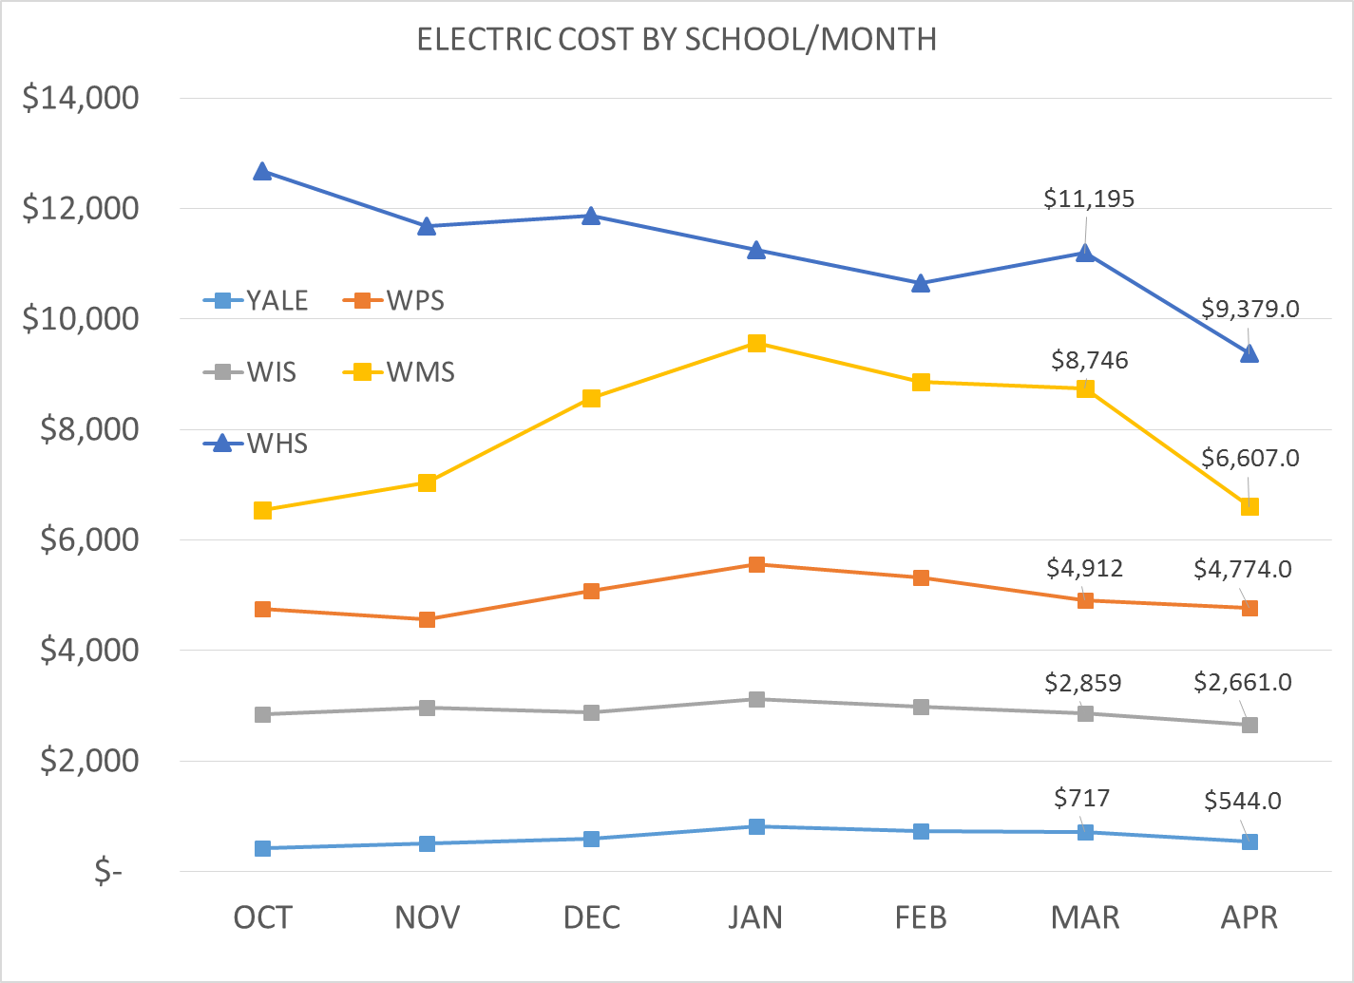
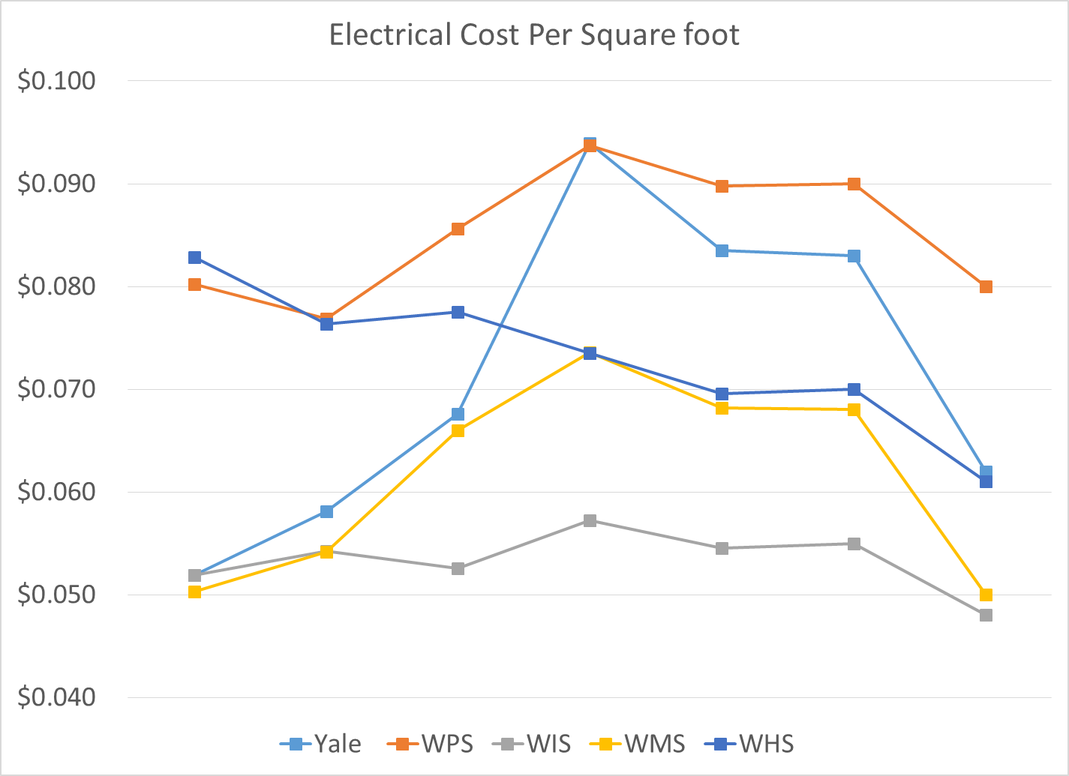
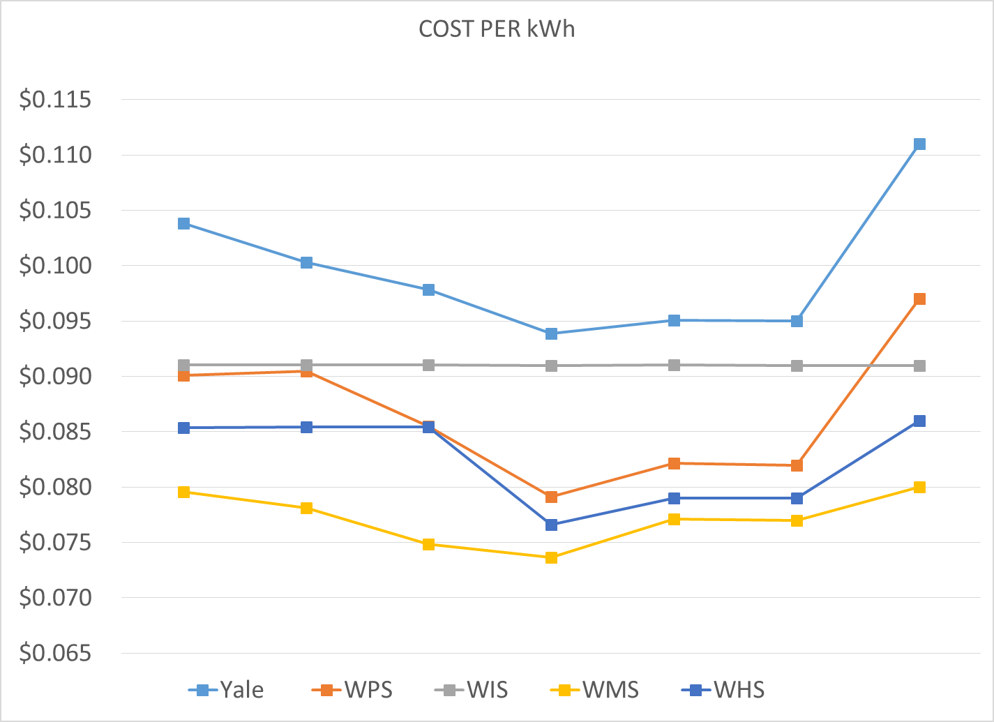
Electric Cost
Changes were made to the High School and Middle School campuses this month, resulting in a reasonable cost savings at both campuses. Changes were made to the programming at the High School, and unnecessary electrical loads were shed at the Middle School. The charts shown in this report are consolidated. In the raw data, we are tracking each meter. Where we see upsets or unusual consumption on a specific meter, it provides us an opportunity to challenge the cost.

Slide 4
SAFETY
Accidents for the month
There were a total of 7 injuries in the month of March.
They included 3 students and 4 faculty members
Staff Accidents/Incidents (4)
WMS-Teacher hit in back of head with basketball, sore neck and shoulder.
WIS-Employee was standing in door swing, student opened door, sore back and shoulder.
WPS-Upset student bit teacher, bruised arm.
WPS-Employee had asthmatic reaction to drain cleaning chemical.
Student Accidents (3)
WIS – Student hit head on climbing wall, bruise.
WMS – Head injury, safety cone kicked into head of another student, bruise.
WMS – Upset student kick bleacher, sprained ankle and chipped bone.
All safety-related incidents are examined and investigated. District level communications are made when necessary, to address cross-campus closure of safety related items.
A District-wide communication on slip/trip/fall and carelessness accidents was distributed in May, to heighten the awareness to these accidents/incidents.

Slide 5
