Slide 1
A place where learning and community connect
Notes:
Introduction and welcome

Slide 2
Our Mission
To empower every child to become a self directed, life-long learner through a positive partnership of family, school, and community.
Notes:
Give history to our program beginnings

Slide 3
Yale Demographics
Grade Level | Number of Students (15-16)
K | 7
1 | 8
2 | 5
3 | 8
4 | 11
5 | 2
ELL Student Population | 2
Free and Reduced Lunch Population | 48.8%
Notes:
Discuss our special services

Slide 4
How we learn and achieve
Multi age classrooms
Three lessons in one
Yale Schedule
Performance on state tests
Notes:
Talk about the varied level of flexibility, support, structure, and pace.

Slide 5
Teamwork
Monday Meetings
Instructional Assistants
Additional Responsibilities
Student supports from all corners of the district
Notes:
Checking on kids at the bus stop
Purchasing
Discipline
Working with PTO to organize special events
Transportation issues
Schedules
Sub plans for IAs

Slide 6
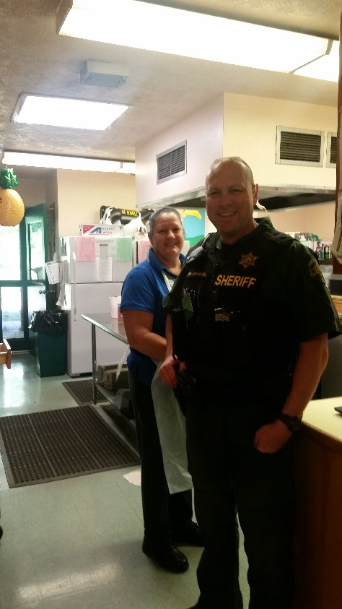
School Safety
Collaboration with local Fire Department
Collaboration with the Cowlitz County Sheriff’s Department

Slide 7
Partnerships with our community
Yale Valley Regional Library District
Columbia School Gardens
Yale PTO
Cowlitz County Sheriff’s Department
Local Fire Department

