Slide 1

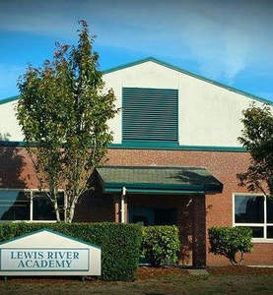
Notes:
Introduction and welcome

Slide 2

Our Mission
Lewis River Academy recognizes and supports family choice education where parents are the first and most important educators for their children. Through Lewis River Academy, families can enjoy the benefits of being highly involved in their child's learning while accessing the resources made available to all public school students in Washington State.
Notes:
Give history to our program beginnings

Slide 3
Range of Learning Environments
Traditional Setting
WPS
Alternative Setting
Alternative Learning Setting
Home Setting
Home School
WIS
WMS
WHS
TEAM
Home Study
LEWIS RIVER ACADEMY
Notes:
Talk about the varied level of flexibility, support, structure, and pace.

Slide 4
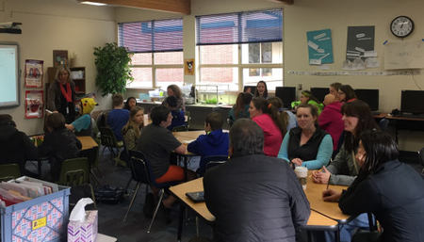
Why Lewis River Academy?
Tuition free quality curriculum
Flexible schedules and pacing for students
Opportunity for high degree of parent involvement
Low anxiety learning experience
We do the messy science
Learning activities and meetings with other local home-study families and students
Local support from a certificated teacher
Co-enrollment options are available on any of our campuses

Slide 5
Current Demographics
Who we serve
K-12 Students
Currently we have 54 students enrolled in our program
We are qualified as a multi-district provider so we enroll students with a 40 minute drive from campus
37% of our students qualify for free or reduced lunch program
We serve a number of students with unique medical conditions
We serve families who travel quite a bit
We serve typical home school families
We also serve students for a year or less due to various situations

Slide 6


K-8
High School
Mastery Based Curriculum
Notes:
Discuss

Slide 7
Monitoring Student Success
Written Student Learning Plans
  All students must have a written student learning plan, also known as a WSLP.
Monthly Satisfactory Progress
  The teacher will email the Monthly Progress Review to parents to review with students.
Weekly Student Contact
  Each student enrolled in an alternative learning experience must have Direct Personal Contact with a certificated teacher at least once every school week
Notes:
Copies of each document will be passed out

Slide 8
Looking Ahead
9-12 Program location change
Co-enrollment will continue
Increased access to highly qualified certificated teachers
9-12 students are still welcome on WHS campus

