Slide 1
KWRL
Transportation Cooperative
Overview Presentation
October 2023

Slide 2
What is a Transportation Cooperative?

Slide 3
KWRL Transportation Cooperative
Is an interagency agreement between the Kalama, Woodland, Ridgefield and LaCenter Schools created in 1979.

Slide 4
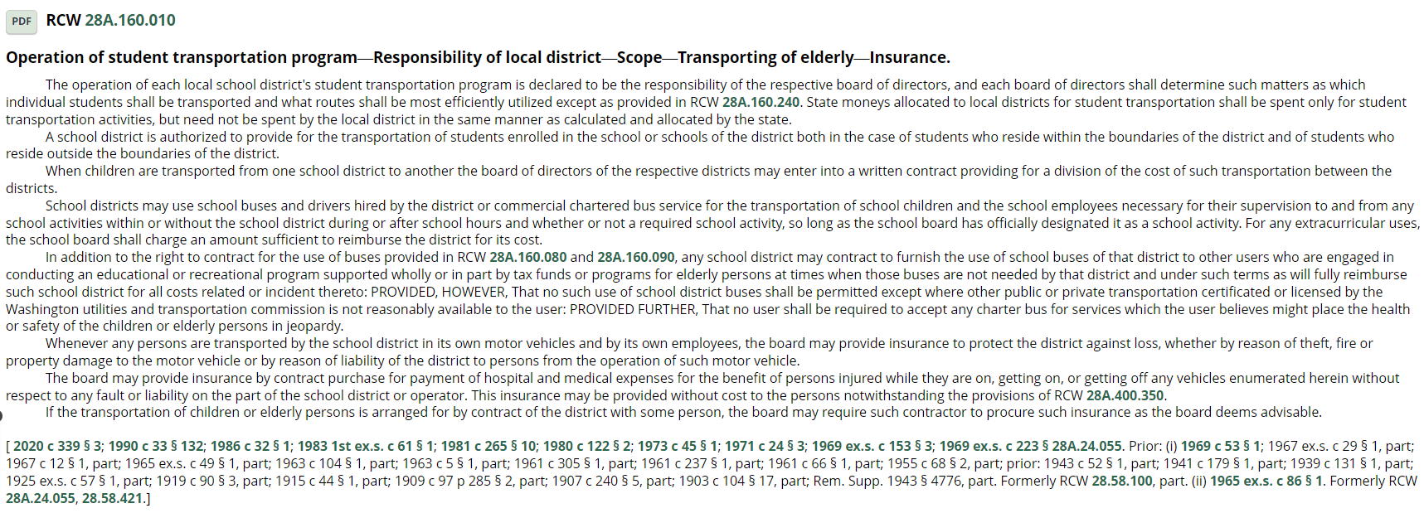
RCW 28A.160.010 / Operation of a student transportation program

Slide 5
392-346-015 Interdistrict transportation cooperative members

Slide 6
Why would a school district create or join a cooperative?

Slide 7
“Efficiency”
Shared Administrative expenses
Shared Maintenance (facility, equipment, labor)
Collaborative access to larger fleet
Collaborative access to larger staffing pool
Reduced capital outlay(two instead of four)
Collaborative emergency response ability
Collaborative general operations

Slide 8
“Funding?”
How are cooperatives funded in Washington?

Slide 9
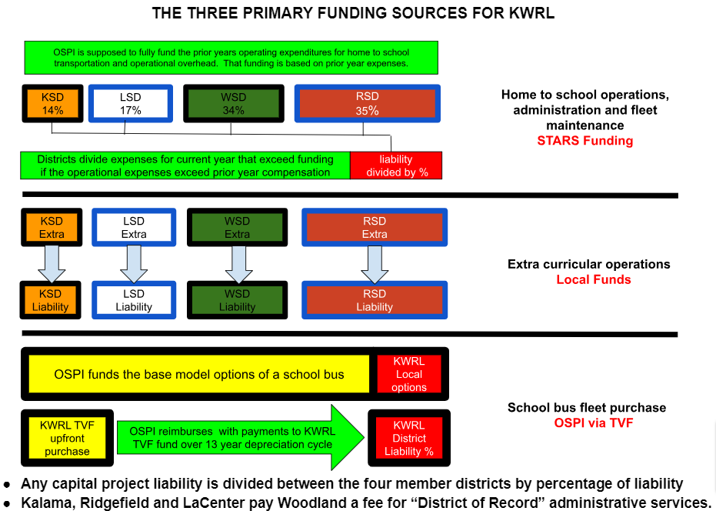

Slide 10
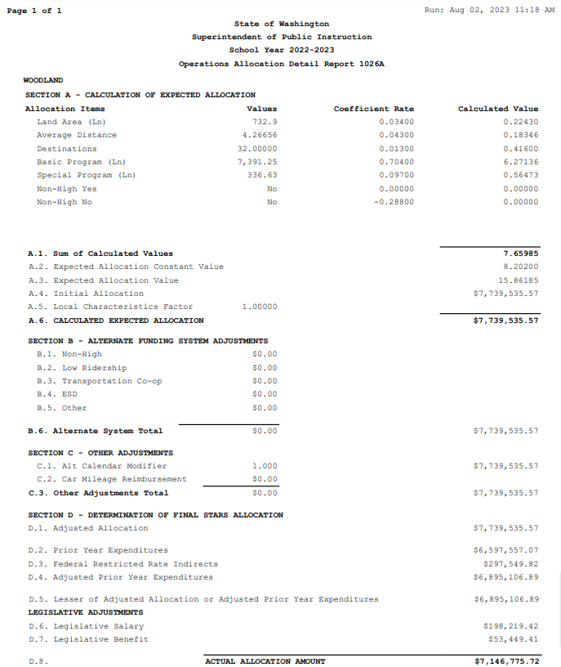
OSPI
Operation Allocation Detail Report
“The 1026A”

Slide 11
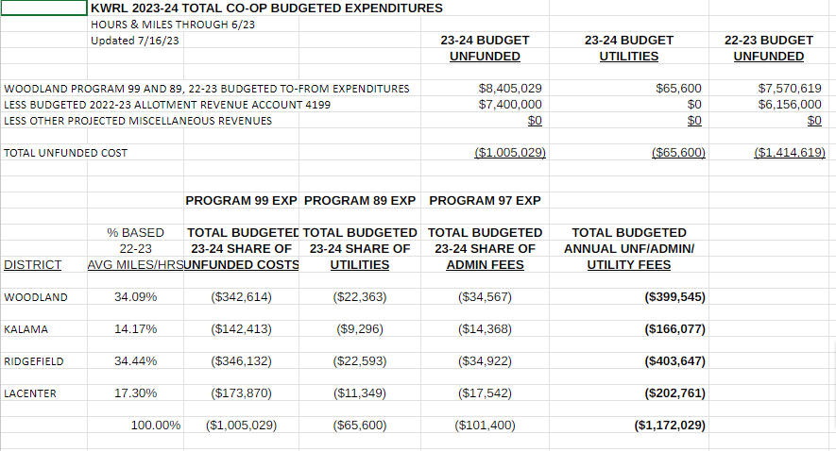

Slide 12
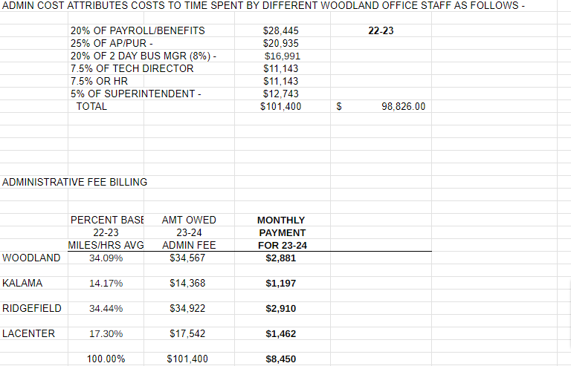

Slide 13
Transportation Vehicle Fund
“The TVF Fund”
Also known as the
depreciation program.
Current balance is $3,854,000

Slide 15
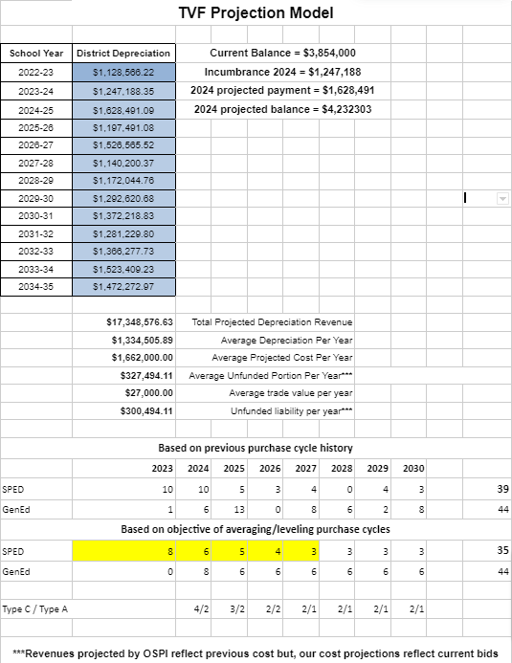
13 Year Projection Model
Four Primary Objectives
Projects anticipated revenue cycle
Anticipates market prices
Monitor manufacturing markets
Prepares district liability for liability

Slide 16
“KWRL OPERATIONS”
What are some of KWRL’s current operational goals or achievements?

Slide 17
“KWRL OPERATIONS”
Customer Service
Constantly seek out ways to improve customer service across all four districts through:
Accurate, timely and proactive communications
Consistent and accountable student management
Assess and evaluate operational consistency

Slide 18
“KWRL OPERATIONS”
How do you train to succeed, and how do we measure achievement?

Slide 19
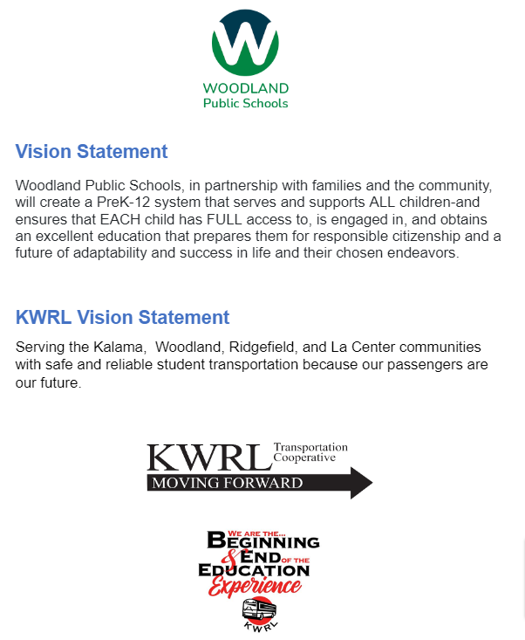
General Points
“Training”
Present the vision which is the “what and why”

Slide 20
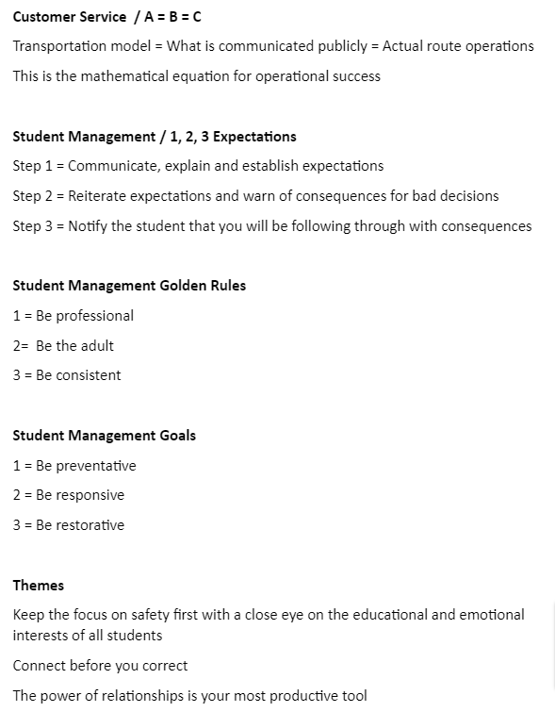
Finer Points
“Training”
Keep the “how and when” short, sweet, simple and easy to communicate and remember

Slide 21
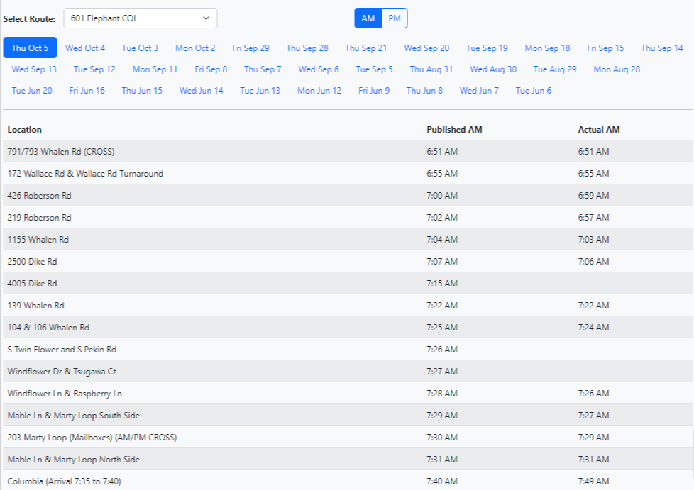
Use effective tools for accountability
A= The route model we develop
B= What we communicate to customers
C= The service we actually provide
If you have an A=B=C formula for success then make sure you have tools to show and score your work!

Slide 22
Effectively develop, train and utilize consistent student management systems
“KWRL Student Managment”
I have developed a student management system that improves and supports healthy student management
Changed KWRL systems from being responsive only, to a program that is preventative, responsive and restorative.
Bridges gaps between drivers, buildings and districts to reconstitute the philosophy that the bus is an extension of the classroom.
Coordinates PBIS models to either change behavior or remove behavior in the interests of healthy climate and culture on KWRL school buses
Transparent HIB tracking and documentation

Slide 23
Develop and utilize technology that improves efficient operations
“The KWRL Portal”
Far and away the sharpest tool in the shed! The portal has been the most effective tool KWRL has to improve:
Timely communications
Payroll**
Coordination of extracurricular trips**
Routing**
STARS Reporting
SPED enrollment/registration
Maintenance**
Regulatory compliance
HIB tracking and coordination
Oversight and accountability
**(reduced staffing or elimination of contracted services)

Slide 24
The four KWRL member districts consistently provide KWRL with the support and tools needed for the job, and for success!
The four districts provide to KWRL
The best buses for the job
Staffing needed 5am to 5pm
Resources (example: Behavior Specialist)
Preventative collaboration
Reactive investigations
Restorative plans and coaching
Technology needed for success
To assess operations efficiency
To evaluate performance
To measure progress
To communicate accurately/timely
Consistent trust and support

