Slide 1
Woodland School District 2022-23 BUDGET Summary
Presented by:
Stacy Brown
Executive Director of Business Services
August 11, 2022

Slide 2
Enrollment History – Budget to Actual
Actual enrollment for 21-22 was 35.42 students less than budget. The estimated enrollment for 22-23 is 9 students less than the 21-22 budget and only 26 students more than the 21-22 actual average FTE.

Slide 3
22-23 Budget Historical Fund Balance/FB as a % of Expenditures Summary
This slide shows a history of actual ending fund balance and historical FB as percentage of expenditures. We often budget a decrease in FB, but if you look at the historical year-end FB, you see that we have increased FB in each of the past 2 years.. 21-22 is projected to have another increase in Fund Balance (between $300,000 and $500,000), with a % of approximately 11.0% The projected increase in fund balance allows us to budget a much higher deficit than in past years ($620,000), while still maintaining a fund balance that is approximately 9.0% of the budgeted 22-23 expenditures.

Slide 4
22-23 Budget General Fund – Revenues By Source
For the 22-23 revenue sources, the “Local Sources” have increased, with the return of Local Food Service Revenue).
Federal funds have increased considerably, due to the ESSER funds.

Slide 5
22-23 Budget General Fund– History of Revenues By Source
This graph shows the changes we have seen in major revenues sources over the last several years. This shows the severe drop in local revenues from 2018 to 2020 and local taxes up in 2021, as a result of increased EP&O levy. For 22-23, although projected enrollment is down, State funding is up due to Apportionment cost of living increases and Transportation back to pre-pandemic levels. As in the previous slide, Federal Funds are much higher than in previous years.

Slide 6
22-23 Budget 20-21 Actual, 221-22 Budget and 22-23 Budget Comparison – Revenues
Slide shows year to year budget comparison of revenues. Increases in local taxes due to increase of 2022 levy. Large local Non-Tax increase of due to food service revenues returning after 2 years of free meals for all students. State General Purpose increase due to 5.5% IPD and 6% SEBB (health benefit premiums) increase. State Special Purpose due to LAP increases and Transportation increase from previous budget. Federal Special Purpose increase due to Covid ESSER funds. The large increase from other school districts is because of the expected increase in Transportation costs (IPD, SEBB, fuel, parts), but the increase in funding is not enough to cover the large increases in expenditures..

Slide 7
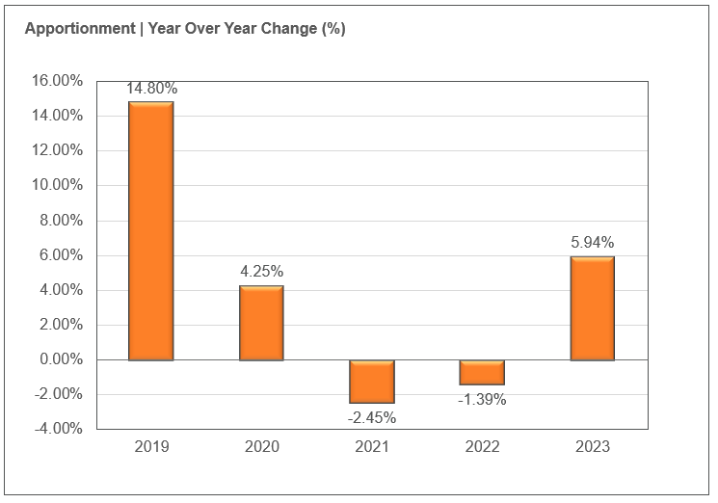
22-23 Budget General Fund – Apportionment History
This graph shows the history of apportionment. The increase for 22-23 is not due to increased enrollment, but due to cost of living (IPD) increases of 5.5% to the funded salaries and a 6% increase to the funded health benefits.

Slide 8
22-23 Budget – Detailed Revenue Comparison

Slide 9
22-23 Budget General Fund Expenditures
Salaries and benefits account for 84% of total expenditures. This is up from 81% last year, due to large IPD increases, SBB increases and increases in certificated and classified staffing.

Slide 10
22-23 Budget 20-21 Actual, 21-221 Budget and 22-23 Budget Comparison – By Object
Slide shows increases from budget year to budget year. Increases in Salaries include negotiated increases, larger than usual cost of living adjustments and certificated and classified staffing increases. The Benefit increase is larger than normal, as the SEBB monthly fee increased by 6% and we added a number of staff, which increased the benefits. Double digit increase in supplies due mainly to the increase to fuel prices (Budget increased from $700,000 to $1.2M). Purchased Services decreased as we are sending less special educations students out of district (decrease of $400,000) compared to last year. Travel budgets are back up to pre-pandemic levels.

Slide 11
22-23 Budget 20-21 Actual, 21-22 Budget and 22-23 Budget Comparison – By Program
Almost all programs are increased due to increased salaries and benefits districtwide. The ESSER funds are the reason for the large increase in Federal Special Purpose funding. These funds continue to fund COVID testing and tracking, technology staff to maintain the increased number of devices, additional mental health services, curriculum and technology supplies and additional academic supports, professional development for staff , support for the Dual Language Program and a position hired specifically to support our Unaccompanied Youth. These funds will also be used for additional Special Education staff in the most severe classrooms at WMS and WHS (Diverse Support Program also referred to as DSP), the Deans that have been added all of the brick and mortal schools (except Yale),and additional professional development for staff. In addition to the COLA increases, Special Education increases due to increased classified staffing

Slide 12
22-23 Budget – Expenditures by Activity

Slide 13
Uses of Levy/Enrichment Funds
Expenditure Type | Enrichment Funds 2022-2023
Certificated Salaries | $ 518,000
Classified Salaries | $1,422,000
Administrator Salaries | $ 454,000
Benefits | $1,125,000
MSOCS (Maerials/Supplies/Operating Costs) | $ 250,000
Extracurricular | $ 703,000
Special Education | $ 970,000
WCC | $ 74,000
Family Resource Coordinator | $ 15,000
To/From Transportation | $ 470,000
KWRL Bus Purchase/Capital Allocation | $ 118,000

Slide 14
22-23 Budget Transportation & Food Service
Transportation Revenues/Expend
Food Service Revenues/Expend
Revenues only include the state-funded revenues. We also receive payments from the other districts. Woodland’s portion of KWRL for 22-23 is $500,102 plus $118,265 for bus purchases
22-23 Food Service cost is approximately $36,000 in comparison with the previous year budgeted cost of $129,000. It was time to rebid and our current vendor decreased our per meal cost by $.10 and we are getting approx. $35,000 in Supply Chain Assistance funds.

Slide 15
22-23 Budget Before and After School Care
For many years, the WCC programs have provided opportunities for parents and students in a small community without many daycare options for families.
The programs served about 120 families throughout the year at Columbia and North Fork. They also provide summer care at Columbia.
The WCC program is licensed by the state and able to provide options for low-income families.
Daycare programs are budgeted to run at a loss of $74,000 for 22-23 (in comparison with $104,000 in 21-22). Opening NFES added one additional staff and the full benefits for that staff member. Missy has applied for a received a number of grants from DSHS and the Cowlitz Tribe and if any grants are awarded this number will decrease.

Slide 16
22-23 Budget Staff Changes
Admin Staff decreased as the K-4 shared Asst Principal was not effective.
Certificated Staffing changes include increases in school Deans (4), Sped PK, RR and DSP (4), ELL (2), CES Classroom (1), TEAM High, CTE (Early Childhood and Careers in Ed .8) and Transitional KG (1). We did have a decrease in the LRA staff as one of the teachers is taking a leave and we did not replace the position.
Classified 21-22 budget vs actual shows approximately 20 FTE budgeted, but not filled. This was almost all in Special Education paras and bus drivers. The positions are included in the budget for 22-23, including additional positions (2 for the new NFES PK, for example). There is also an additional maintenance position and a Tech position (added in 21-22, but not in the budget) in the 22-23 budget.

Slide 17
Other Funds
Capital Projects
Debt Service
ASB
Transportation vehicle

Slide 18
CAPITAL PROJECTS FUND
Beginning Fund Balance $ 700,000
Revenues/Other Financing Source $ 672,000
Expenditures/Financial Uses $1,100,000
Ending Fund Balance $ 272,000

Slide 19
DEBT SERVICE FUND
Beginning Fund Balance $ 1,623,000
Revenues/Other Financial Source $ 3,588,276
Expenditures/Other Financial Uses $ 3,663,000
Ending Fund Balance $ 1,548,276
Debt Outstanding 9/1/22 = $47,160,000

Slide 20
ASB FUND
ASB funds are for the extracurricular benefit of the students. Their involvement in the decision-making process is an integral part of associated student body government.
Beginning Fund Balance $ 280,000
Revenues $ 384,250
Expenditures $ 390,000
Ending Fund Balance $ 274,250

Slide 21
TRANSPORTATION VEHICLE FUND
This fund is used to replace buses for the KWRL Cooperative districts. Revenue comes from the State (in the form of depreciation payments), interest earned on the investments and the annual payments made by the four member districts (Kalama, Woodland, Ridgefield and La Center) to cover options and buses necessary for growth..
Beginning Fund Balance $ 3,680,000
Revenues $ 1,305,000
Expenditures $ 2,000,000
Ending Fund Balance $ 2,985,000

