Slide 1
Woodland High School
Our Mission Statement: “It is our job to ensure all students learn, graduate and are challenged.”

Slide 2
A little about who we are
As of March 2, 2016
Total Student Population: (688 head-count)...(603 FTE)...up 50 FTE from a year ago
Free/Reduced (36.1%)
ELL Population: (1.5%)
Homeless Students: Currently 16 (2%) identified @ HS (3 being transported)
Special Education: Approximately (12%)

Slide 3
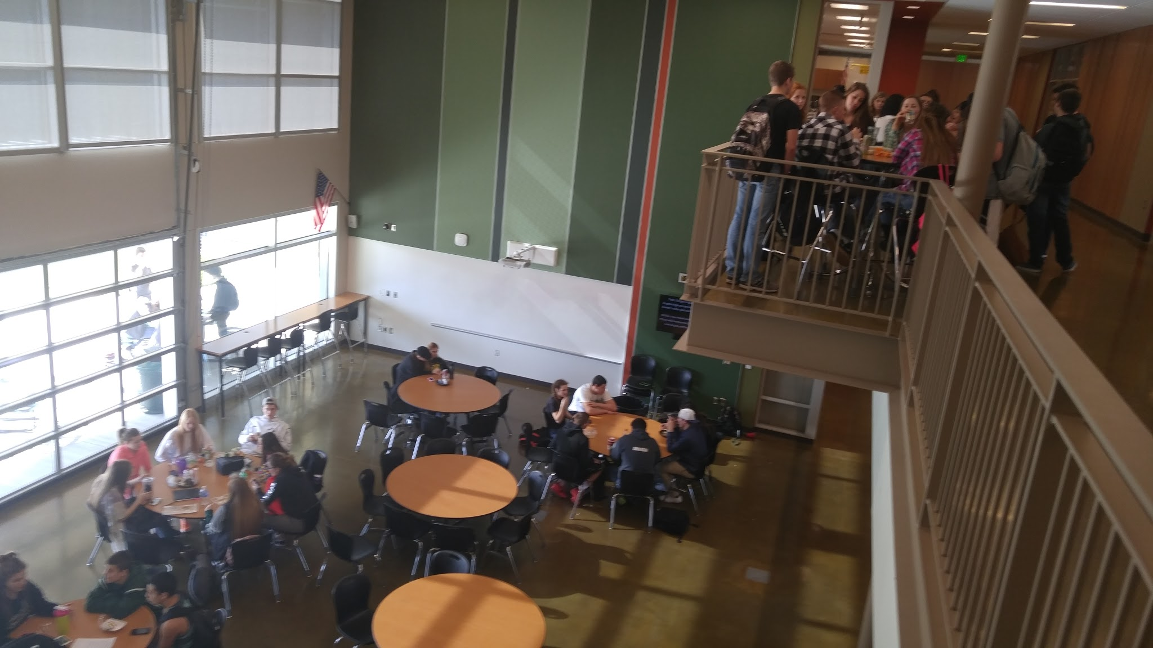
The Expectations…
1.Learn
2.Graduate
3.Challenge

Slide 4
Learn:
*We are working on standards-based grading and learning.
*Multiple attempts at assessments, clear expectations (learning targets).
*Learning from mistakes is part of our culture.
*Strong emphasis on using technology as a tool to enhance our learning.

Slide 5
Learning and Career Readiness
*High School and Beyond Plan
*New Career Center
*Culminating Project overview
*CTE offerings

Slide 6
Common Core and Learning
*English and Science Departments currently working with Asha on Washington’s new learning standards.
*Math Department working with Heidi on the new standards.
*Other departments use/rely on state standards for guidance.
(We use approximately ½ of our Monday’s for this work)

Slide 7
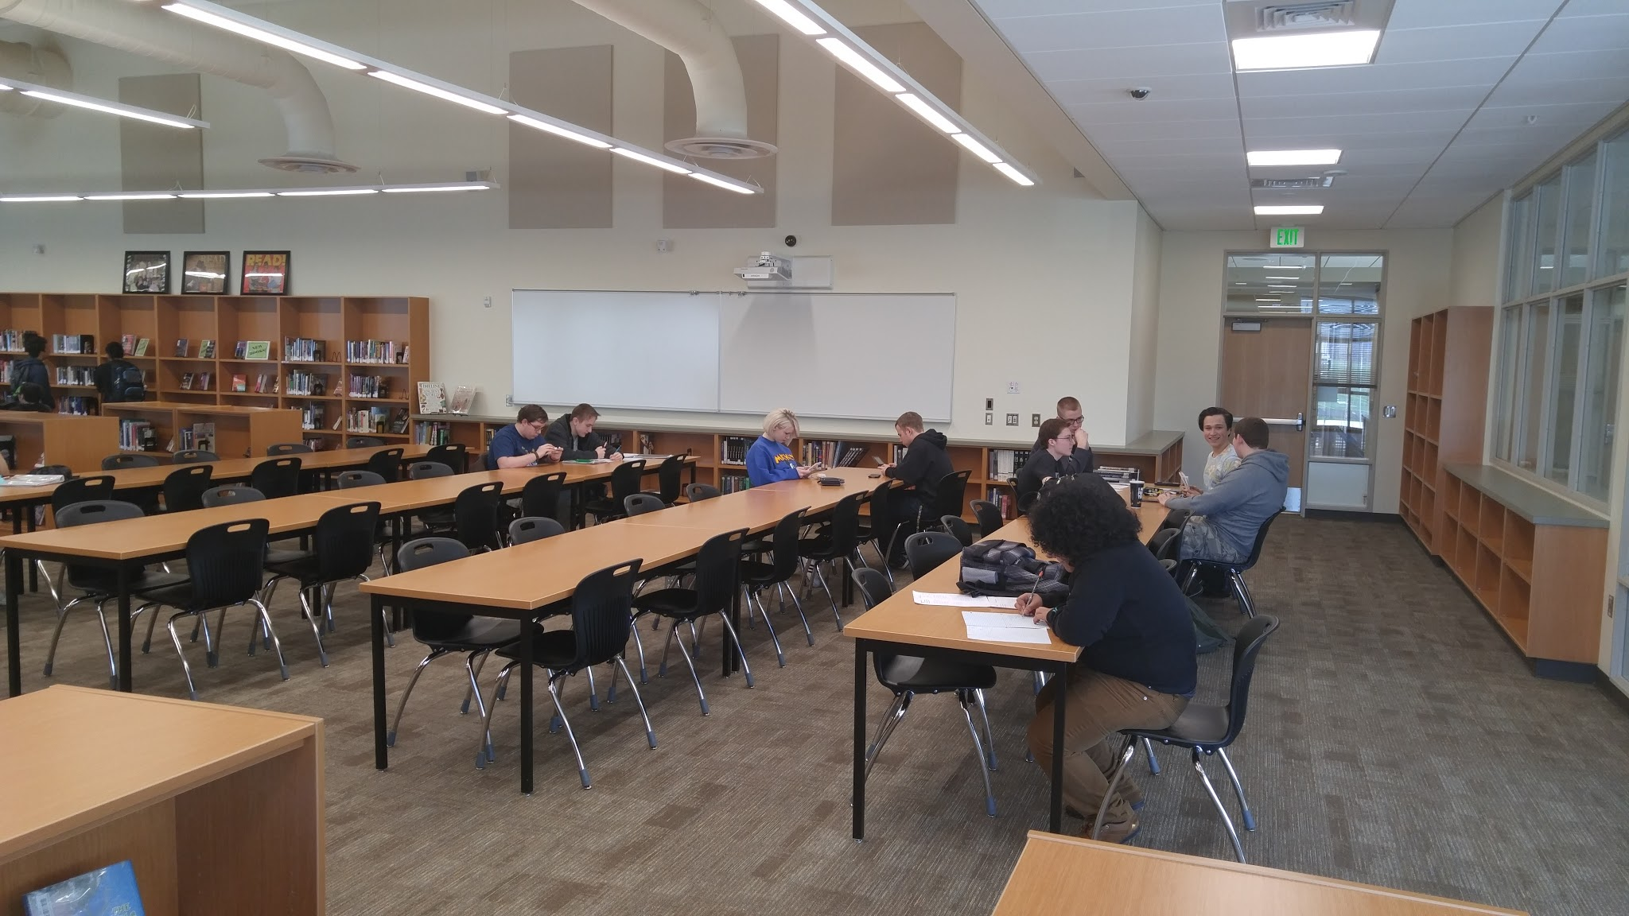

Slide 8
2. Graduate:
*22 or 24 Credits required (specific to certain content areas)
*Culminating Project and High School and Beyond Plan.
*Graduation rate @ 90% via OSPI info for class of 2014.
*Time vs learning ...Some take more time!

Slide 9
State Testing Requirements
Math: Pass a test (Smarter Balance or End of Course)
Science: Current Juniors and younger need to pass End of Course (maybe).
English: Pass a test (Smarter Balance or High School Writing and Reading)

Slide 10
Need More time to Graduate?
Incompletes
Credit Recovery through APEX (during the year and summer school)
Re-Take a final (math only right now)
New plan being developed as we speak with English, Math and Science. (Plans to expand too)
Notes:
Mention PE waiver for athletics here and later in the meeting you will be reviewing an administrative procedure on this topic

Slide 11
3. Challenge:
*College in the HS (76 possible college qtr. credits)
*10 Adv. Placement offerings, 5 Honors level offerings)...used to only have 1 AP course in 2000.
*Trying to find ways to individually “challenge” kids in every class on a regular basis.
*Admin in classrooms four (4) full days per week.

Slide 12
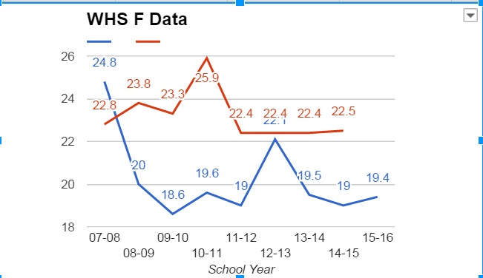
A Little Data
Only 2 seniors taking Reading/Writing state exam tomorrow!
15 seniors in math…
Our “F” Trend Data (Blue is 1st semester, Red is 2nd semester)
Notes:
Mention hard to give our longitudinal data on state assessments because of the changing of tests/expectations….in particular the meaningless 11th grade data. 2012-13 School year was when the math department went to the no “D” policy.

Slide 13
New Building...Same old drills, but some new procedures
We do at least 1 drill a month (fire, earthquake, lock down, shelter in place).
Radios a bit of a bug a boo right now.
Doors lock...except main entrance at start of school
Closed Campus
105 Cameras
24 hour custodial support (5 days a week)

Slide 14
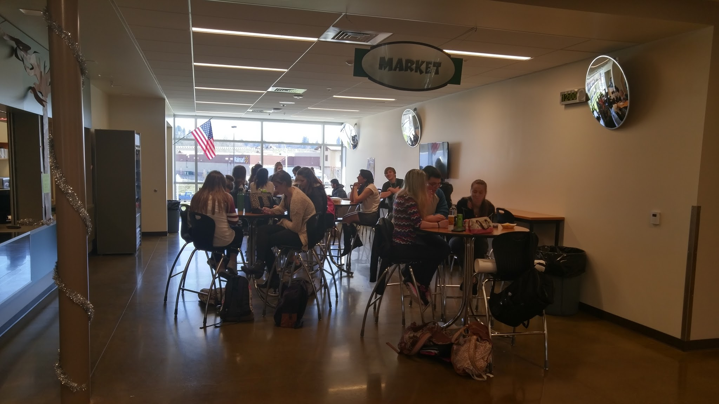

Slide 15
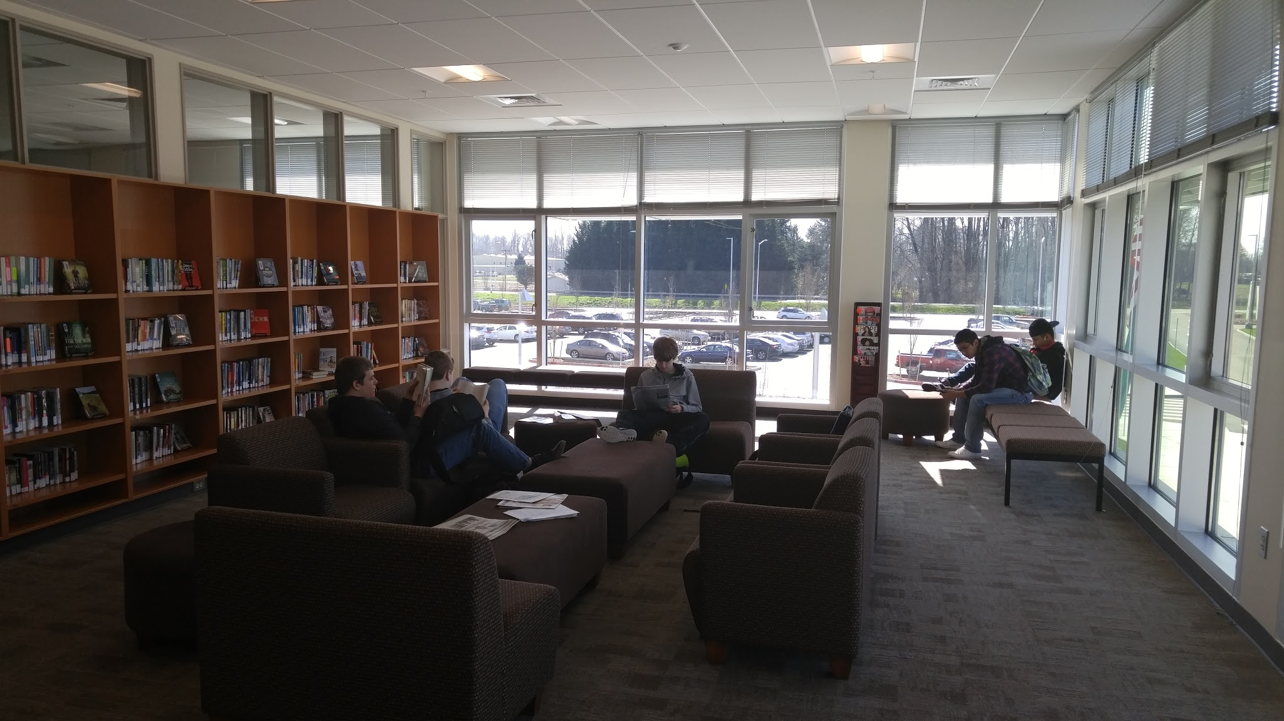

Slide 16
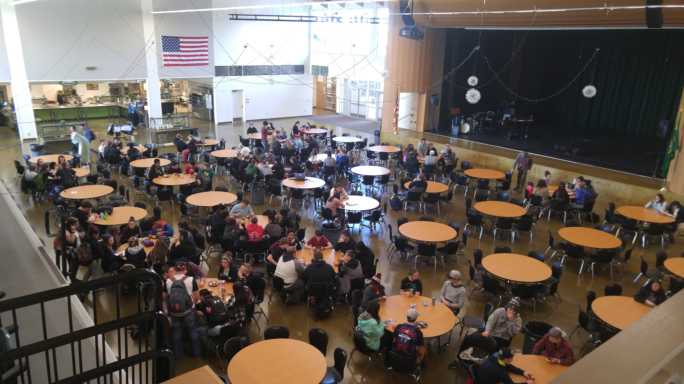

Slide 17
School activities
Knowledge Bowl
Interact
Leadership
Dance Team
Art Club
Skills USA
FFA
FBLA
Equestrian
Honor Society
Be the Change Club
12. Athletic teams
13. Trap
13. Jazz Choir
14. Jazz Band
15. Theatre
16. HOSA
17. Cheerleading (competition)
18. Adding shop competition group next year.
Notes:
Research shows being involved in 2 or more activities increase GPA by atleast 0.4 We want a diversity of opportunities for kids.

Slide 18
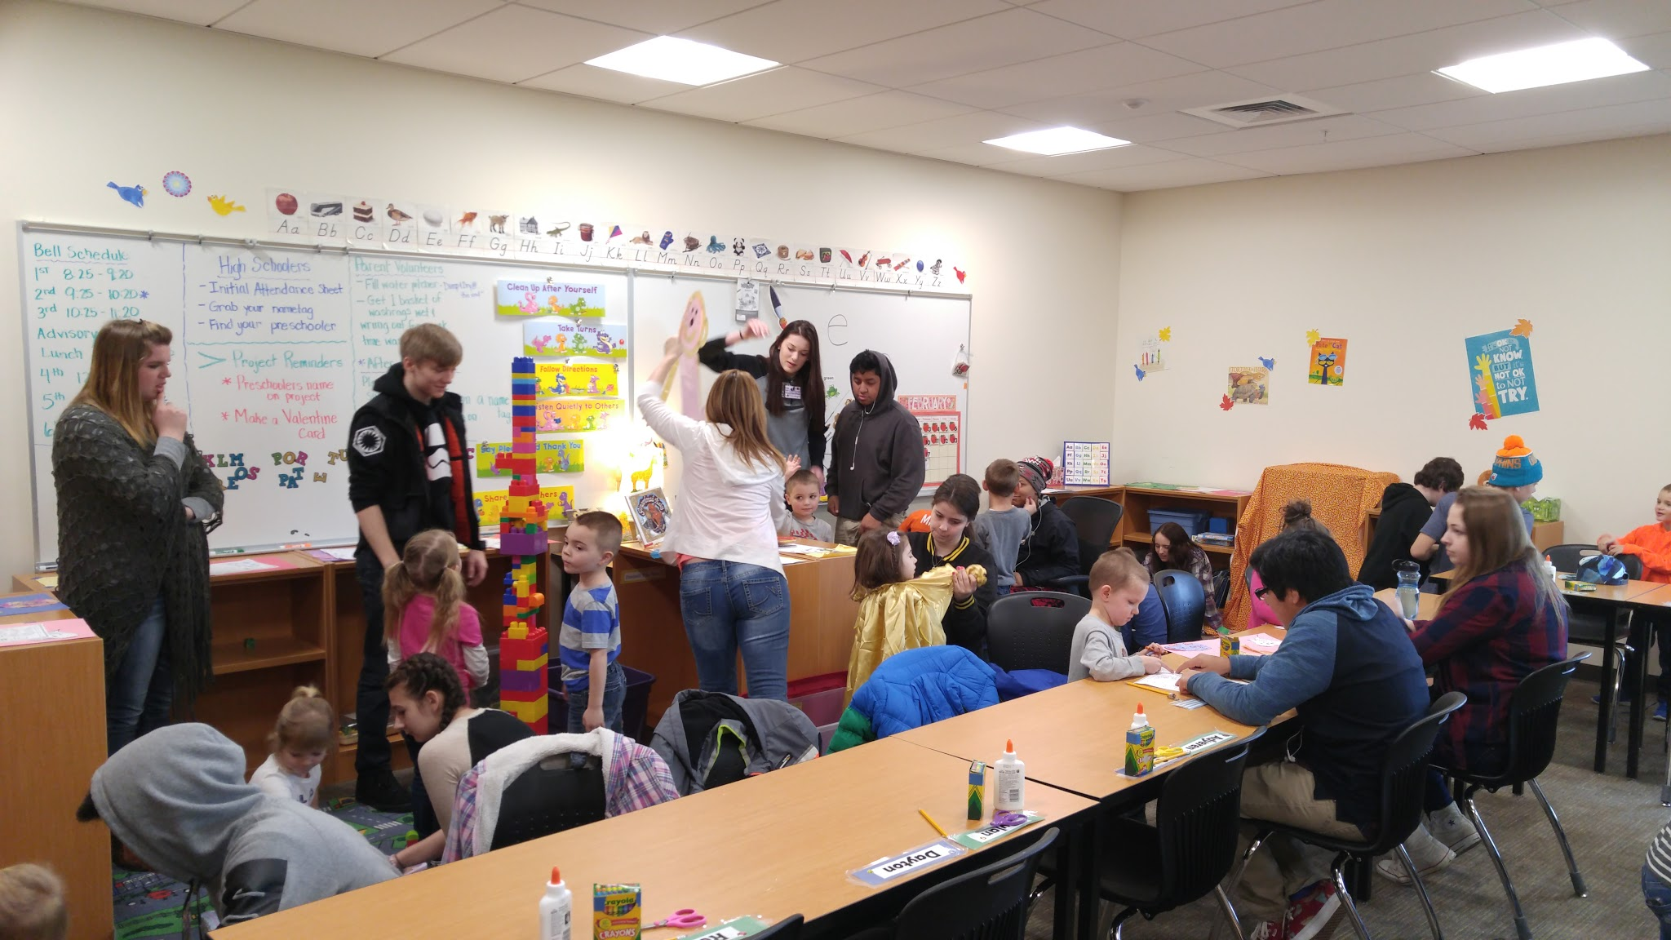
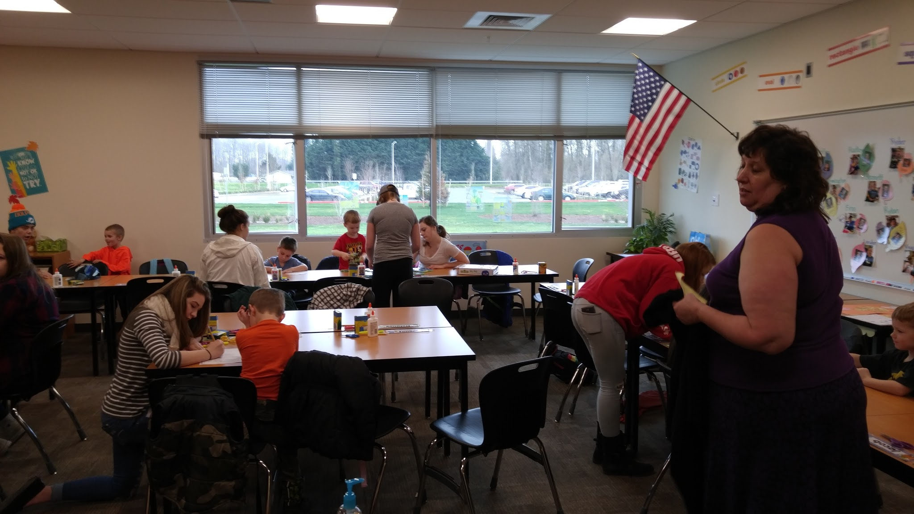
CTE: Preparing kids for “real life.”
-Culinary Arts, Early Childhood
-Floral
-Shop
-Business Education

Slide 19
Question and Answer Time

